Slide 1
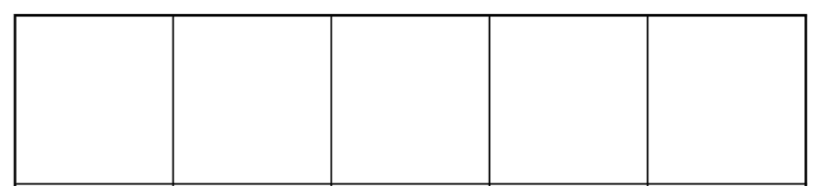

Slide 7
Let’s count

Slide 8
one

Slide 9
two

Slide 10
three

Slide 11
four

Slide 12
five

Slide 13

Let’s put the in the five frame

Slide 14
one

Slide 15
two

Slide 16
three

Slide 17
four

Slide 18
five

Slide 19
Let’s count

Slide 21
one

Slide 22
four

Slide 23
two

Slide 25
five

Slide 26
one

Slide 28
three

Slide 29
two

Slide 30
five

Slide 31
four

Slide 32
one

Slide 33
five

Slide 36
three

Slide 37
two

Slide 38
five

Slide 39
Now let’s fill up the boxes with smiley faces

Slide 40
Count together

Slide 50
two

Slide 51
two

Slide 52
two

Slide 53
two

Slide 54
three

Slide 55
three

Slide 56
three

Slide 57
three

Slide 58
three

Slide 59
four

Slide 60
four

Slide 61
four

Slide 62
four

Slide 63
four

