Slide 1
Here is a pattern.

Slide 2
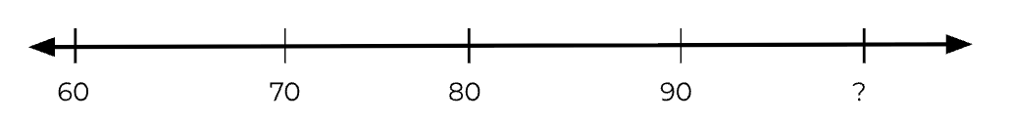
Here is a pattern.

Slide 3
Here is a pattern.
What is the rule?

Slide 4
Here is a pattern.
What is the rule?

Slide 5
Here is a pattern.
What is the rule?
10

Slide 6
Here is a pattern.
What is the rule?
10

Slide 7
Here is a pattern.
What is the rule?
10

Slide 8
Here is a pattern.
What is the rule?
10
Rule: Skip count by 10

Slide 9
?
Rule: Skip count by 10

Slide 10
10
?
Rule: Skip count by 10

Slide 11
10
100
Rule: Skip count by 10

Slide 12
Here is a pattern.

Slide 13
Here is a pattern.
3
5
7
9
11
13
15
17
?
?
?

Slide 14
Here is a pattern.
What is the rule?
3
5
7
9
11
13
15
17
?
?
?

Slide 15
Here is a pattern.
What is the rule?
2
3
5
7
9
11
13
15
17
?
?
?

Slide 16
Here is a pattern.
What is the rule?
2
3
5
7
9
11
13
15
17
?
?
?

Slide 17
Here is a pattern.
What is the rule?
2
3
5
7
9
11
13
15
17
?
?
?

Slide 18
Here is a pattern.
What is the rule?
2
3
5
7
9
11
13
15
17
?
?
?

Slide 19
2
3
5
7
9
11
13
15
17
?
?
?
Rule: Skip count by 2

Slide 20
3
5
7
9
11
13
15
17
?
?
?
Rule: Skip count by 2

Slide 21
2
3
5
7
9
11
13
15
17
?
?
?
Rule: Skip count by 2

Slide 22
2
3
5
7
9
11
13
15
17
19
?
?
Rule: Skip count by 2

Slide 23
2
3
5
7
9
11
13
15
17
19
?
?
Rule: Skip count by 2

Slide 24
2
3
5
7
9
11
13
15
17
19
?
?
Rule: Skip count by 2

Slide 25
2
3
5
7
9
11
13
15
17
19
21
?
Rule: Skip count by 2

Slide 26
3
5
7
9
11
13
15
17
19
21
?
Rule: Skip count by 2

Slide 27
2
3
5
7
9
11
13
15
17
19
21
?
Rule: Skip count by 2

Slide 28
2
3
5
7
9
11
13
15
17
19
21
23
Rule: Skip count by 2

Slide 29
3
5
7
9
11
13
15
17
19
21
23
Rule: Skip count by 2

Slide 30
Here is a pattern.

Slide 31
Here is a pattern.
33, 38, 43, 48, 53, ___, ___, ___

Slide 32
Here is a pattern.
What is the rule?
33, 38, 43, 48, 53, ___, ___, ___

Slide 33
Here is a pattern.
What is the rule?
?
33, 38, 43, 48, 53, ___, ___, ___

Slide 34
Here is a pattern.
What is the rule?
5
33, 38, 43, 48, 53, ___, ___, ___

Slide 35
Here is a pattern.
What is the rule?
5
33, 38, 43, 48, 53, ___, ___, ___

Slide 36
Here is a pattern.
What is the rule?
5
33, 38, 43, 48, 53, ___, ___, ___

Slide 37
Here is a pattern.
What is the rule?
5
33, 38, 43, 48, 53, ___, ___, ___

Slide 38
5
33, 38, 43, 48, 53, ___, ___, ___
Rule: Skip count by 5

Slide 39
33, 38, 43, 48, 53, _?__, ___, ___
Rule: Skip count by 5

Slide 40
33, 38, 43, 48, 53, 58, ___, ___
Rule: Skip count by 5

Slide 41
33, 38, 43, 48, 53, 58, _?__, ___
Rule: Skip count by 5

Slide 42
33, 38, 43, 48, 53, 58, 63, ___
Rule: Skip count by 5

Slide 43
33, 38, 43, 48, 53, 58, 63, _?__
Rule: Skip count by 5

Slide 44
33, 38, 43, 48, 53, 58, 63, 68
Rule: Skip count by 5

