Slide 1
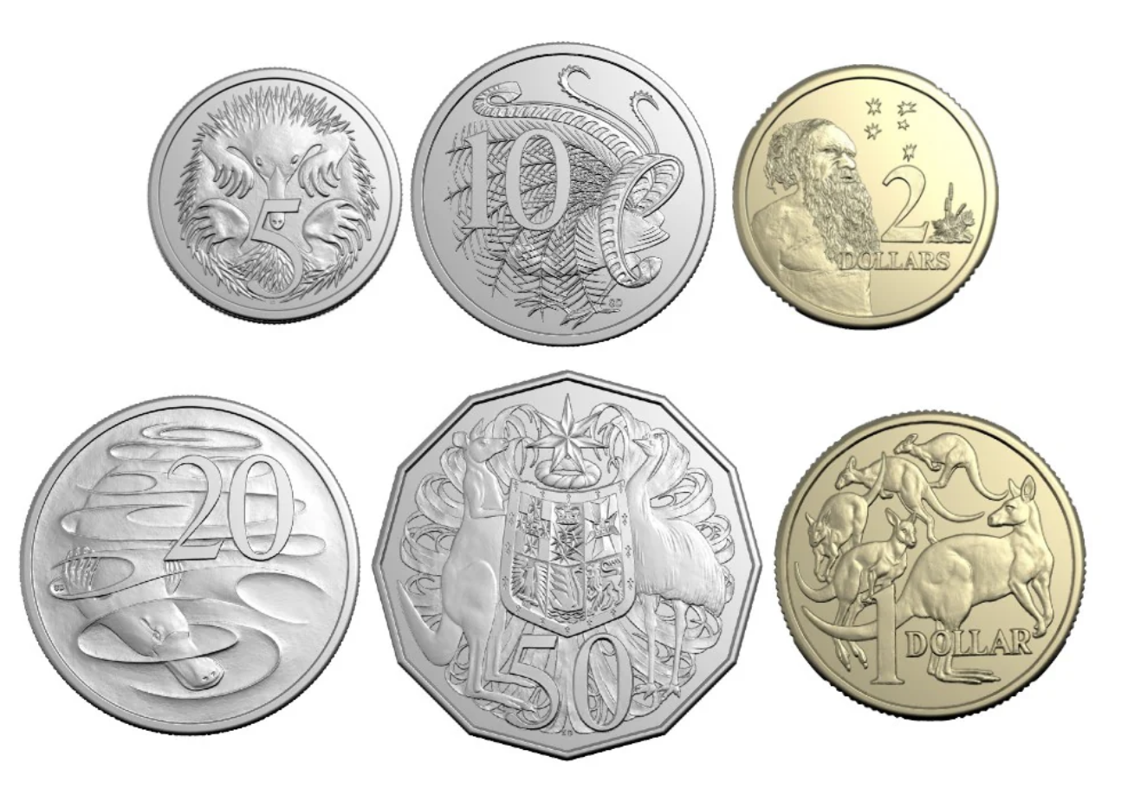
This is one dollar

Slide 2
We can say this is 100 cents

Slide 3
But to write this, write it in dollars

Slide 4
But to write this, write it in dollars
$ 1

Slide 5
But to write this, write it in dollars
The dollar sign is before the amount
$ 1

Slide 6
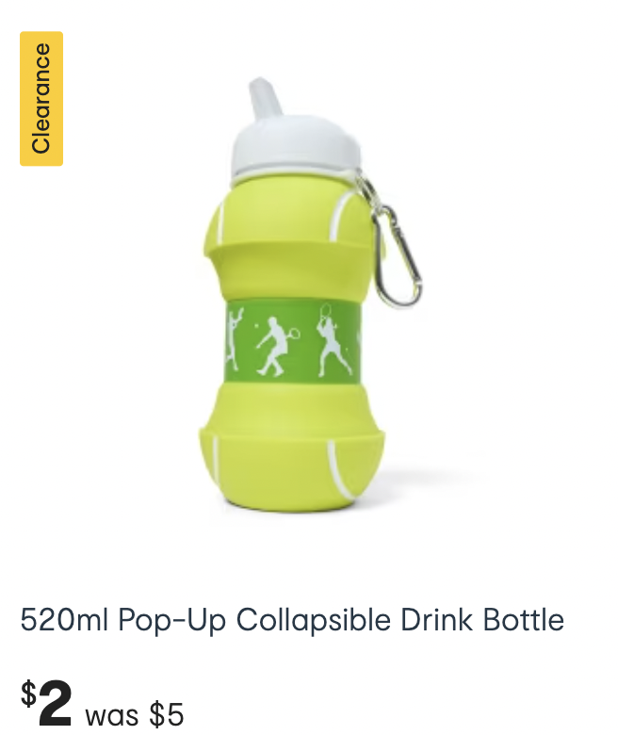
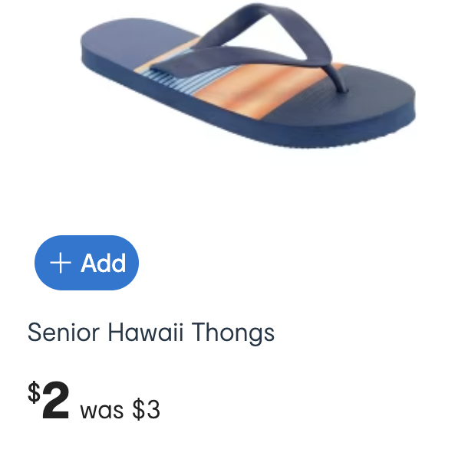
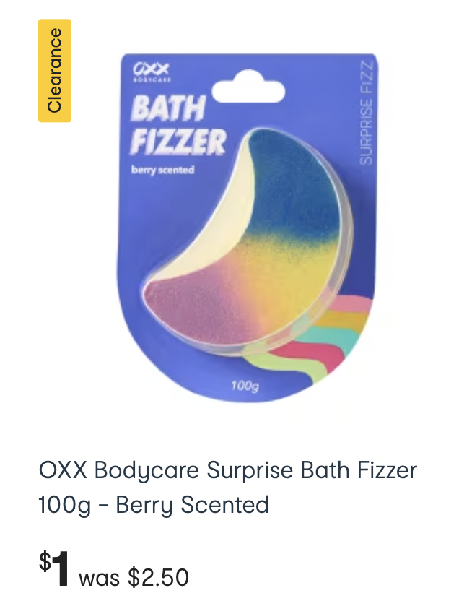
Examples of prices written in dollars $

Slide 7
This is 70 cents

Slide 8
This is less than one dollar.
We have to say and write it using cents

Slide 9
This is less than one dollar.
We have to say and write it using cents
70 c

Slide 10
This is less than one dollar.
We have to say and write it using cents
The cent sign is after the amount
70 c

Slide 11
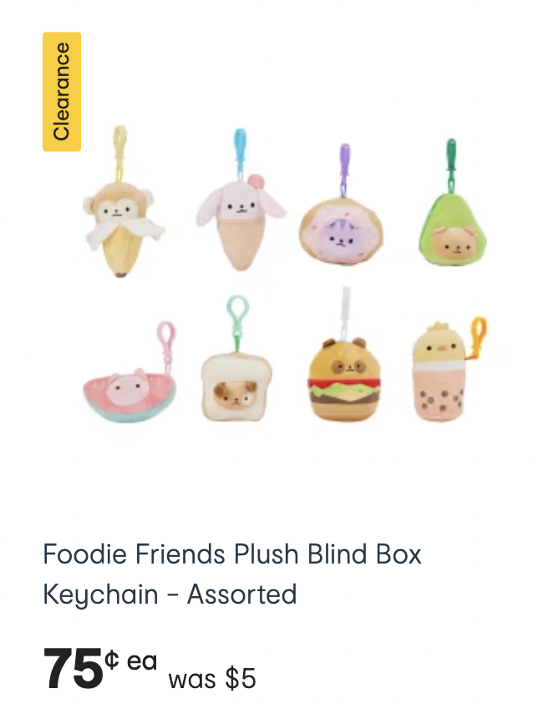
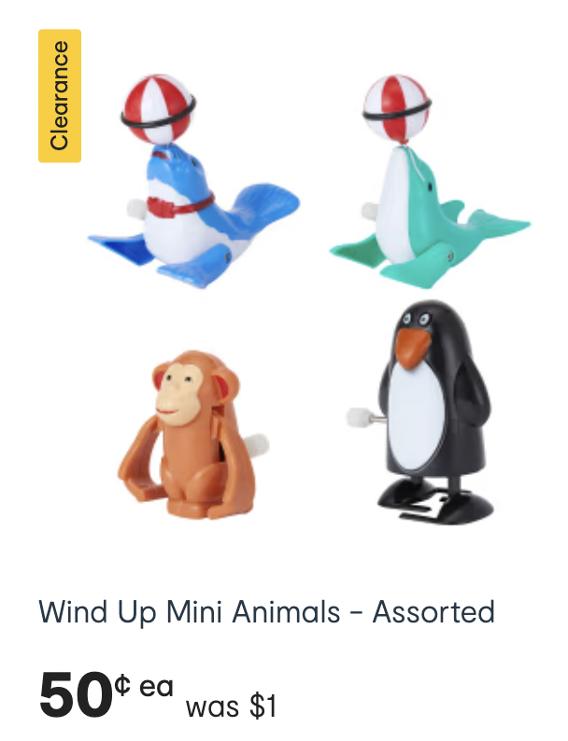
Examples of prices written in cents c

Slide 12
Another symbol for cents is ¢

Slide 13
What about this amount?

Slide 14
We can say 2 dollars and 50 cents

Slide 15
This is the notation we can use
$ __ __ . __ __

Slide 16
Dollars are before the dot
$ __ __ . __ __

Slide 17
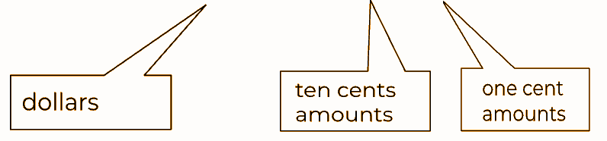
Dollars are before the dot
$ __ __ . __ __

Slide 18
Cents are after the dot
$ __ __ . __ __

Slide 19
Cents are after the dot
$ __ __ . __ __

Slide 20
Let’s put in the dollars
$ __ __ . __ __

Slide 21
Let’s put in the dollars
$ __ __ . __ __

Slide 22
Let’s put in the dollars
$ __ 2 . __ __

Slide 23
Now let’s put in the cents
$ __ 2 . __ __

Slide 24
Now let’s put in the cents
$ __ 2 . __ __

Slide 25
Now let’s put in the cents
$ __ 2 . 5 0

Slide 26
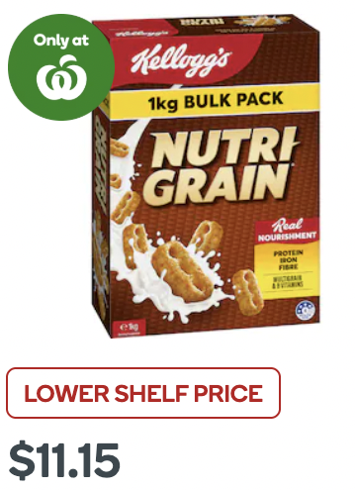
Examples of prices showing dollars and cents

Slide 27
Examples of prices showing dollars and cents
$ __ __ . __ __

Slide 28
Examples of prices showing dollars and cents
$ 1 1 . 1 5

Slide 29
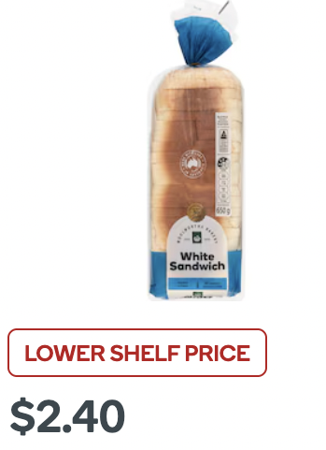
Examples of prices showing dollars and cents

Slide 30
Examples of prices showing dollars and cents
$ __ __ . __ __

Slide 31
Examples of prices showing dollars and cents
$ 2 . 4 0

Slide 32

Examples of prices showing dollars and cents

Slide 33
Examples of prices showing dollars and cents
$ __ __ . __ __

Slide 34
Examples of prices showing dollars and cents
$ 3 . 5 0

Slide 35
How do we write this amount?
$ __ __ . __ __

Slide 36
How do we write this amount?
$ __ __ . __ __

Slide 37
How do we write this amount?
$ 2 . __ __

Slide 38
How do we write this amount?
$ 2 . __ __

Slide 39
How do we write this amount?
$ 2 . 5 0

Slide 40
How do we write this amount?
$ 2 . 5 0

Slide 41
How do we write this amount?
$ __ __ . __ __

Slide 42
How do we write this amount?
$ __ __ . __ __

Slide 43
How do we write this amount?
$ 3 . __ __

Slide 44
How do we write this amount?
$ 3 . __ __

Slide 45
How do we write this amount?
$ 3 . 0 0

Slide 46
How do we write this amount?
$ 3 . 0 0
or
$ 3

Slide 47
How do we write this amount?
$ __ __ . __ __

Slide 48
How do we write this amount?
$ __ __ . __ __

Slide 49
How do we write this amount?
$ 2 . __ __

Slide 50
How do we write this amount?
$ 2 . __ __

Slide 51
How do we write this amount?
$ 2 . 1 5

Slide 52
How do we write this amount?
$ 2 . 1 5

Slide 53
How do we write this amount?
$ __ __ . __ __

Slide 54
How do we write this amount?
$ __ __ . __ __

Slide 55
How do we write this amount?
$ 6 . __ __

Slide 56
How do we write this amount?
$ 6 . __ __

Slide 57
Where do we put the 5 cents?
$ 6 . __ __

Slide 58
Where do we put the 5 cents?
$ 6 . 5

Slide 59
This is the place for the ten cent amounts
$ 6 . 5

Slide 60
So it would actually be $6.50
$ 6 . 5 0

Slide 61
Where do we put the 5 cents?
$ 6 . __ __

Slide 62
Where do we put the 5 cents?
$ 6 . __ 5

Slide 63
There are no 10 cent amounts
$ 6 . __ 5

Slide 64
There are no 10 cent amounts
$ 6 . 0 5

