Slide 1
We have learnt to count to 30

Slide 2
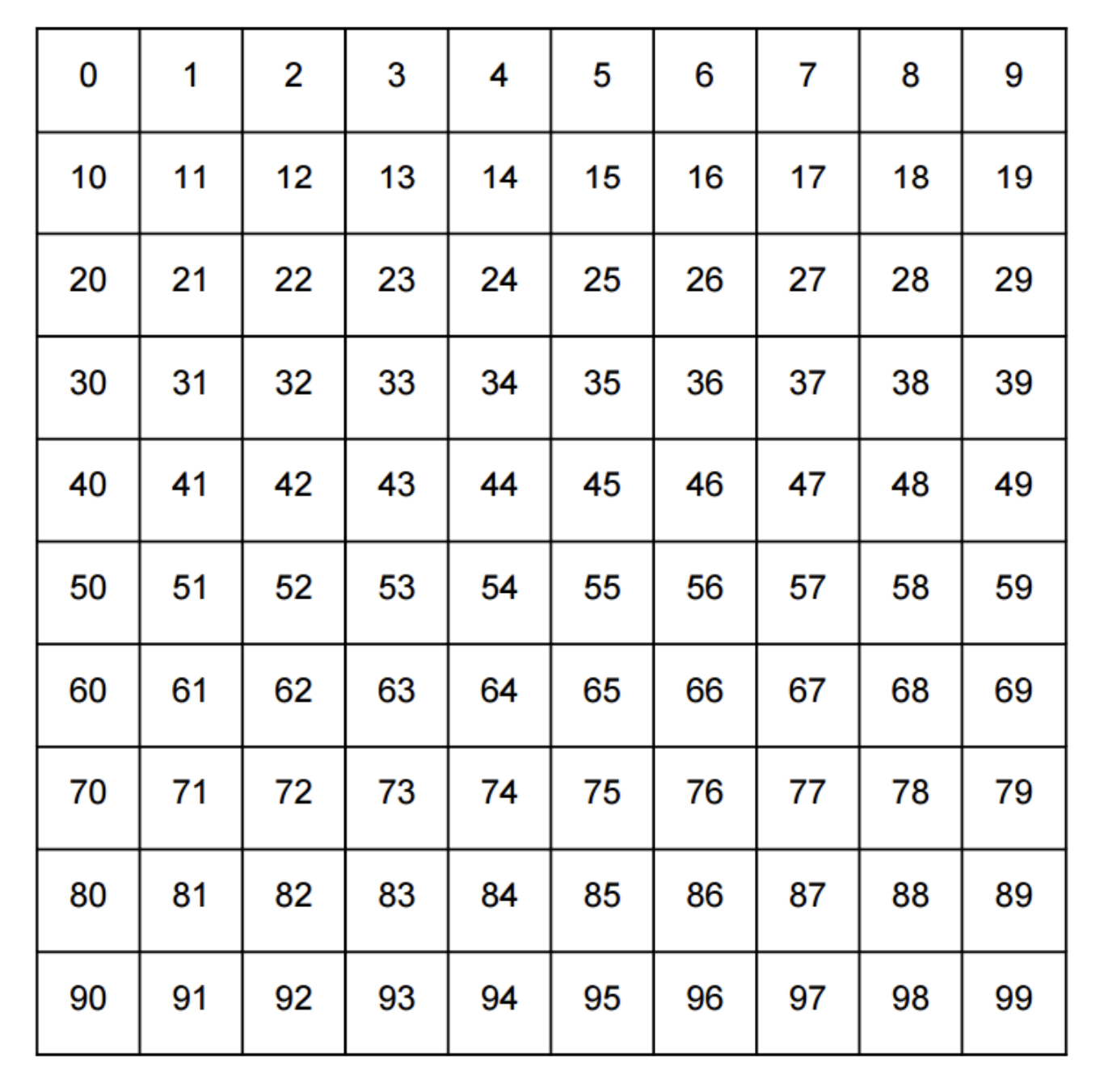

Slide 6
What next?

Slide 8
Twenty-one

Slide 9
Twenty-one
Thirty-one

Slide 11
Twenty-two

Slide 12
Twenty-two
Thirty-two

Slide 14
Twenty-three

Slide 15
Twenty-three
Thirty-three

Slide 17
Twenty-four

Slide 18
Twenty-four
Thirty-four

Slide 20
Twenty-five

Slide 21
Twenty-five
Thirty-five

Slide 23
Twenty-six

Slide 24
Twenty-six
Thirty-six

Slide 37
Let’s practice the tens

Slide 38
zero

Slide 39
ten

Slide 40
twenty

Slide 41
thirty

Slide 42
forty

Slide 43
fifty

Slide 44
sixty

Slide 45
seventy

Slide 46
eighty

Slide 47
ninety

Slide 48
Let’s practice counting

Slide 60
Count on from here

Slide 62
Count on from here

Slide 64
Count on from here

Slide 66
Count on from here

Slide 68
Count on from here

Slide 70
Count on from here

Slide 72
Count on from here

Slide 74
Practice the tens

