Slide 1
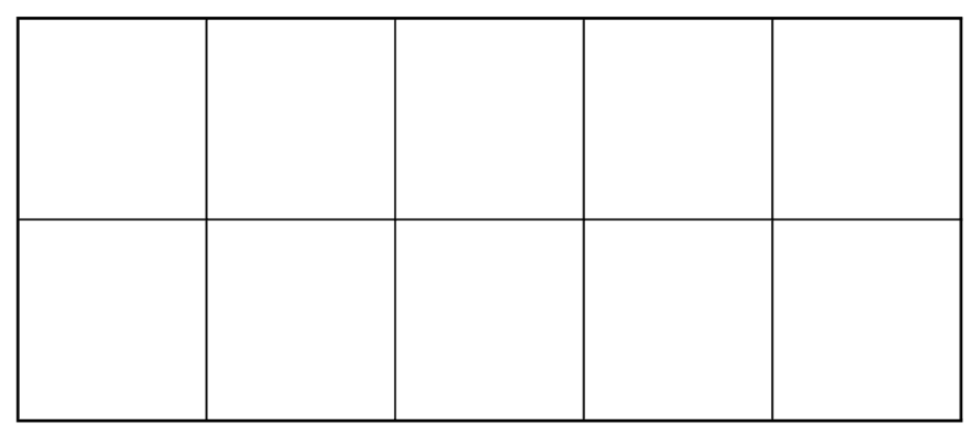
Remember

Slide 7
Let’s add another row

Slide 8
“Five and one more”

Slide 9
“Five and two more”

Slide 10
“Five and three more”

Slide 11
“Five and three more”

Slide 12
“Five and four more”

Slide 13
“Five and five more”

Slide 14
“This is ten”

Slide 15
Let’s describe the dots

Slide 16
“Five and one more, this is six”

Slide 17
“Five and two more, this is seven”

Slide 18
“Five and three more, this is eight”

Slide 19
“Five and four more, this is nine”

Slide 20
“Five and five more, this is ten”

Slide 21
“Five and one more, this is six”

Slide 22
“Five and four more, this is nine”

Slide 23
“Five and zero more, this is five”

Slide 24
“Five and four more, this is nine”

Slide 25
“Five and three more, this is eight”

Slide 26
“Five and two more, this is seven”

Slide 27
“Five and four more, this is nine”

Slide 28
“Five and five more, this is ten”

Slide 29
“Five and zero more, this is five”

Slide 30
“Five and three more, this is eight”

Slide 31
“Five and one more, this is six”

Slide 32
“Five and two more, this is seven”

Slide 33
“Five and five more, this is ten”

Slide 34
“Five and one more, this is six”

Slide 35
“Five and three more, this is eight”

Slide 36
“Five and two more, this is seven”

Slide 37
“Five and four more, this is nine”

Slide 38
“Five and zero more, this is five”

Slide 39
“Five and five more, this is ten”

