Slide 1
How many fingers?

Slide 2
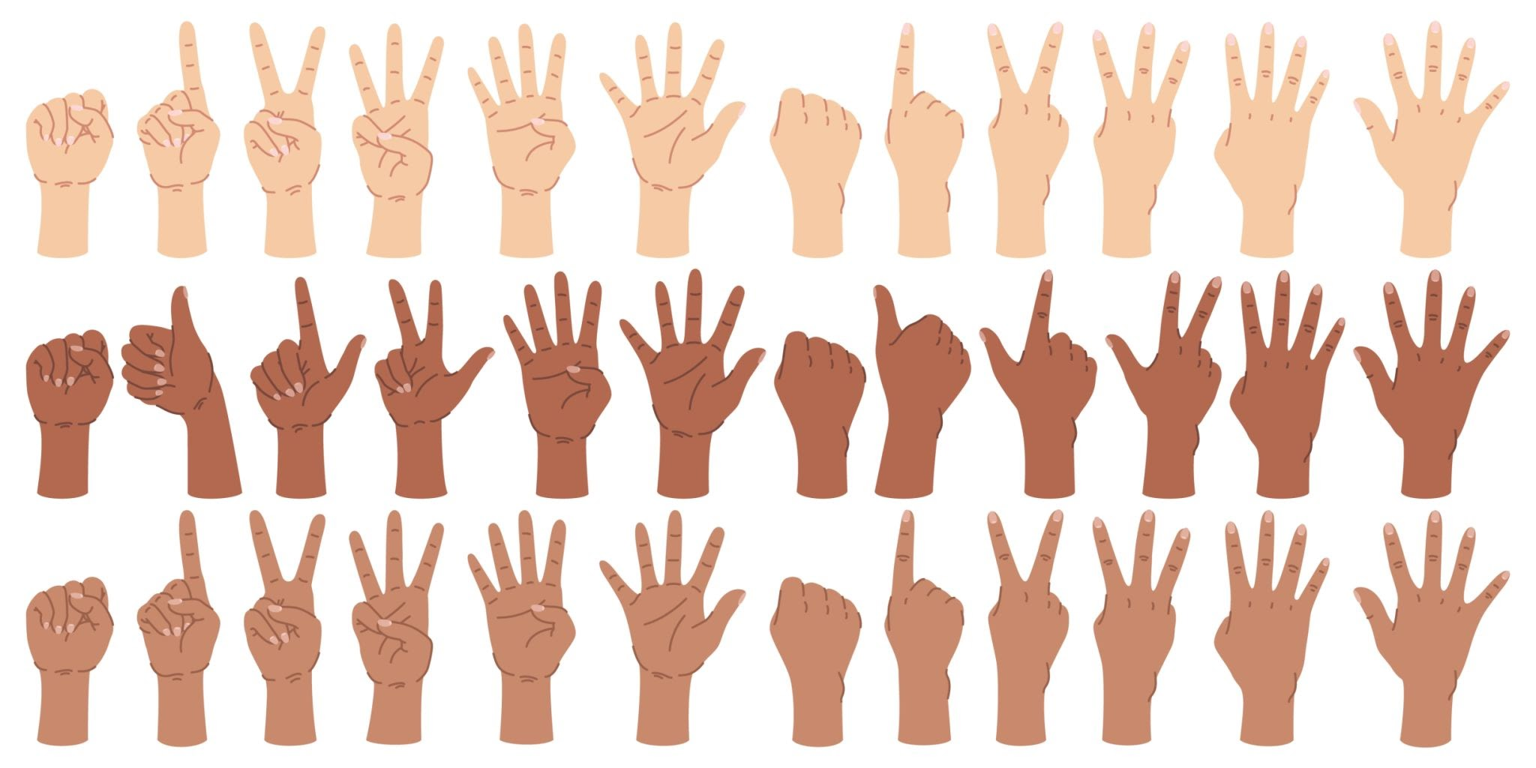
0
zero

Slide 3
1
one

Slide 4
2
two

Slide 5
3
three

Slide 6
4
four

Slide 7
5
five

Slide 8
6
six

Slide 9
7
seven

Slide 10
8
eight

Slide 11
9
nine

Slide 12
10
ten

Slide 13
How many plants?

Slide 14
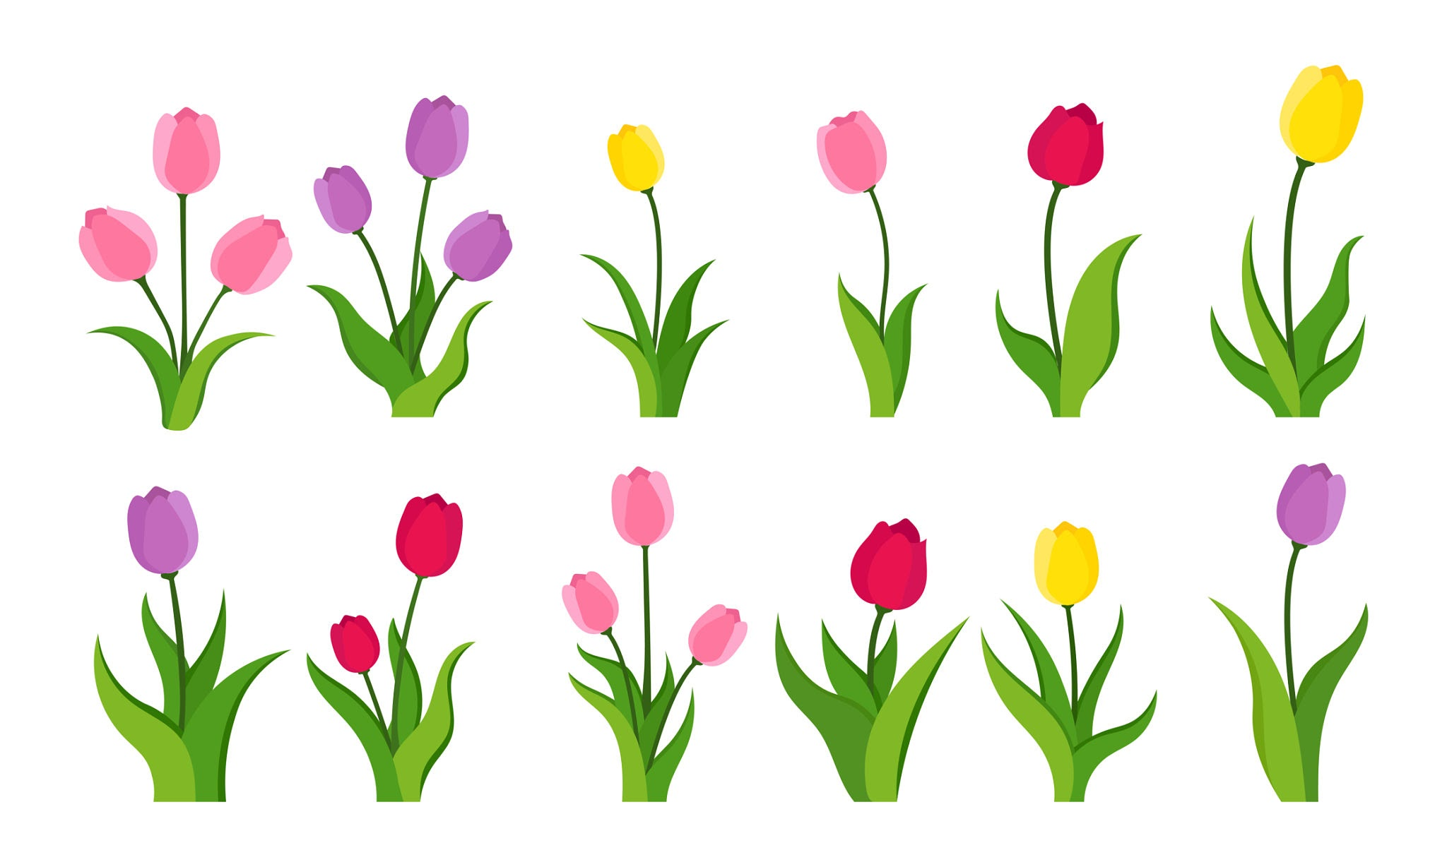
How many plants?

Slide 15
1

Slide 16
2

Slide 17
3

Slide 18
4

Slide 19
5

Slide 20
6

Slide 21
7

Slide 22
8

Slide 23
9

Slide 24
10

Slide 25
How many plants?

Slide 26
How many plants?

Slide 27
one

Slide 28
two

Slide 29
three

Slide 30
four

Slide 31
five

Slide 32
six

Slide 33
seven

Slide 34
eight

Slide 35
nine

Slide 36
ten

Slide 37
How many ants?

Slide 38
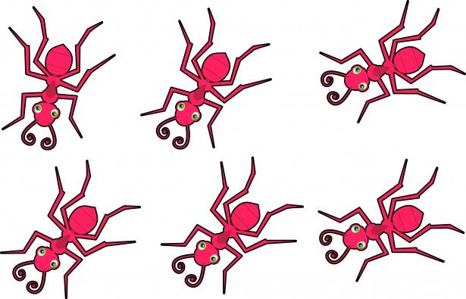
1

Slide 39
2

Slide 40
3

Slide 41
4

Slide 42
5

Slide 43
6

Slide 44
7

Slide 45
8

Slide 46
9

Slide 47
10

Slide 48
How many ants?

Slide 49
one

Slide 50
two

Slide 51
three

Slide 52
four

Slide 53
five

Slide 54
six

Slide 55
seven

Slide 56
eight

Slide 57
nine

Slide 58
ten

Slide 59
How many stars?

Slide 60
0
zero

Slide 61
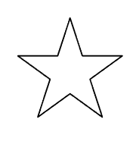
0 1
zero one

Slide 62
0 1 2
zero one two

Slide 63
0 1 2 3
zero one two three

Slide 64
0 1 2 3 4
zero one two three four

Slide 65
0 1 2 3 4 5
zero one two three four five

Slide 66
6
six

Slide 67
6
six
7
seven

Slide 68
6
six
7
seven
8
eighth

Slide 69
6
six
7
seven
8
eighth
9
nine

Slide 70
6
six
7
seven
8
eighth
9
nine
10
ten

Slide 71
How many stars?

Slide 72
How many stars?
Practice writing these words

Slide 73
0 zero

Slide 74
1 one

Slide 75
2 two

Slide 76
3 three

Slide 77
4 four

Slide 78
5 five

Slide 79
6 six

Slide 80
7 seven

Slide 81
8 eight

Slide 82
9 nine

Slide 83
10 ten

