Slide 1
How many?

Slide 2

1

Slide 3
2

Slide 4
3

Slide 5
4

Slide 6
5

Slide 7
6

Slide 8
7

Slide 9
8

Slide 10
9

Slide 11
10

Slide 12
11

Slide 13
12

Slide 14
How many?

Slide 15
1

Slide 16
1
2

Slide 17
1
3
2

Slide 18
1
3
2
4

Slide 19
1
3
2
4
5

Slide 20
1
3
2
4
6
5

Slide 21
7
1
3
2
4
6
5

Slide 22
7
1
3
2
8
4
6
5

Slide 23
7
1
3
2
8
4
6
5
9

Slide 24
7
1
3
2
10
8
4
6
5
9

Slide 25
7
1
3
2
10
8
4
6
11
5
9

Slide 26
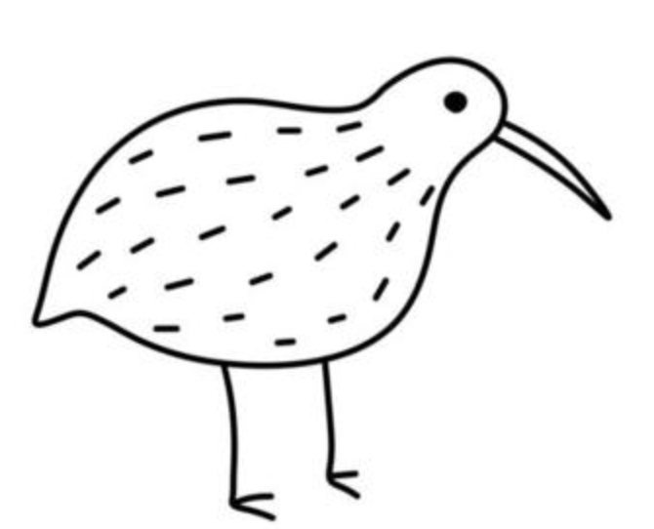
How many?

Slide 27
1

Slide 28
1
2

Slide 29
1
3
2

Slide 30
1
3
4
2

Slide 31
5
1
3
4
2

Slide 32
5
1
3
4
6
2

Slide 33
5
7
1
3
4
6
2

Slide 34
5
7
1
3
4
6
2
8

Slide 35
5
7
1
3
9
4
6
2
8

Slide 36
5
7
1
3
9
4
6
2
8
10

Slide 37
5
7
1
3
9
4
6
2
8
10
11

Slide 38
5
7
1
3
9
4
6
2
8
12
10
11

Slide 39
5
7
1
3
9
4
6
2
8
12
10
13
11

Slide 40
5
7
1
3
9
4
6
2
8
12
10
13
11
14

Slide 41

How many?

Slide 42
1
X

Slide 43
2
X
X

Slide 44
3
X
X
X

Slide 45
4
X
X
X
X

Slide 46
5
X
X
X
X
X

Slide 47
6
X
X
X
X
X
X

Slide 48
7
X
X
X
X
X
X
X

Slide 49
8
X
X
X
X
X
X
X
X

Slide 50
9
X
X
X
X
X
X
X
X
X

Slide 51
10
X
X
X
X
X
X
X
X
X
X

Slide 52
11
X
X
X
X
X
X
X
X
X
X
X

Slide 53
12
X
X
X
X
X
X
X
X
X
X
X
X

Slide 54
13
X
X
X
X
X
X
X
X
X
X
X
X
X

Slide 55
14
X
X
X
X
X
X
X
X
X
X
X
X
X
X

Slide 56
15
X
X
X
X
X
X
X
X
X
X
X
X
X
X
X

Slide 57
16
X
X
X
X
X
X
X
X
X
X
X
X
X
X
X
X

Slide 58
17
X
X
X
X
X
X
X
X
X
X
X
X
X
X
X
X
X

Slide 59
18
X
X
X
X
X
X
X
X
X
X
X
X
X
X
X
X
X
X

Slide 60
19
X
X
X
X
X
X
X
X
X
X
X
X
X
X
X
X
X
X
X

