Slide 1
More than
What does more than mean?

Slide 2
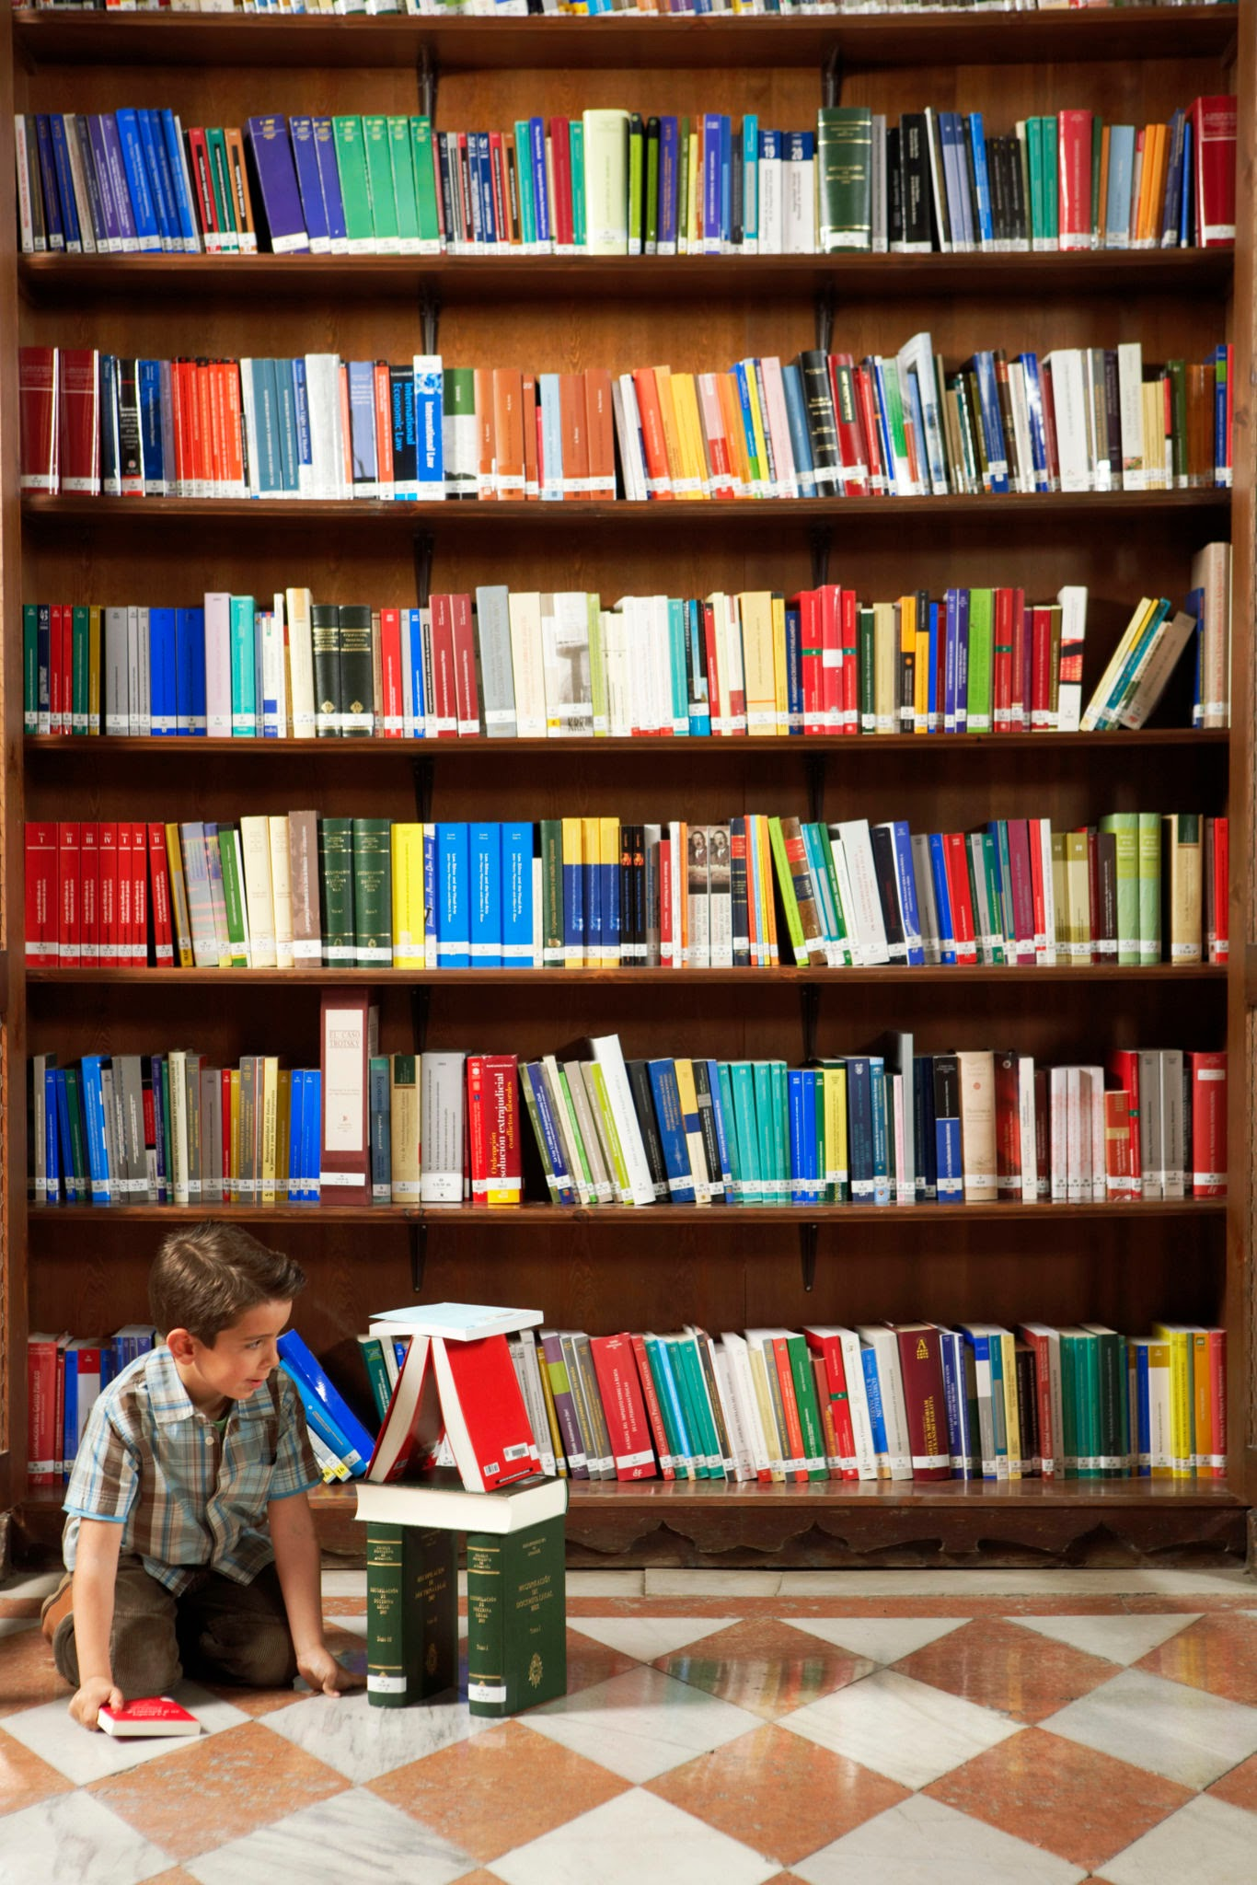
Does this collection of books have more than?

Slide 3
Does this collection of books have more than?
We need a collection to compare to.

Slide 4

More than

Slide 5
Does one collection of books have more than the other?

Slide 6
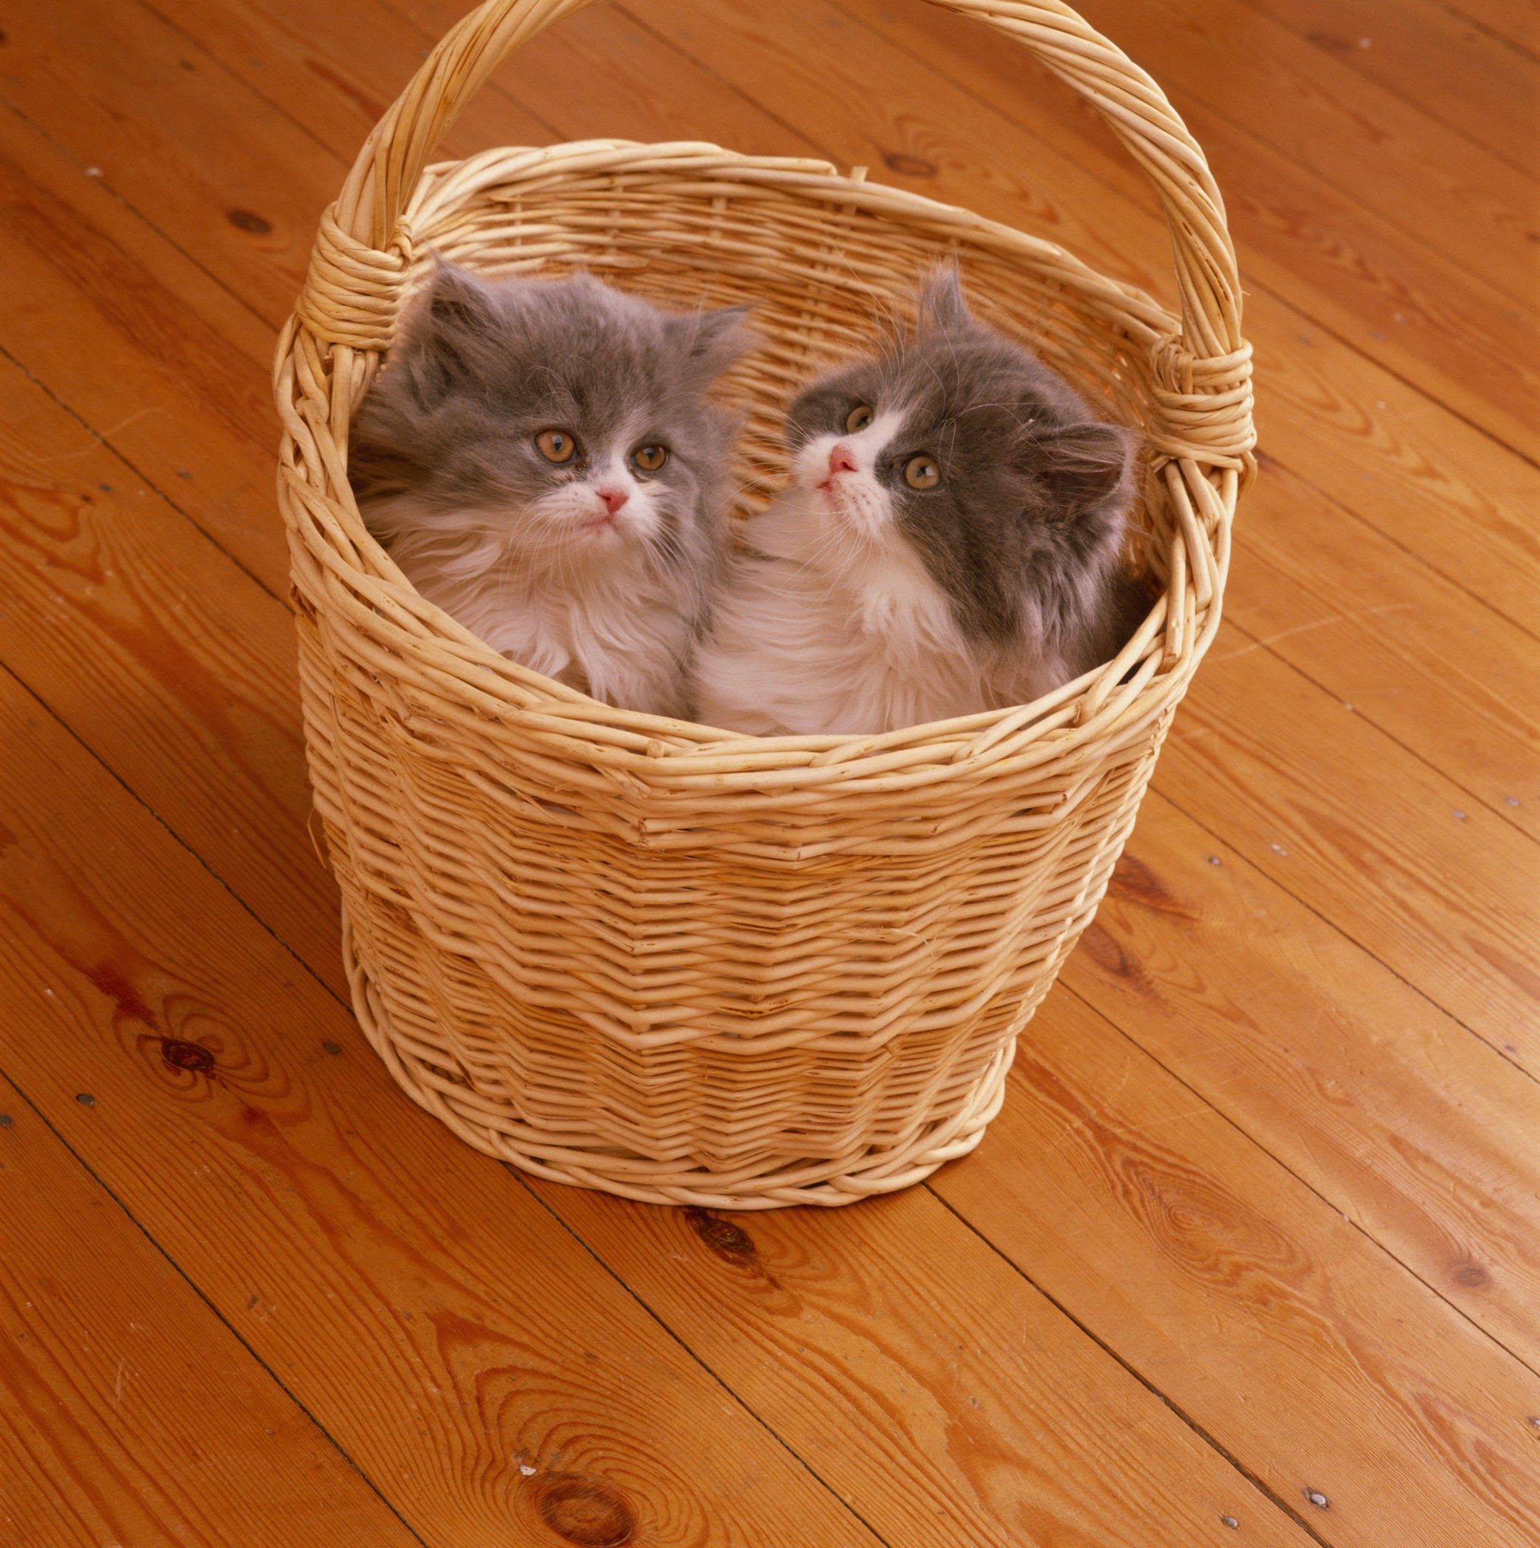
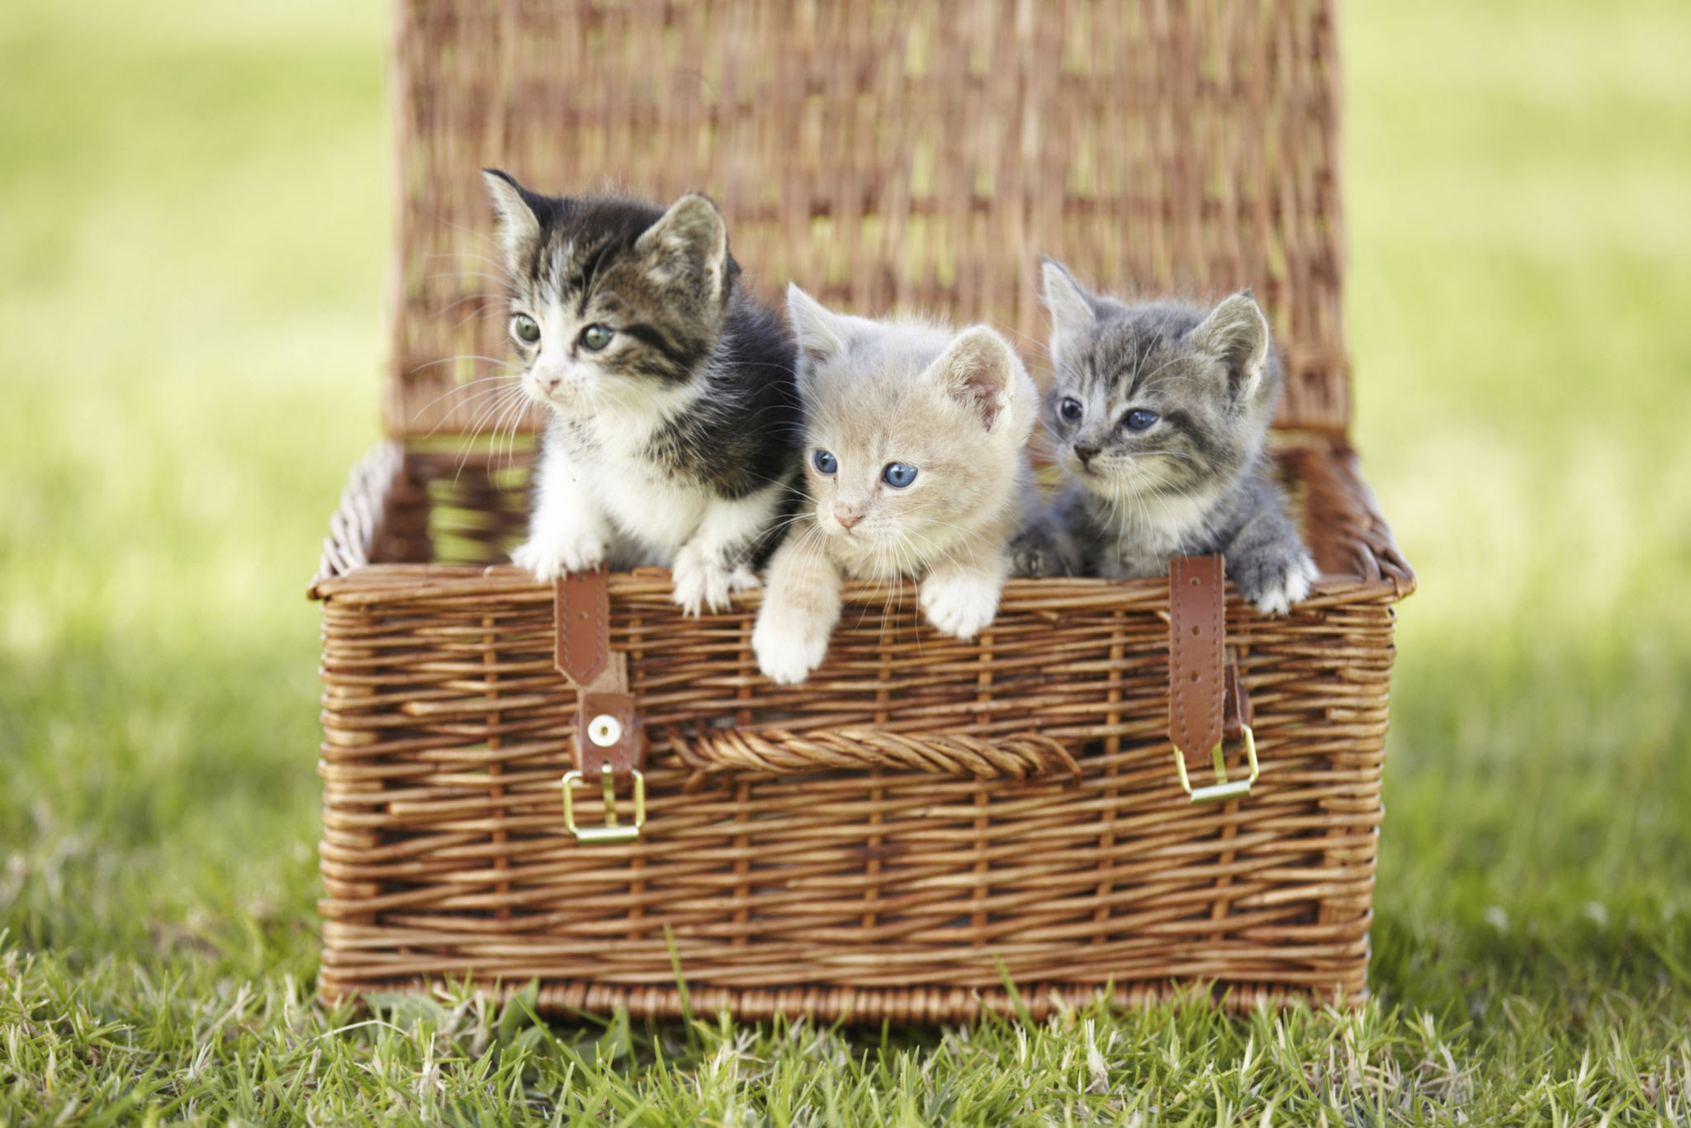
Compare these cat baskets using more than

Slide 7
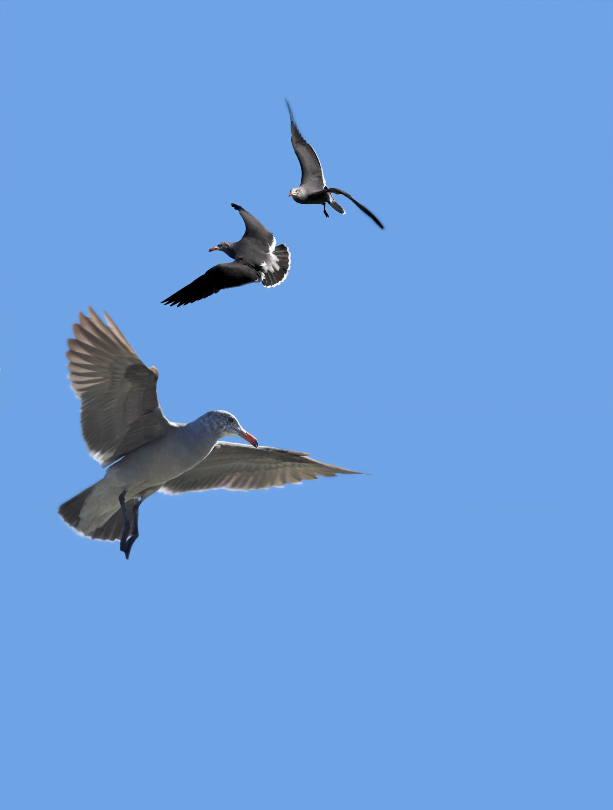
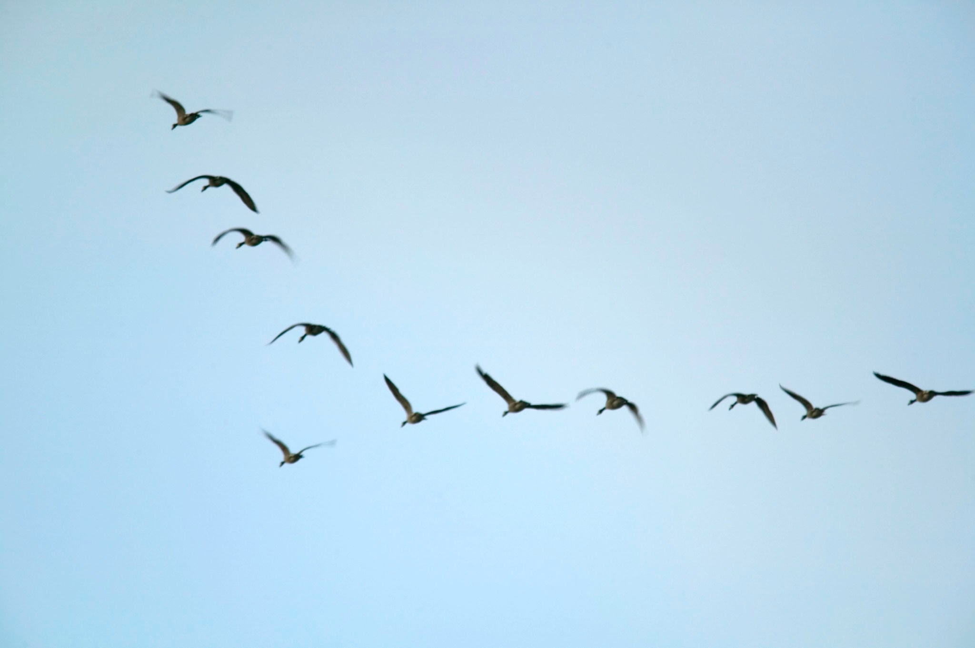
Compare these bird flocks using more than

Slide 8
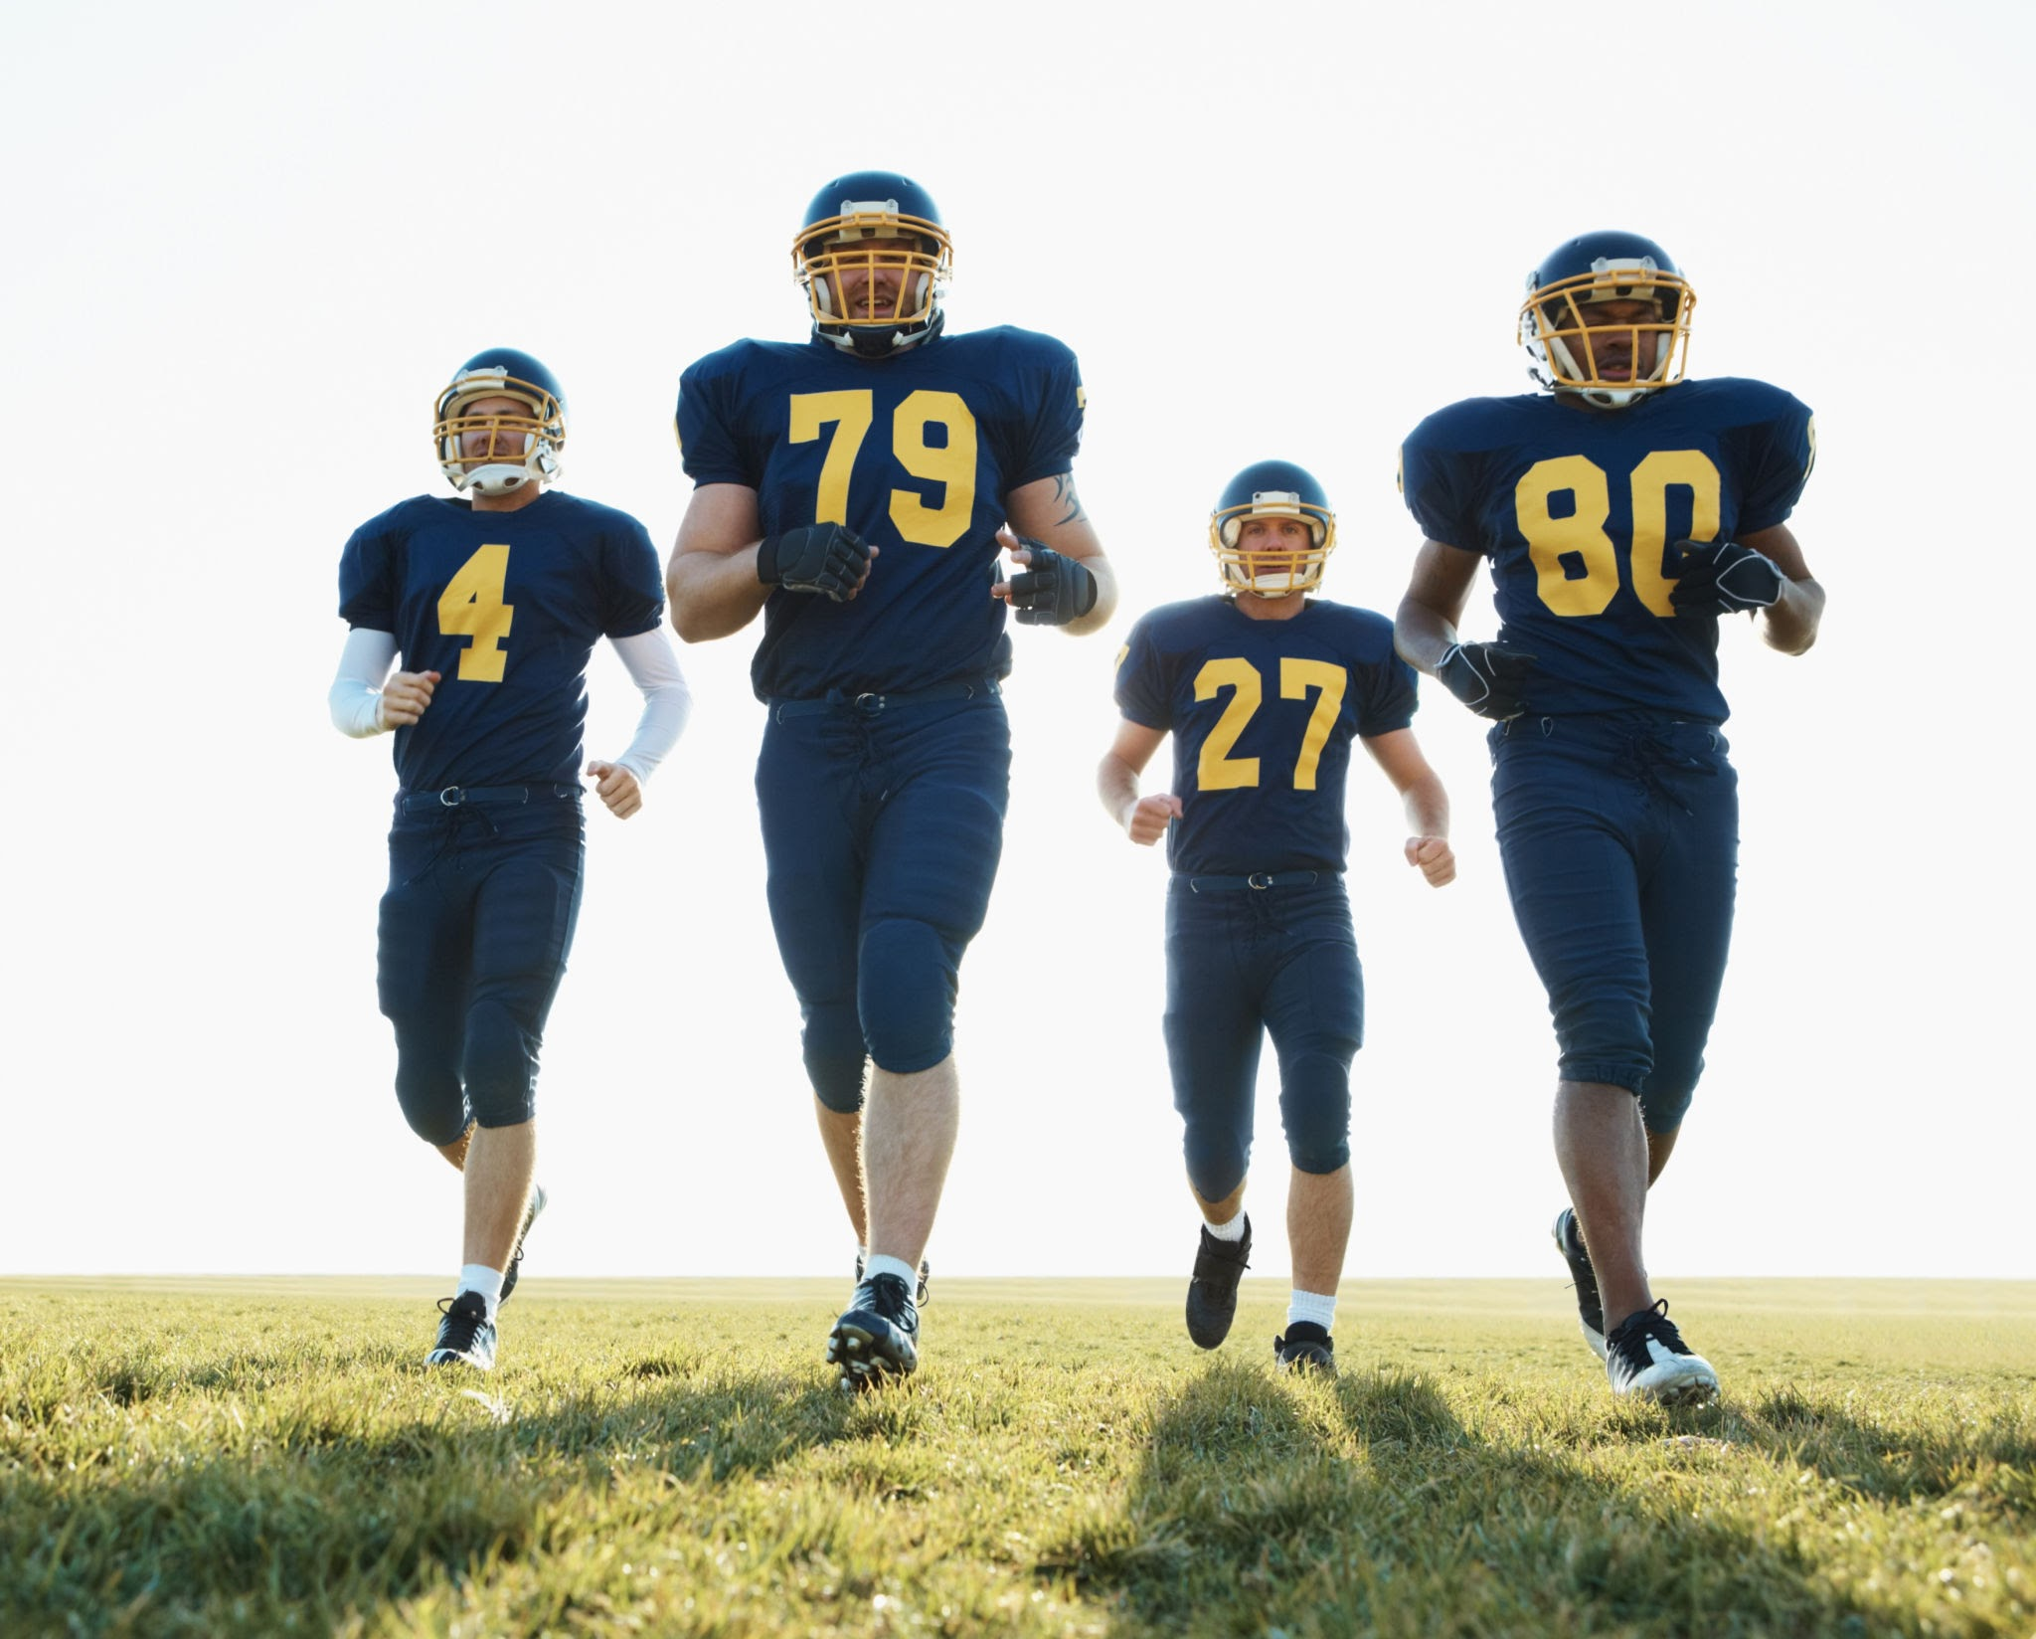
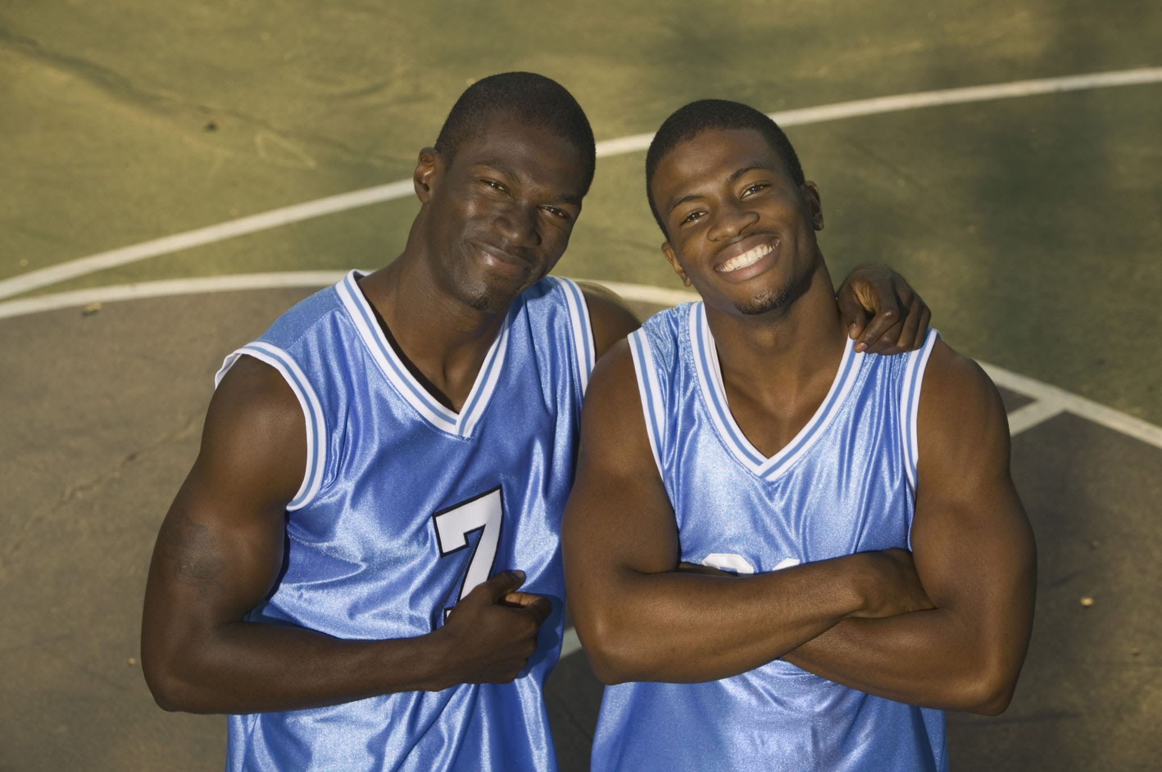
Compare these teams using more than

Slide 9
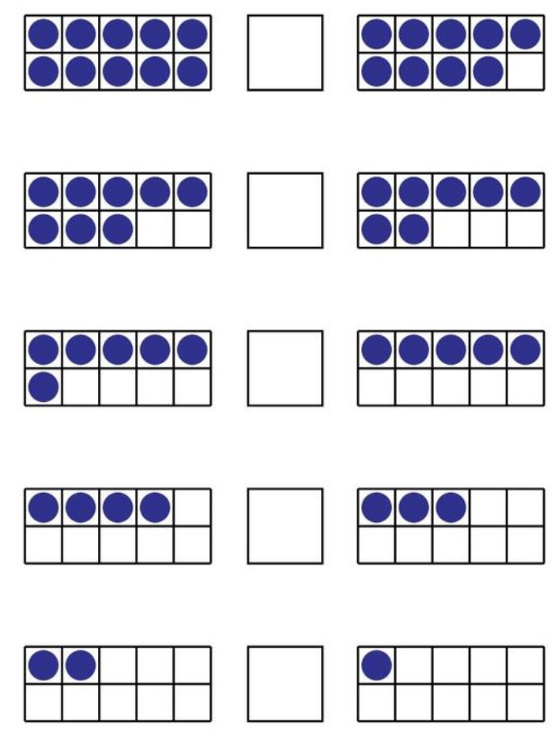
Compare these collections using more than

Slide 10
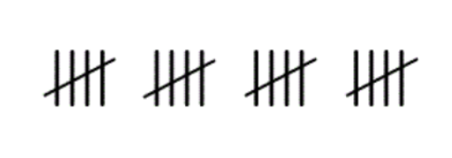
Compare these collections using more than

Slide 11
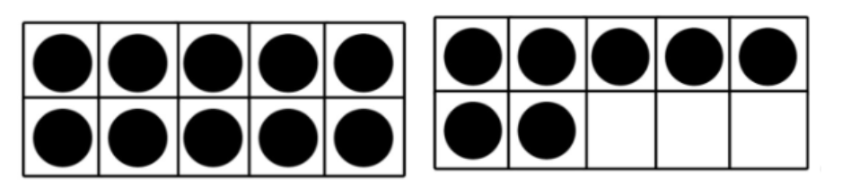
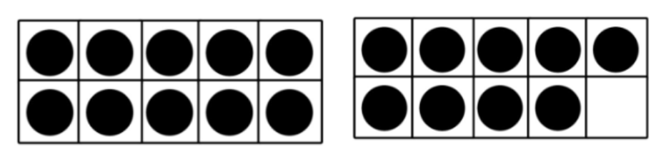
Compare these collections using more than

Slide 12
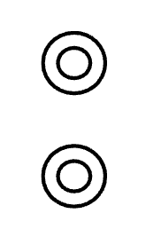
Compare these collections using more than

Slide 13

Compare these collections using more than

Slide 14
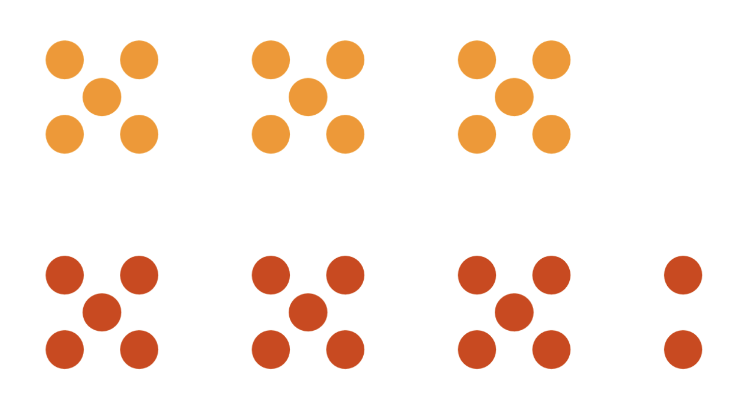
Compare these collections using more than

Slide 15
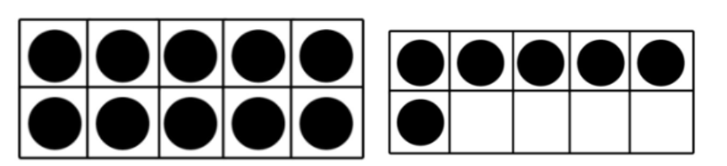
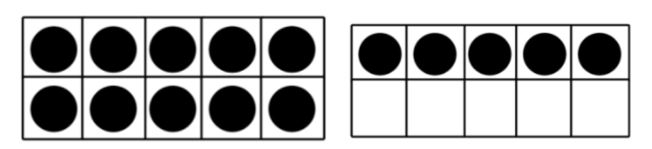
Compare these collections using more than

Slide 16
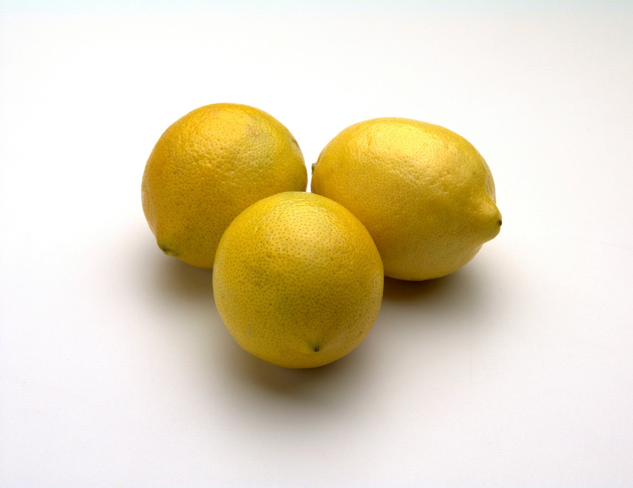
Does this pile of lemons have more than?

Slide 17
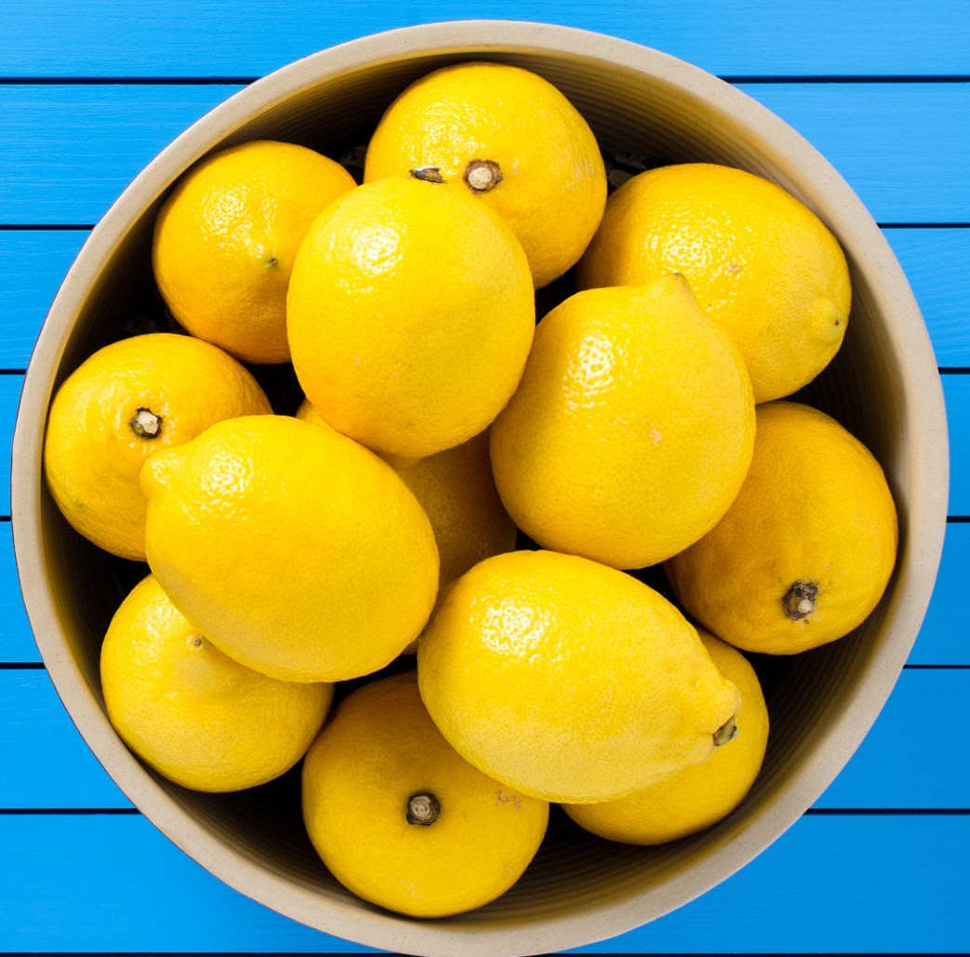
Does this pile of lemons
have more than this pile of lemons?

Slide 18
Does this pile of lemons
have more than this pile of lemons?

Slide 19
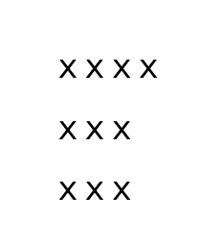
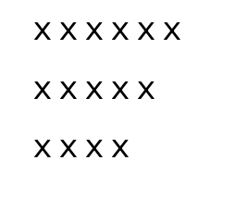
Does this collection
have more than this collection?

Slide 20
Does this collection
have more than this collection?

Slide 21
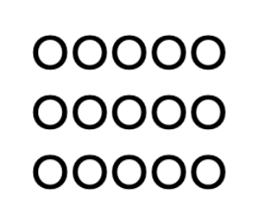
Does this collection
have more than this collection?

Slide 22
The same amount as
What does the same amount as mean?

Slide 23
Does this collection of books have the same amount as?

Slide 24
Does this collection of books have the same amount as?
We need a collection to compare to.

Slide 25
Does one collection of books have the same amount as the other?

Slide 26
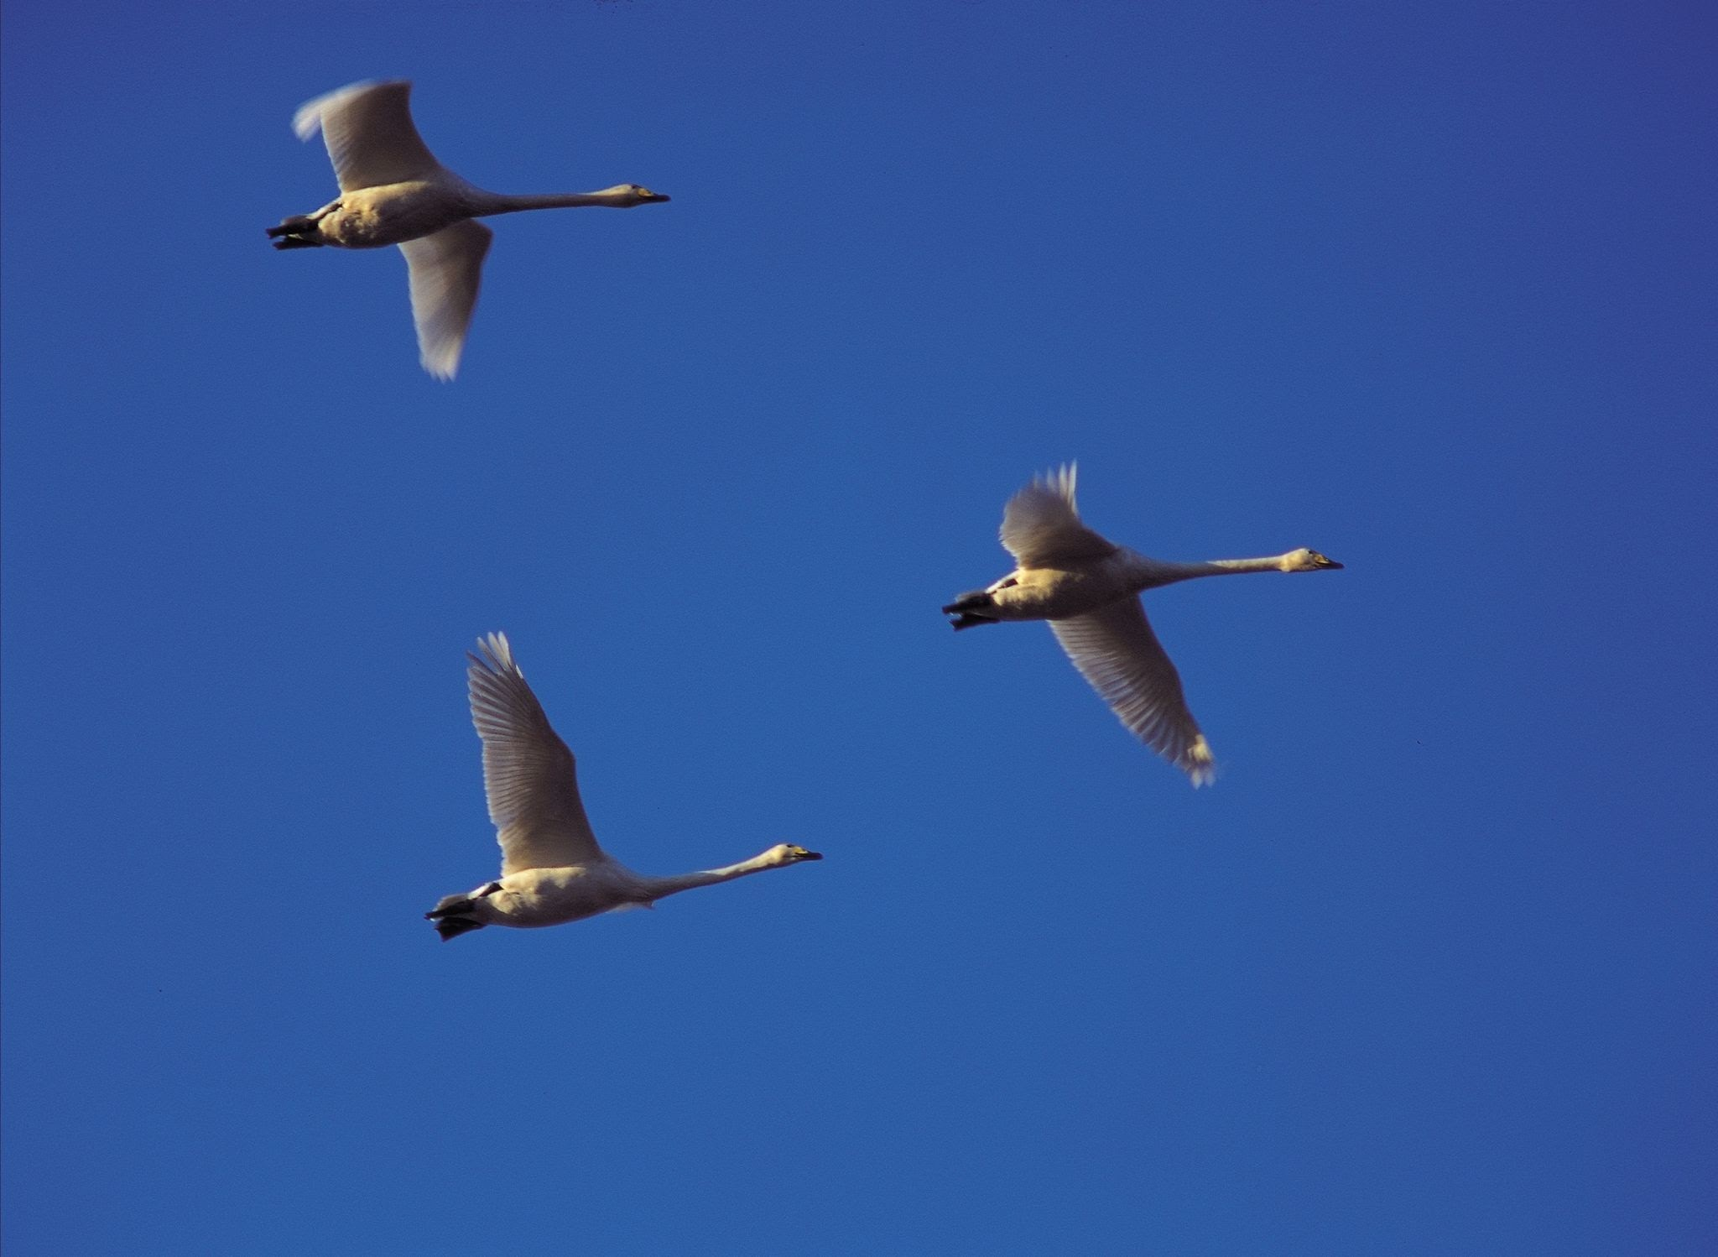
Compare these birds using
the same amount as

Slide 27
Compare these cat collections using the same amount as

Slide 28
Compare these teams using
the same amount as

Slide 29
Compare these collections using
the same amount as

Slide 30
Compare these collections using
the same amount as

Slide 31
Compare these collections using
the same amount as

Slide 32
Compare these collections using
the same amount as

Slide 33
Compare these collections using
the same amount as

Slide 34
Compare these collections using
the same amount as

Slide 35
Compare these collections using
the same amount as

Slide 36
Does this pile of lemons have
the same amount as?

Slide 37
Does this pile of lemons
have the same amount as this pile of lemons?

Slide 38
Does this pile of lemons
have the same amount as this pile of lemons?

Slide 39
Does this collection
have the same amount as this collection?

Slide 40
Does this collection
have the same amount as this collection?

Slide 41
Less than
What does less than mean?

Slide 42
Does this collection of books have less than?

Slide 43
Does one collection of books have less than the other?

Slide 44
Compare these birds using
less than

Slide 45
Compare these cat collections using less than

Slide 46
Compare these teams using
less than

Slide 47
Compare these collections using
less than

Slide 48
Compare these collections using
less than

Slide 49
Compare these collections using
less than

Slide 50
Compare these collections using
less than

Slide 51
Compare these collections using
less than

Slide 52
Compare these collections using
less than

Slide 53
Compare these collections using
less than

Slide 54
Does this pile of lemons have
less than?

Slide 55
Does this pile of lemons
have the less than this pile of lemons?

Slide 56
Does this pile of lemons
have less than this pile of lemons?

Slide 57
Does this collection
have less than this collection?

Slide 58
Does this collection
have less than this collection?

Slide 59
more than - greater than
less than - fewer than
the same amount as - equal amount

Slide 60


more than - greater than

Slide 61


more than - greater than

Slide 62
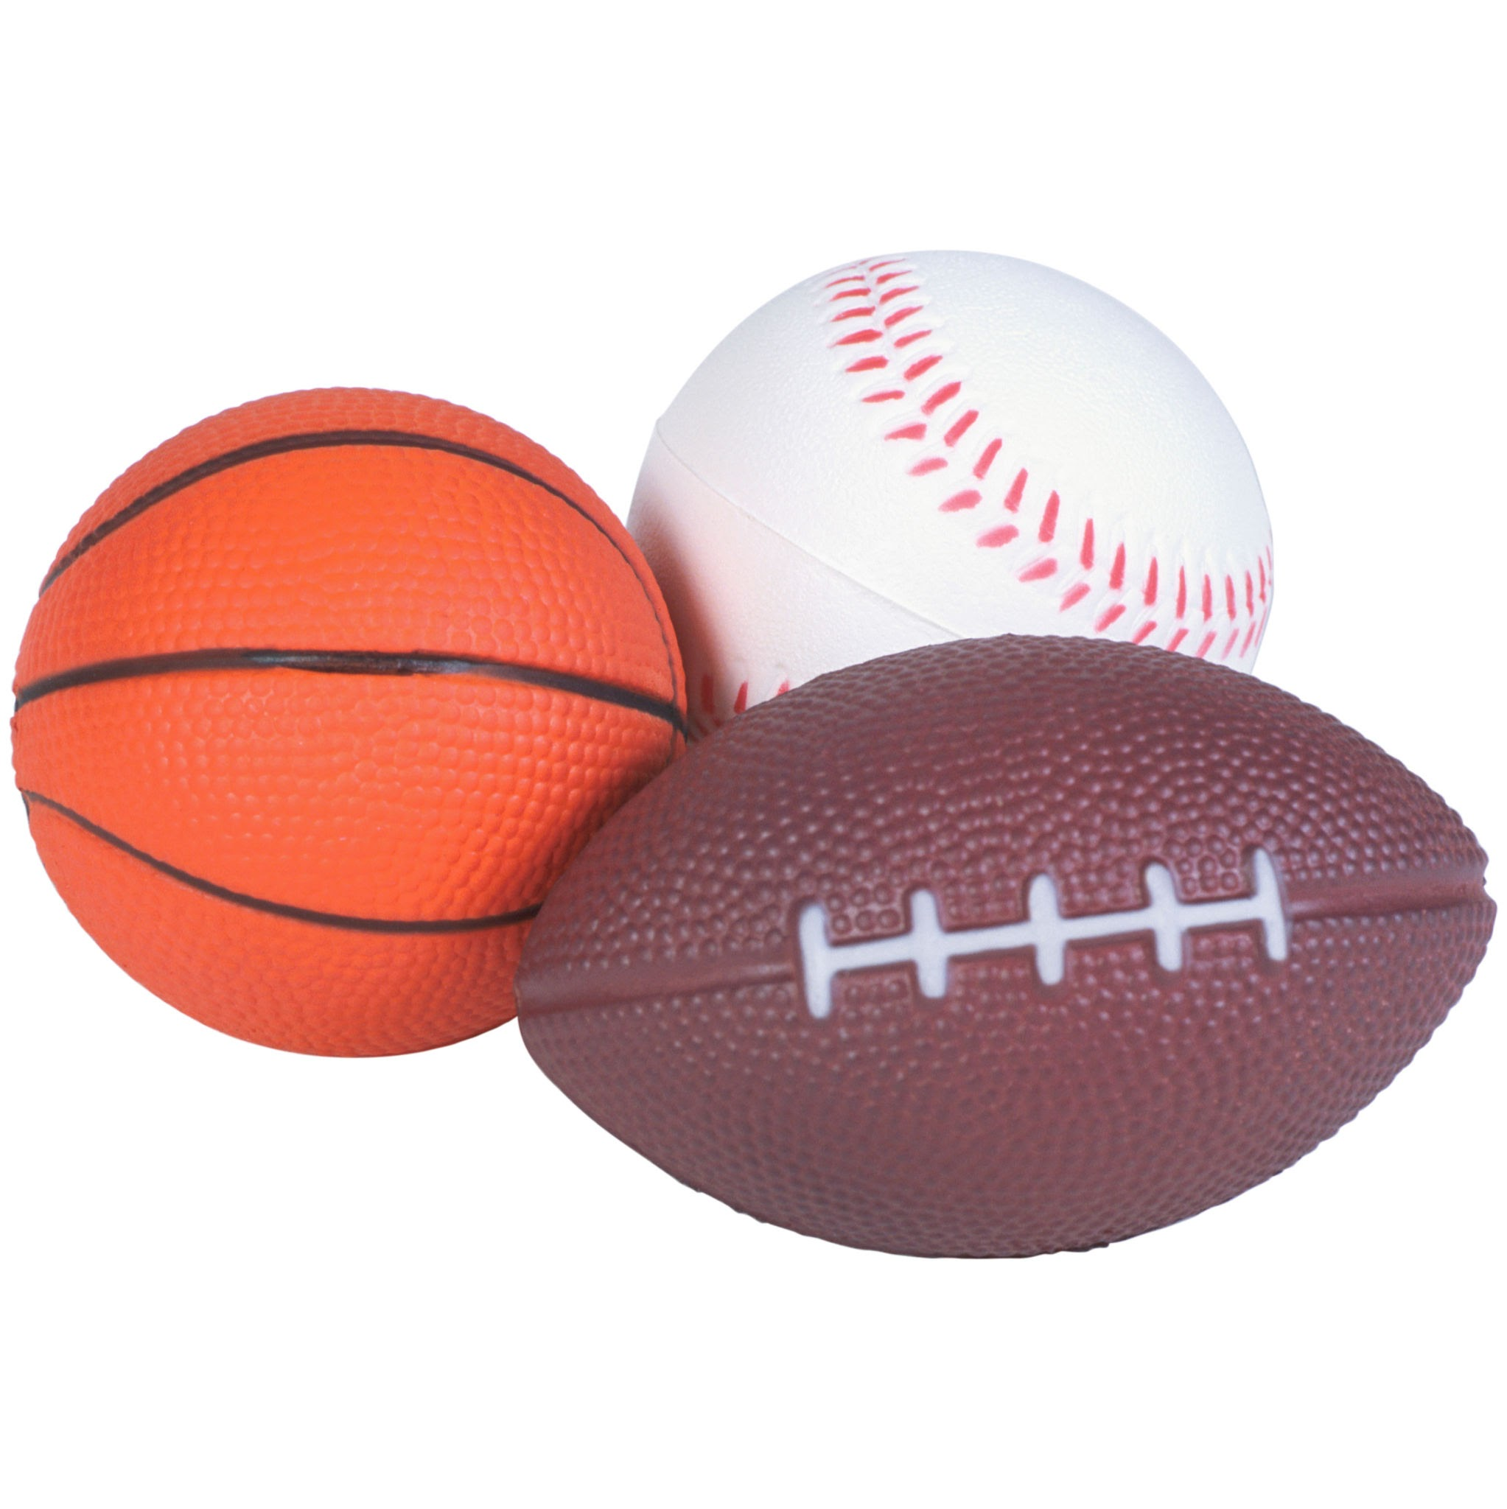
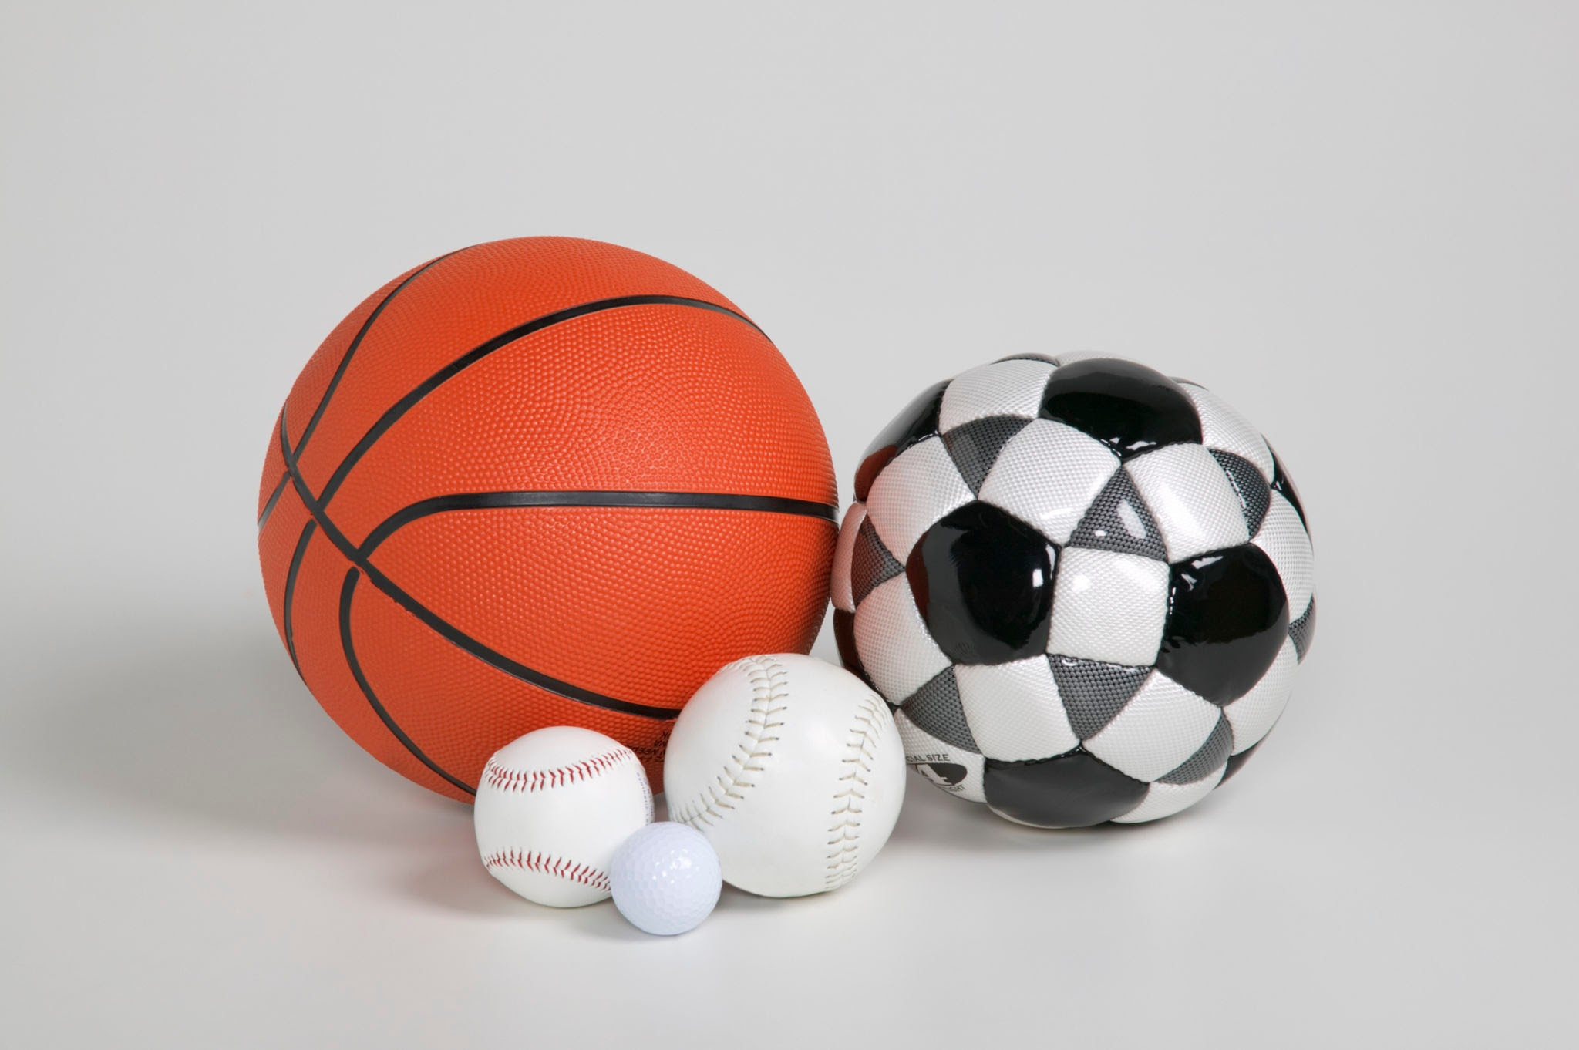
less than - fewer than

Slide 63


less than - fewer than

Slide 64
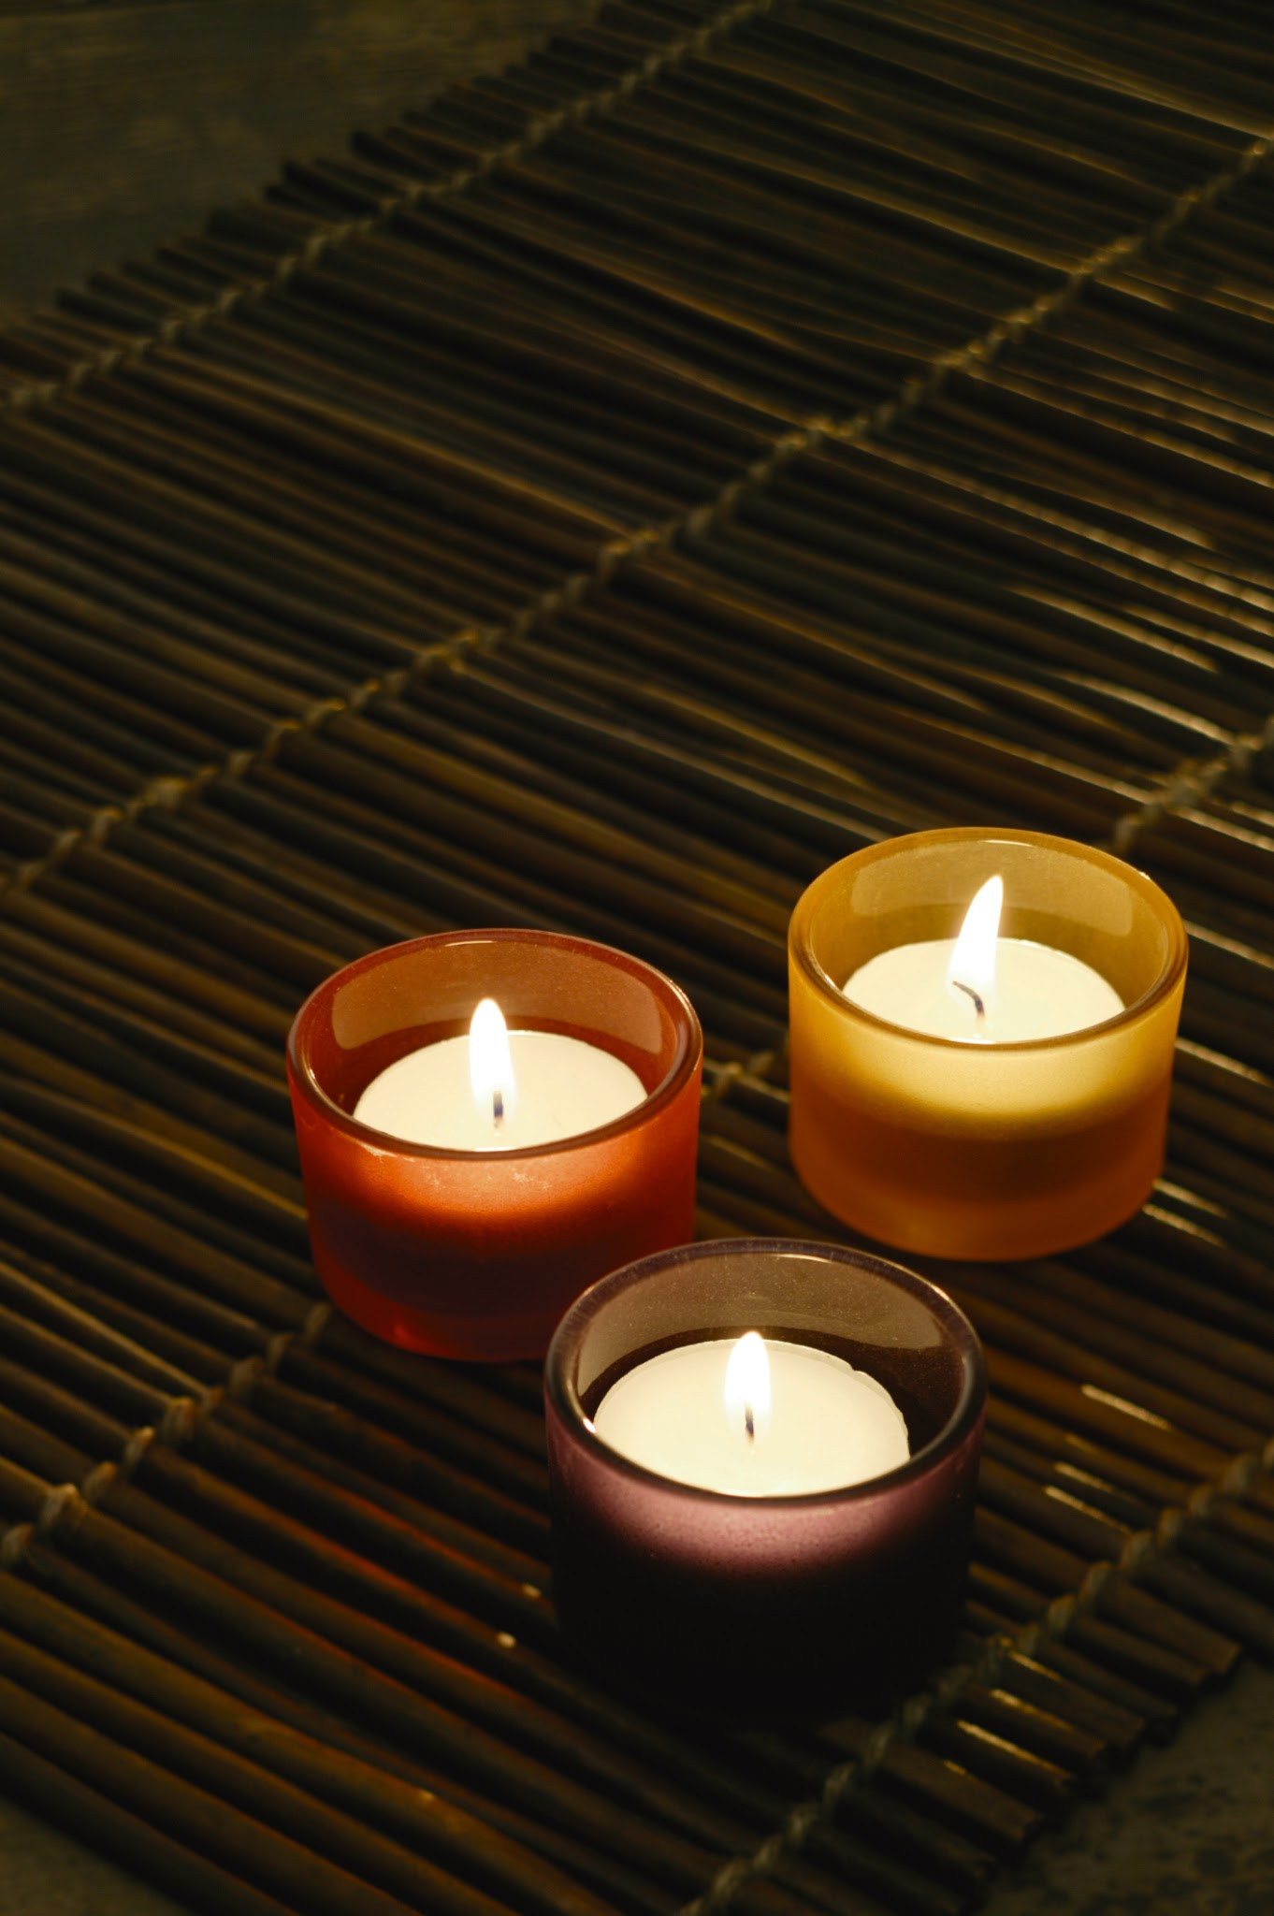
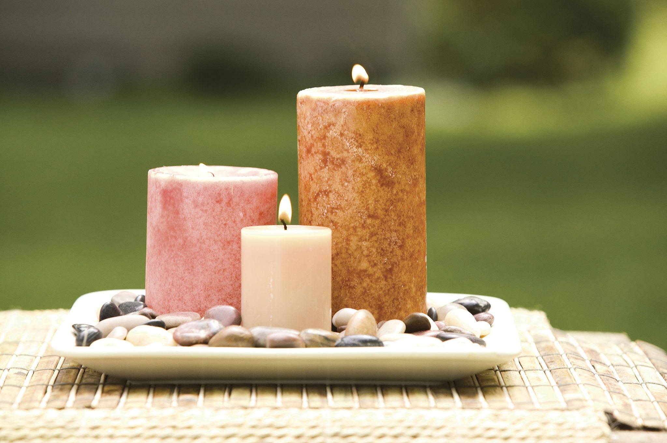
the same amount as - an equal amount to

Slide 65

the same amount as - an equal amount to

