Slide 1
Let’s count

Slide 2

Let’s count

Slide 3
Let’s count

Slide 4
Let’s count

Slide 5
Let’s count

Slide 6
Let’s count

Slide 7
Let’s count

Slide 8
Let’s count

Slide 9
Let’s count

Slide 10
Let’s count

Slide 11
Let’s count

Slide 12
Let’s count

Slide 13
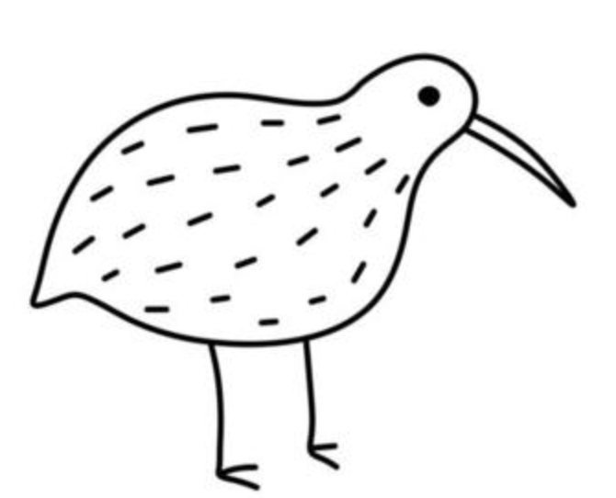
Let’s count

Slide 14
Let’s count

Slide 15
Let’s count

Slide 16
Let’s count

Slide 17
Let’s count

Slide 18
Let’s count

Slide 19
Let’s count

Slide 20
Let’s count

Slide 21
Let’s count

Slide 22
Let’s count

Slide 23
Let’s count from here

Slide 28

Let’s count from here

Slide 34
How many?

Slide 35
How many?

Slide 36
How many?

Slide 37
How many?

Slide 38
How many?

Slide 39
How many?

Slide 40
How many?

Slide 41
1

Slide 42
1
2

Slide 43
1
2
3

Slide 44
1
2
3
4

Slide 45
1
2
3
5
4

Slide 46
There are 6
1
2
3
5
6
4

Slide 47

How many?

Slide 48
1
x

Slide 49
2
x
x

Slide 50
3
x
x
x

Slide 51
4
x
x
x
x

Slide 52
5
x
x
x
x
x

Slide 53
6
x
x
x
x
x
x

Slide 54
7
x
x
x
x
x
x
x

Slide 55
There are 7
x
x
x
x
x
x
x

Slide 56
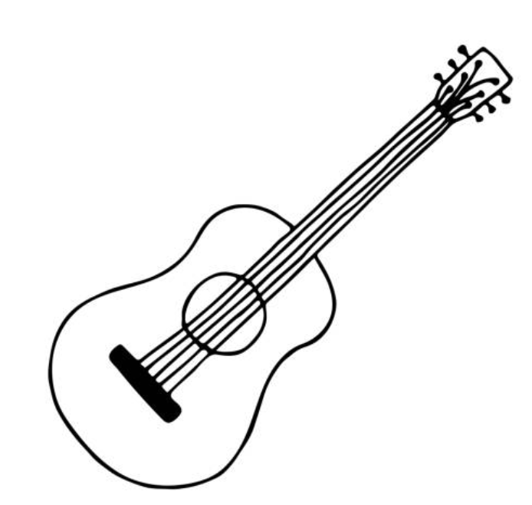
How many?

Slide 57

1

Slide 58
2

Slide 59
3

Slide 60
4

Slide 61
5

Slide 62
6

Slide 63
7

Slide 64
8

Slide 65
9

Slide 66
There are 9

Slide 67

Practice

Slide 68
Practice

Slide 69
Practice

Slide 70
Practice

Slide 71
Practice

