Slide 1
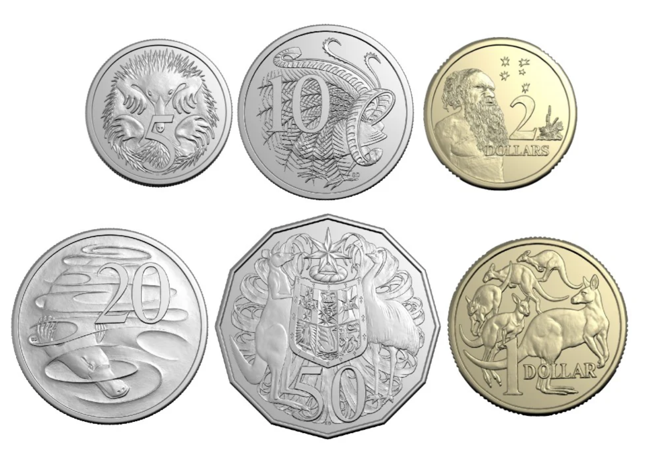
What coin is this?

Slide 2
What coin is this?
1 dollar

Slide 3
What coin is this?
1 dollar
$1

Slide 4
What picture is on this coin?

Slide 5
What picture is on this coin?
5 kangaroos

Slide 6
What coin is this?

Slide 7
What coin is this?
2 dollars

Slide 8
What coin is this?
2 dollars
$2

Slide 9
What picture is on this coin?

Slide 10
What picture is on this coin?
Gwoya Tjungurrayi

Slide 11
Worth the most

Slide 12
Worth the most

Slide 13
Worth the most

Slide 14
Worth the most

Slide 15
Worth the most

Slide 16
Worth the most

Slide 17
Worth the most
Worth the least

Slide 18
Which is worth more?

Slide 19
Which is worth more?

Slide 20
Which is worth more?

Slide 21
Which is worth less?

Slide 22
Which is worth less?

Slide 23
Which is worth less?

Slide 24
Which is worth less?

