Slide 1
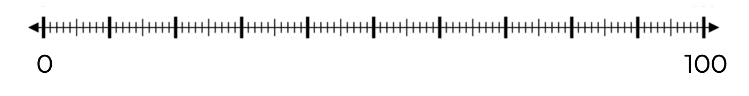
Number line

Slide 2
Number line
Starts at 0

Slide 3
Number line
Ends at 100

Slide 4
Number line
What are the different types of marks?

Slide 5
Number line
Very dark and longer

Slide 6
Number line
A bit longer

Slide 7
Number line
Lots of small ones in between these

Slide 8
Number line
Each of the marks is a jump of one

Slide 9
1
Each of the marks is a jump of one

Slide 10
2

Slide 11
3

Slide 12
4

Slide 13
5

Slide 14
6

Slide 15
7

Slide 16
8

Slide 17
9

Slide 18
10
When we jump ten we reach the first dark mark

Slide 19
10
When we jump ten we reach the first dark mark

Slide 20
Number line
10
Ten more is the next dark mark

Slide 21
Number line
10
20
Ten more is the next dark mark

Slide 22
Number line
10
20
What is this longer mark?

Slide 23
Number line
5
10
20

Slide 24
Number line
5
10
20
What about the same mark here?

Slide 25
Number line
5
10
15
20

Slide 26
Number line
5
10
15
20

