Slide 1
We have learnt to count to 30

Slide 2
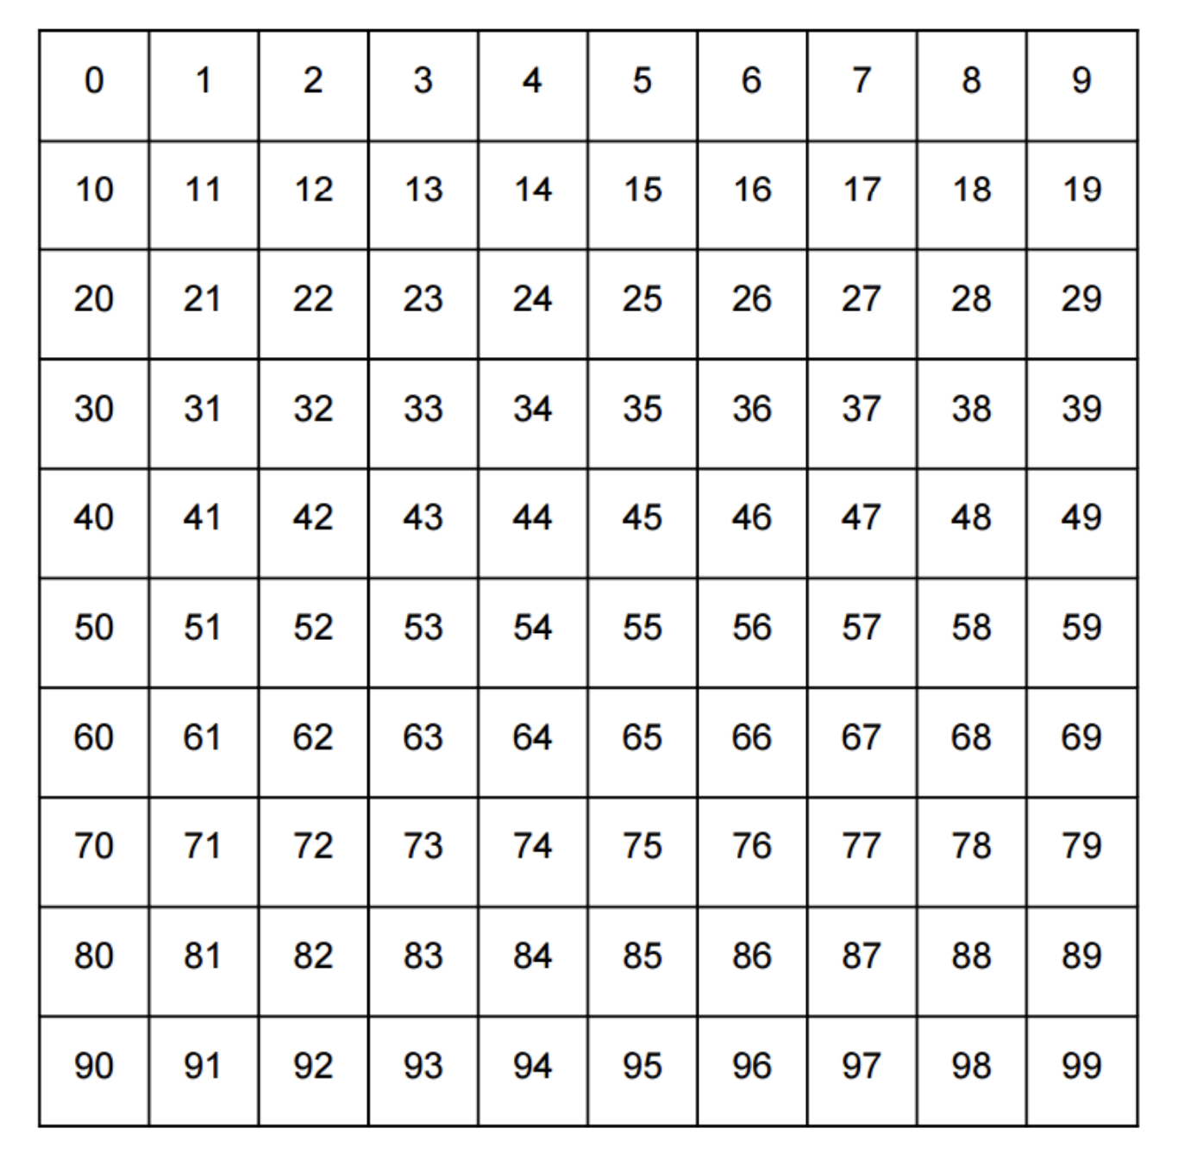

Slide 3
thirteen

Slide 4
thirteen
teen

Slide 6
fourteen

Slide 7
fourteen
teen

Slide 9
fifteen

Slide 10
fifteen
teen

Slide 12
sixteen

Slide 13
sixteen
teen

Slide 15
seventeen

Slide 16
seventeen
teen

Slide 18
eighteen

Slide 19
eighteen
teen

Slide 21
nineteen

Slide 22
nineteen
teen

Slide 24
twenty

Slide 25
twenty
ty

Slide 27
thirty

Slide 28
thirty
ty

Slide 30
forty

Slide 31
forty
ty

Slide 33
fifty

Slide 34
fifty
ty

Slide 36
sixty

Slide 37
sixty
ty

Slide 39
seventy

Slide 40
seventy
ty

Slide 42
eighty

Slide 43
eighty
ty

Slide 45
ninety

Slide 46
ninety
ty

Slide 47
teen or ty

Slide 49
fifty
ty

Slide 51
fifteen
teen

Slide 53
eighteen
teen

Slide 55
sixty
ty

Slide 57
fourteen
teen

Slide 59
twenty
ty

Slide 61
nineteen
teen

Slide 63
eighty
ty

Slide 65
seventeen
teen

Slide 67
seventy
ty

Slide 69
thirteen
teen

Slide 71
forty
ty

Slide 73
ninety
ty

Slide 75
sixteen
teen

Slide 77
thirty
ty

