Slide 1
Making the teen numbers
DIGITS

Slide 2

10 and 0 more

Slide 3
10 and 0 more
10

Slide 4
10 and 1 more

Slide 5
10 and 1 more
11

Slide 6
10 and 2 more

Slide 7
10 and 2 more
12

Slide 8
10 and 3 more

Slide 9
10 and 3 more
13

Slide 10
10 and 4 more

Slide 11
10 and 4 more
14

Slide 12
10 and 5 more

Slide 13
10 and 5 more
15

Slide 14
10 and 6 more

Slide 15
10 and 6 more
16

Slide 16
10 and 7 more

Slide 17
10 and 7 more
17

Slide 18
10 and 8 more

Slide 19
10 and 8 more
18

Slide 20
10 and 9 more

Slide 21
10 and 9 more
19

Slide 22
10 and 10 more

Slide 23
10 and 10 more
20

Slide 24
Making the teen numbers
DIGITS

Slide 25
10 and 0 more

Slide 26
10 and 0 more
ten

Slide 27
10 and 1 more

Slide 28
10 and 1 more
eleven

Slide 29
10 and 2 more

Slide 30
10 and 2 more
twelve

Slide 31
10 and 3 more

Slide 32
10 and 3 more
thir

Slide 33
10 and 3 more
thirteen

Slide 34
10 and 4 more

Slide 35
10 and 4 more
four

Slide 36
10 and 4 more
fourteen

Slide 37
10 and 5 more

Slide 38
10 and 5 more
fif

Slide 39
10 and 5 more
fifteen

Slide 40
10 and 6 more

Slide 41
10 and 6 more
six

Slide 42
10 and 6 more
sixteen

Slide 43
10 and 7 more

Slide 44
10 and 7 more
seven

Slide 45
10 and 7 more
seventeen

Slide 46
10 and 8 more

Slide 47
10 and 8 more
eigh

Slide 48
10 and 8 more
eighteen

Slide 49
10 and 9 more

Slide 50
10 and 9 more
nine

Slide 51
10 and 9 more
nineteen

Slide 52
10 and 10 more

Slide 53
10 and 10 more
twenty

Slide 54
10 and 7 more

Slide 55
10 and 7 more
seven

Slide 56
10 and 7 more
seventeen

Slide 57
10 and 3 more

Slide 58
10 and 3 more
thir

Slide 59
10 and 3 more
thirteen

Slide 60
10 and 8 more

Slide 61
10 and 8 more
eigh

Slide 62
10 and 8 more
eighteen

Slide 63
10 and 5 more

Slide 64
10 and 5 more
fif

Slide 65
10 and 5 more
fifteen

Slide 66
10 and 4 more

Slide 67
10 and 4 more
four

Slide 68
10 and 4 more
fourteen

Slide 69
10 and 2 more

Slide 70
10 and 2 more
twelve

Slide 71
10 and 0 more

Slide 72
10 and 0 more
ten

Slide 73
10 and 6 more

Slide 74
10 and 6 more
six

Slide 75
10 and 6 more
sixteen

Slide 76
10 and 9 more

Slide 77
10 and 9 more
nine

Slide 78
10 and 9 more
nineteen

Slide 79
10 and 1 more

Slide 80
10 and 1 more
eleven

Slide 81
10 and 10 more

Slide 82
10 and 10 more
twenty

Slide 83
teen numbers
other numbers
Spelling the teen numbers

Slide 84
teen numbers
other numbers
eleven

Slide 85
teen numbers
other numbers
eleven
twelve

Slide 86
teen numbers
thirteen
other numbers
eleven
twelve

Slide 87
teen numbers
thirteen
fourteen
other numbers
eleven
twelve

Slide 88
teen numbers
thirteen
fourteen
fifteen
other numbers
eleven
twelve

Slide 89
teen numbers
thirteen
fourteen
fifteen
sixteen
other numbers
eleven
twelve

Slide 90
teen numbers
thirteen
fourteen
fifteen
sixteen
seventeen
other numbers
eleven
twelve

Slide 91
teen numbers
thirteen
fourteen
fifteen
sixteen
seventeen
eighteen
other numbers
eleven
twelve

Slide 92
teen numbers
thirteen
fourteen
fifteen
sixteen
seventeen
eighteen
nineteen
other numbers
eleven
twelve

Slide 93
teen numbers
thirteen
fourteen
fifteen
sixteen
seventeen
eighteen
nineteen
other numbers
eleven
twelve
twenty

Slide 94
Numbers that follow an easy pattern

Slide 95
teen numbers
thirteen
fourteen
fifteen
sixteen
seventeen
eighteen
nineteen
other numbers
eleven
twelve
twenty

Slide 96
teen numbers
thirteen
fourteen
fifteen
sixteen
seventeen
eighteen
nineteen
other numbers
eleven
twelve
twenty

Slide 97
teen numbers
thirteen
fourteen
fifteen
sixteen
seventeen
eighteen
nineteen
other numbers
eleven
twelve
twenty

Slide 98
Numbers to practice and memorise

Slide 99
teen numbers
thirteen
fourteen
fifteen
sixteen
seventeen
eighteen
nineteen
other numbers
eleven
twelve
twenty

Slide 100
teen numbers
thirteen
fourteen
fifteen
sixteen
seventeen
eighteen
nineteen
other numbers
eleven
twelve
twenty

Slide 101
teen numbers
thirteen
fourteen
fifteen
sixteen
seventeen
eighteen
nineteen
other numbers
eleven no tricks!
twelve
twenty

Slide 102
teen numbers
thirteen
fourteen
fifteen
sixteen
seventeen
eighteen
nineteen
other numbers
eleven
twelve ten and two more
twenty

Slide 103
teen numbers
thirteen
fourteen
fifteen
sixteen
seventeen
eighteen
nineteen
other numbers
eleven
twelve
twenty two tens

Slide 104
teen numbers
thirteen
fourteen
fifteen
sixteen
seventeen
eighteen
nineteen
other numbers
eleven
twelve
twenty

Slide 105
teen numbers
thirteen three
fourteen
fifteen
sixteen
seventeen
eighteen
nineteen
other numbers
eleven
twelve
twenty

Slide 106
teen numbers
thirteen
fourteen
fifteen five
sixteen
seventeen
eighteen
nineteen
other numbers
eleven
twelve
twenty

Slide 107
teen numbers
thirteen
fourteen
fifteen
sixteen
seventeen
eighteen eight
nineteen
other numbers
eleven
twelve
twenty

Slide 108
teen numbers
thirteen
fourteen
fifteen
sixteen
seventeen
eighteen
nineteen
other numbers
eleven
twelve
twenty

Slide 109
teen numbers
thirteen
fourteen
fifteen
sixteen
seventeen
eighteen
nineteen
other numbers
eleven
twelve
twenty

Slide 110
How many fingers?

Slide 111
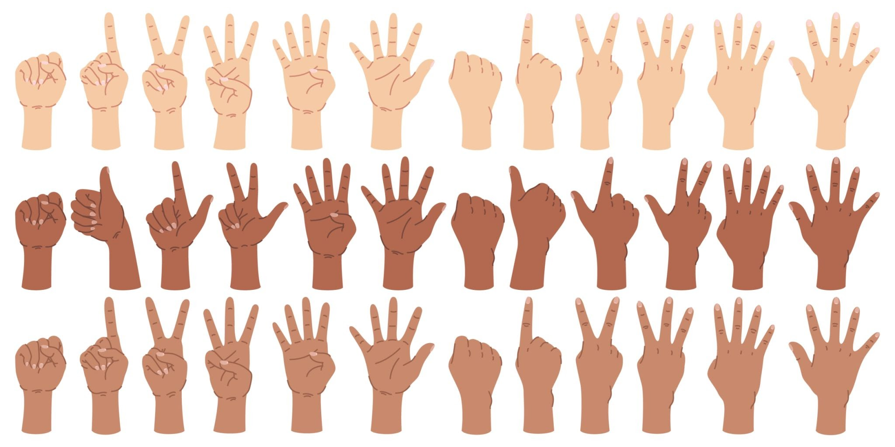
0
zero

Slide 112
1
one

Slide 113
2
two

Slide 114
3
three

Slide 115
4
four

Slide 116
5
five

Slide 117
6
six

Slide 118
7
seven

Slide 119
8
eight

Slide 120
9
nine

Slide 121
10
ten

Slide 122
11
eleven

Slide 123
12
twelve

Slide 124
13
thirteen

Slide 125
14
fourteen

Slide 126
15
fifteen

Slide 127
16
sixteen

Slide 128
17
seventeen

Slide 129
18
eighteen

Slide 130
19
nineteen

Slide 131
20
twenty

Slide 132
How many plants?

Slide 133

How many plants?
10

Slide 134
11

Slide 135
12

Slide 136
13

Slide 137
14

Slide 138
15

Slide 139
16

Slide 140
17

Slide 141
18

Slide 142
19

Slide 143
20

Slide 144
How many plants?

Slide 145
How many plants?
ten

Slide 146
eleven

Slide 147
twelve

Slide 148
thirteen

Slide 149
fourteen

Slide 150
fifteen

Slide 151
sixteen

Slide 152
seventeen

Slide 153
eighteen

Slide 154
nineteen

Slide 155
twenty

Slide 156
How many ants?

Slide 157
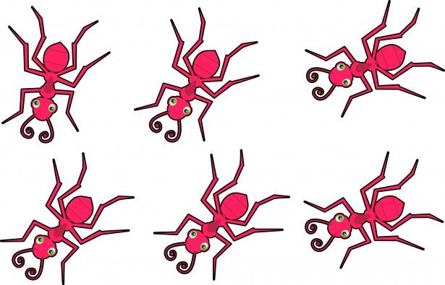
10

Slide 158
11

Slide 159
12

Slide 160
13

Slide 161
14

Slide 162
15

Slide 163
16

Slide 164
17

Slide 165
18

Slide 166
19

Slide 167
20

Slide 168
How many ants?

Slide 169
ten

Slide 170
eleven

Slide 171
twelve

Slide 172
thirteen

Slide 173
fourteen

Slide 174
fifteen

Slide 175
sixteen

Slide 176
seventeen

Slide 177
eighteen

Slide 178
nineteen

Slide 179
twenty

Slide 180
How many stars?

Slide 181
How many stars?

Slide 182
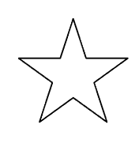
10 ten

Slide 183
11 eleven

Slide 184
12 twelve

Slide 185
13 thirteen

Slide 186
14 fourteen

Slide 187
15 fifteen

Slide 188
16 sixteen

Slide 189
17 seventeen

Slide 190
18 eighteen

Slide 191
19 nineteen

Slide 192
20 twenty

