Slide 1
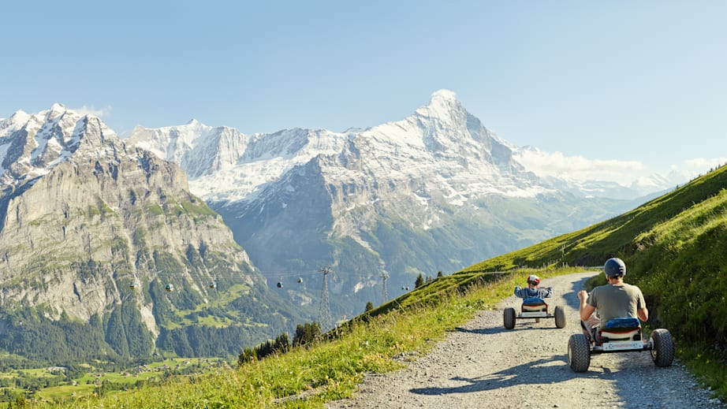
First position

Slide 2
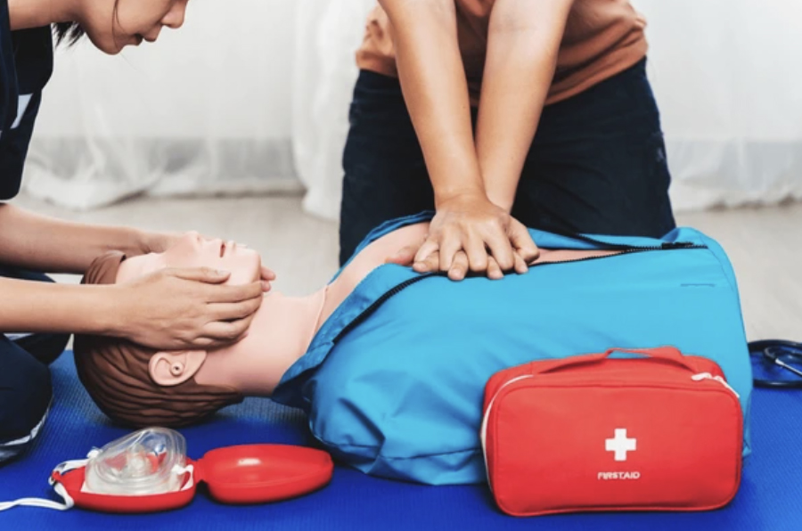
First aid

Slide 3
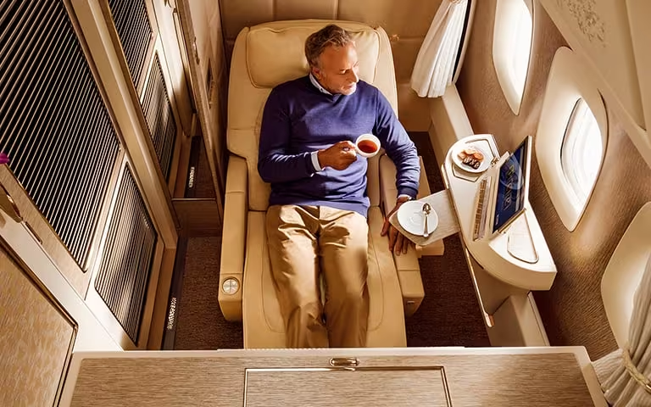
First class

Slide 4
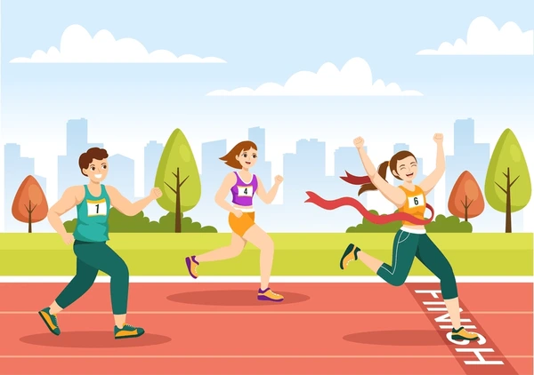
First place

Slide 5
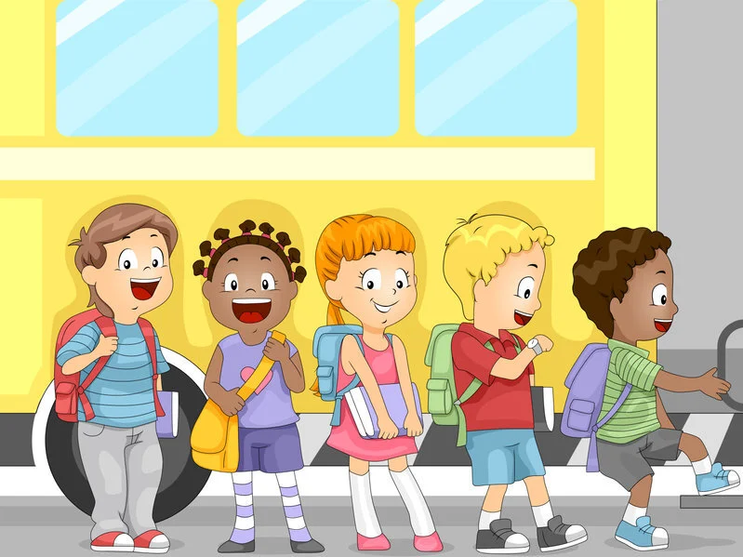
First in line

Slide 6
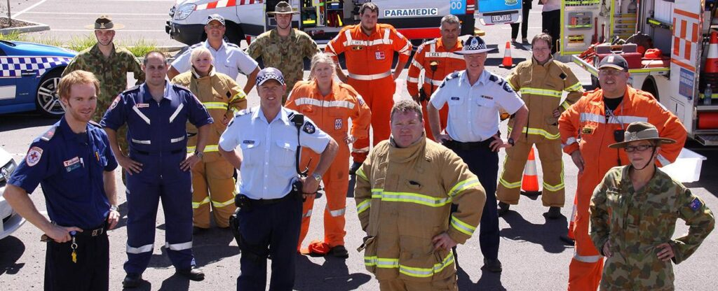
First responders

Slide 7
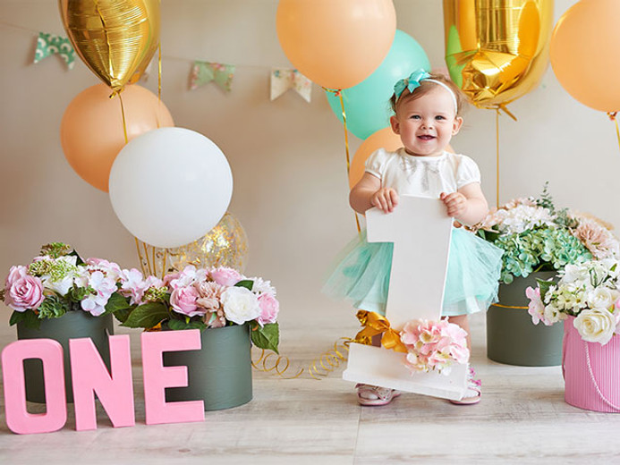
First birthday

Slide 8
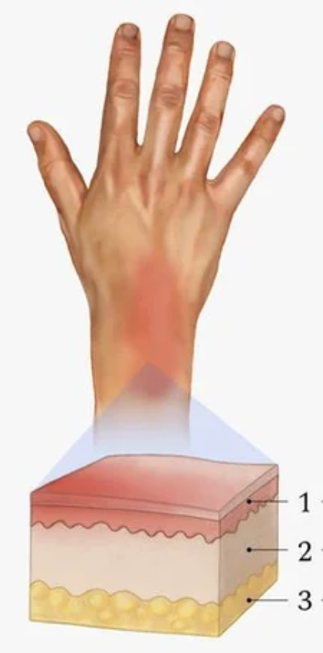
First degree burn

Slide 9
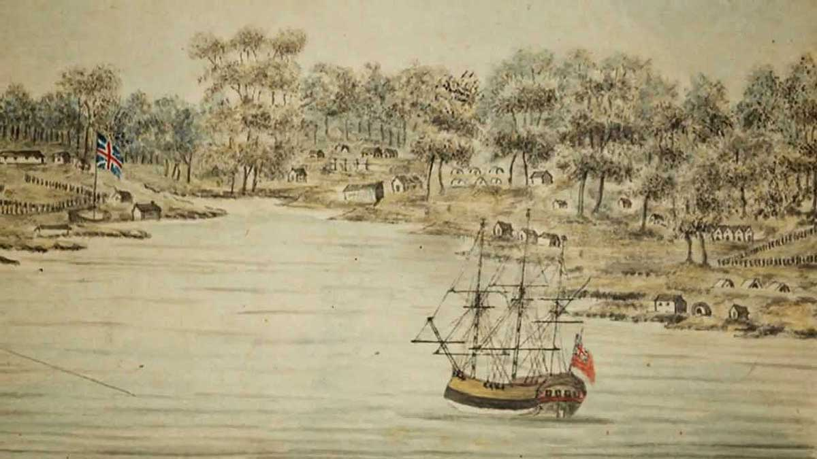
First Fleet

Slide 10
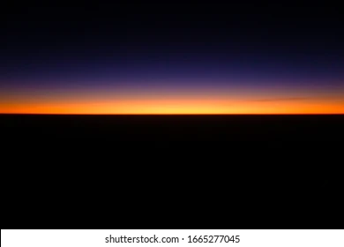
First light

Slide 11
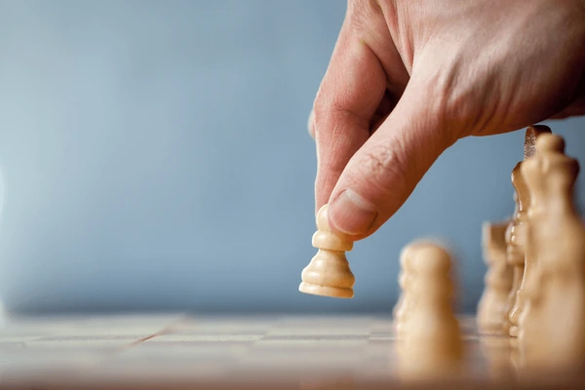
First move

Slide 12
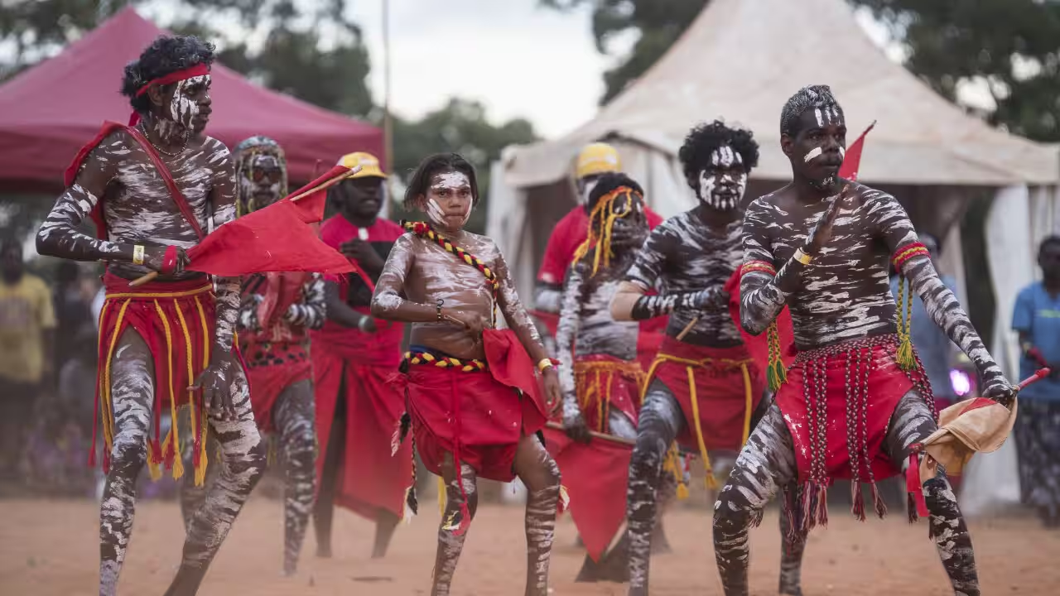
First Nation’s people

Slide 13
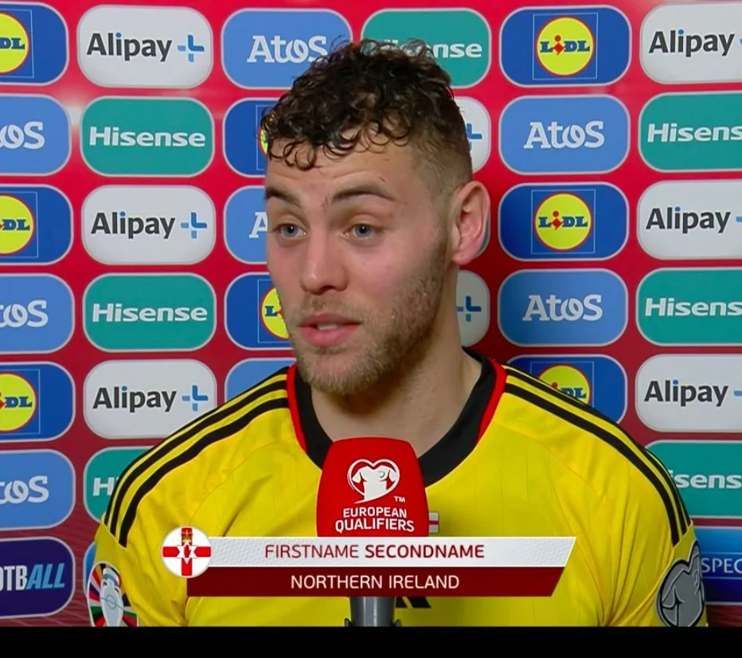
First name

Slide 14
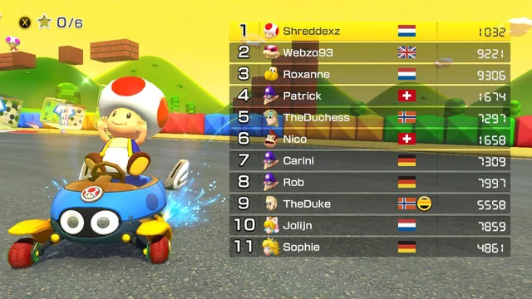
Who is first place?

Slide 15
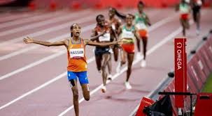
Who is in first place?

Slide 16
How do you know?

Slide 17
Who is the next person after first?

Slide 18
Second

Slide 19
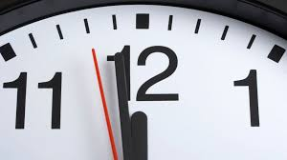
Not ‘second’

Slide 20
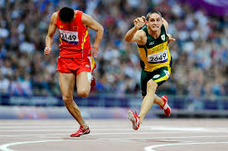
First Second

Slide 21

Second chance

Slide 22
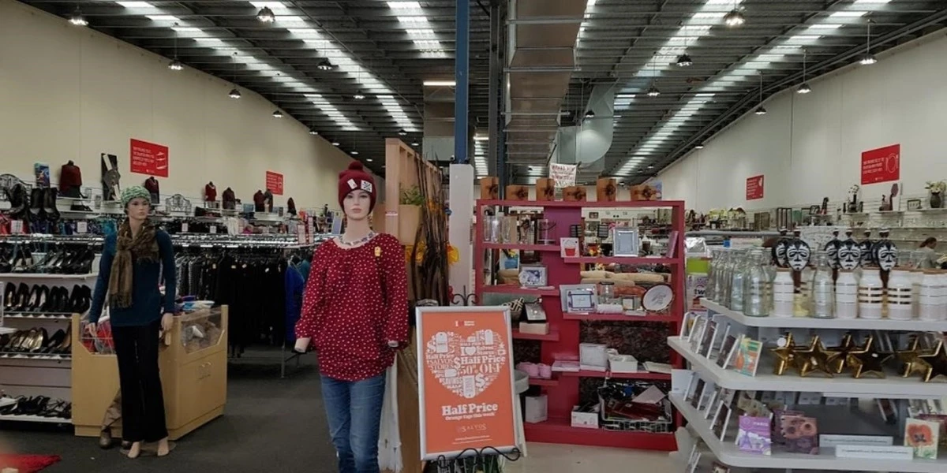
Second hand

Slide 23

Second opinion

Slide 24
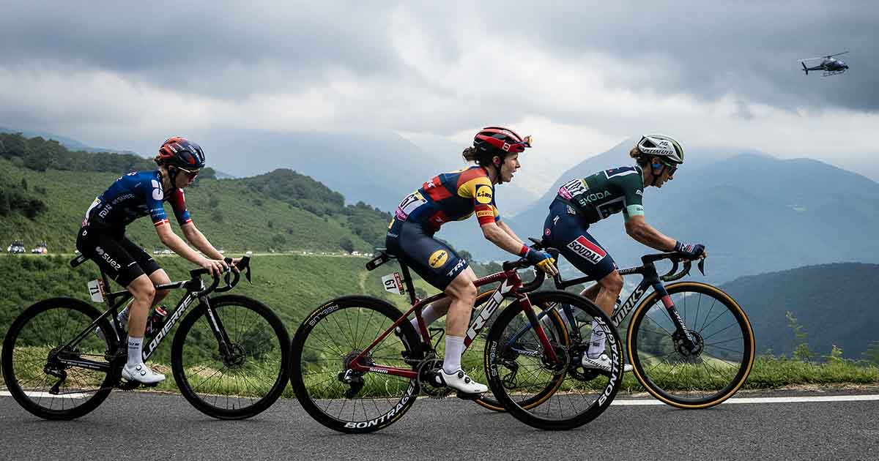
Second to none

Slide 25
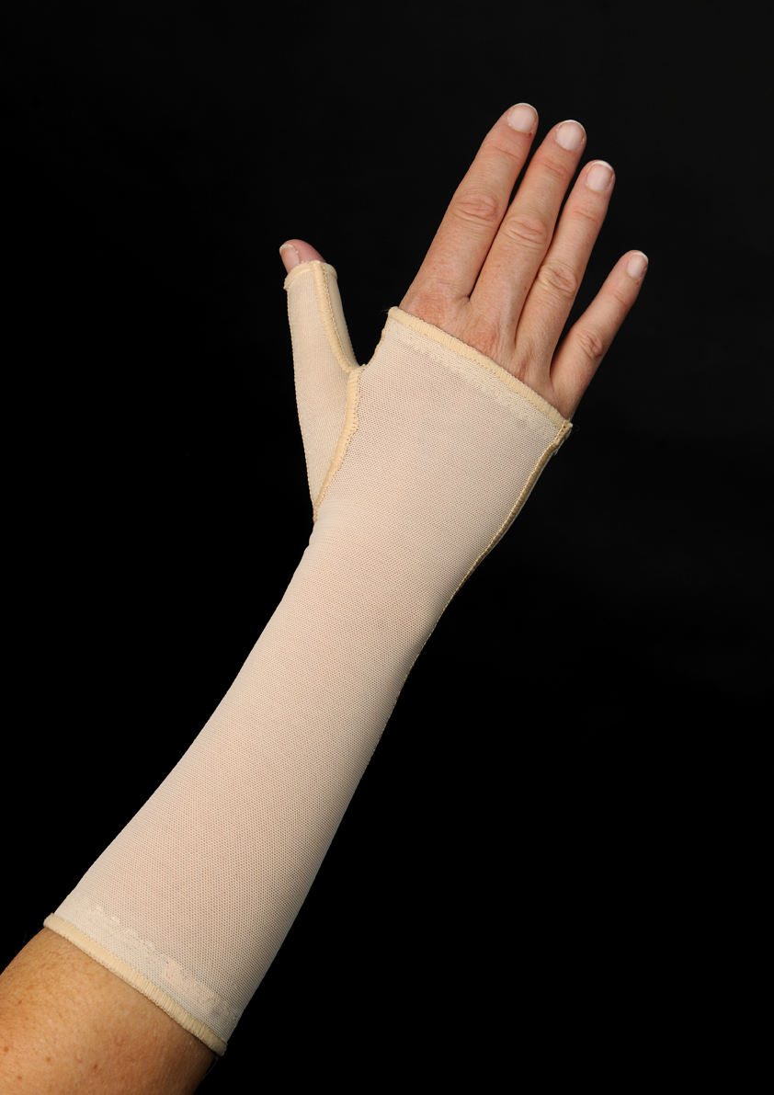
Second skin

Slide 26
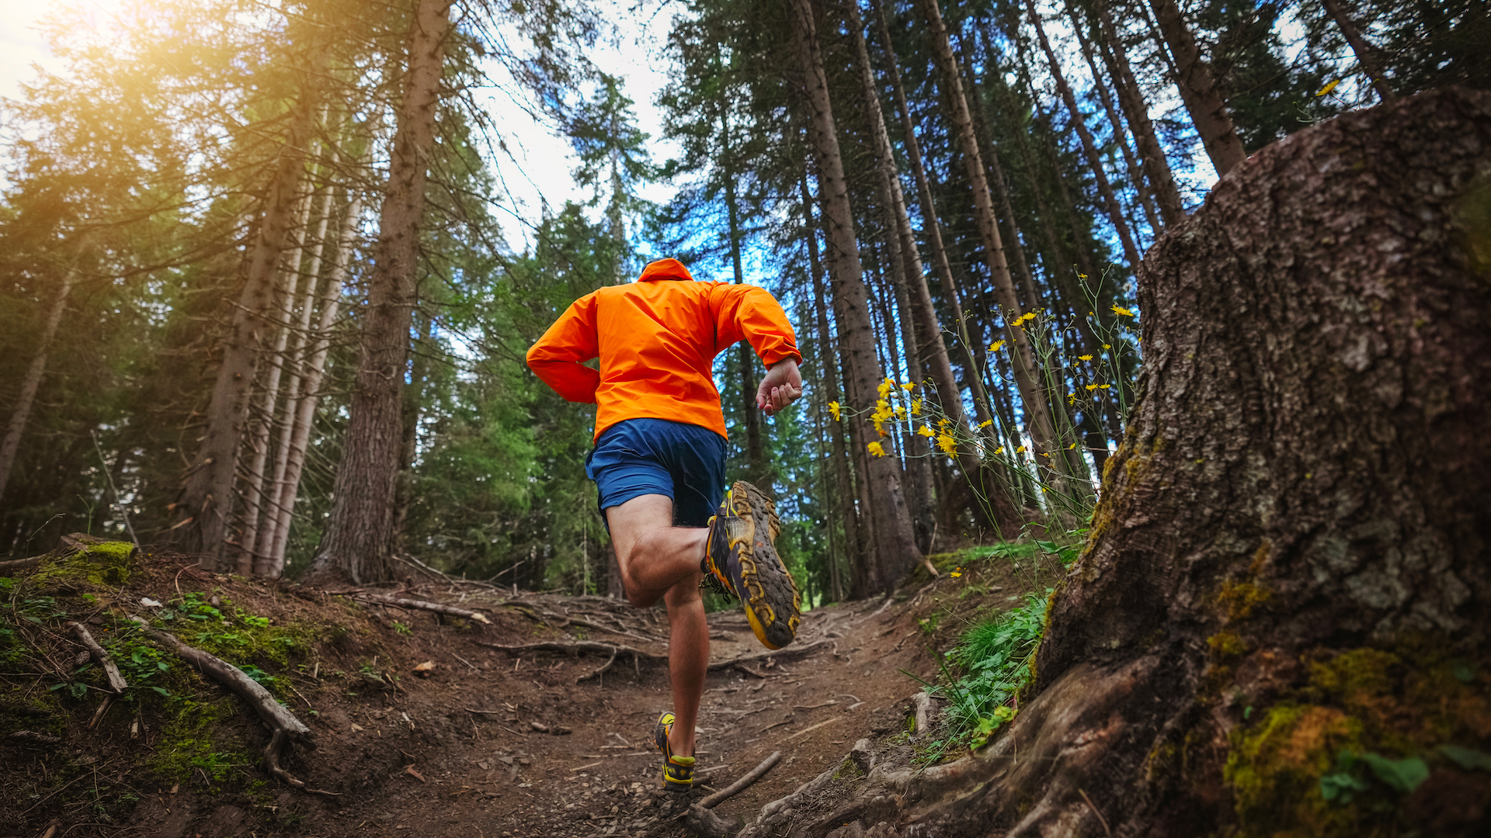
Second wind

Slide 27
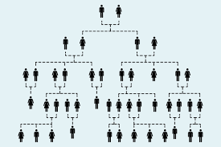
Second cousin

Slide 28
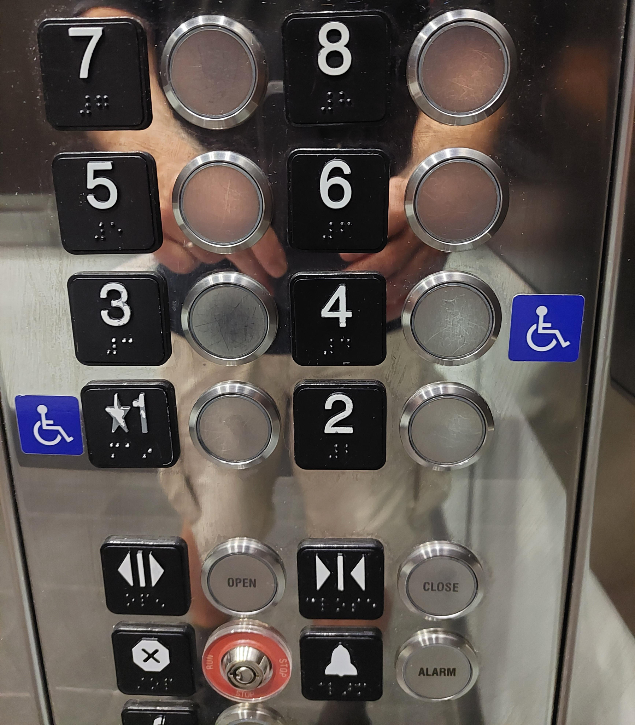
Second floor

Slide 29
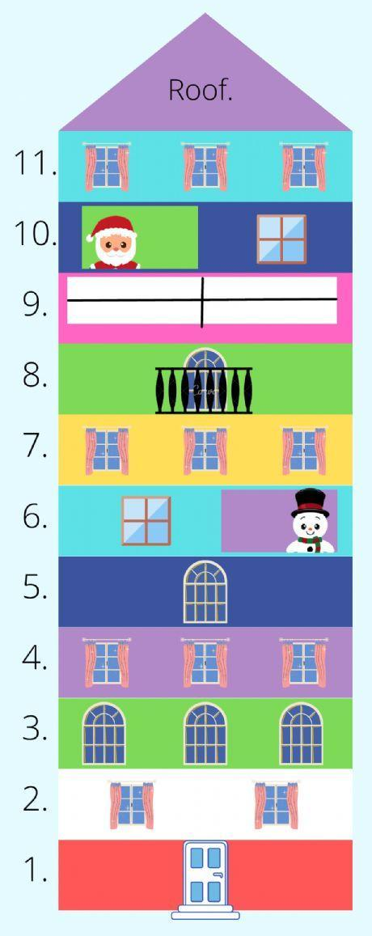
Second story

Slide 30
First
Second

Slide 31
First
Second
1
2

Slide 32
First
Second
1
2

Slide 33
First
Second
1st
2

Slide 34
First
Second
1st
2

Slide 35
First
Second
1st
2nd

Slide 36
First
Second
Third
1st
2nd

Slide 37
First
Second
Third
1st
2nd
3

Slide 38
First
Second
Third
1st
2nd
3

Slide 39
First
Second
Third
1st
2nd
3rd

Slide 40
First
Second
Third
1st
2nd
3rd

Slide 41
First
Second
Third
1st
2nd
3rd

Slide 42
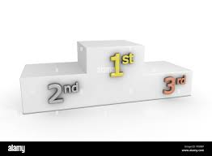
First
Second
Third
1st
2nd
3rd

Slide 43
First
Second
Third
1st
2nd
3rd
silver

Slide 44
First
Second
Third
1st
2nd
3rd
silver gold

Slide 45
First
Second
Third
1st
2nd
3rd
silver gold bronze

Slide 46

First
Second
Third
1st
2nd
3rd
silver gold bronze

Slide 47
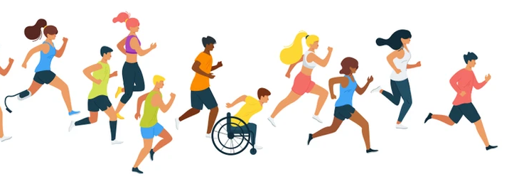
Where is the front?

Slide 48
Where is the front?

Slide 49
first

Slide 50
first

Slide 51
first

Slide 52
first
second

Slide 53
second
first

Slide 54
second
first

Slide 55
second
first
third

Slide 56
second
third
first

Slide 58
1st

Slide 59
1st

Slide 60
1st

Slide 61
1st
2nd

Slide 62
2nd
1st

Slide 63
2nd
1st

Slide 64
2nd
1st
3rd

Slide 65
2nd
1st
3rd

Slide 66
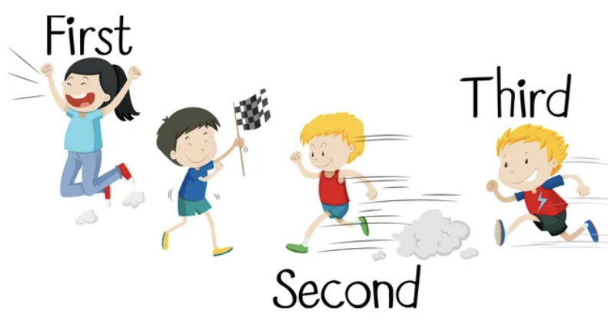

Slide 67
This boy is standing at the finish line

Slide 68
1st

Slide 69
1st
2nd

Slide 70
1st
3rd
2nd

