Slide 1
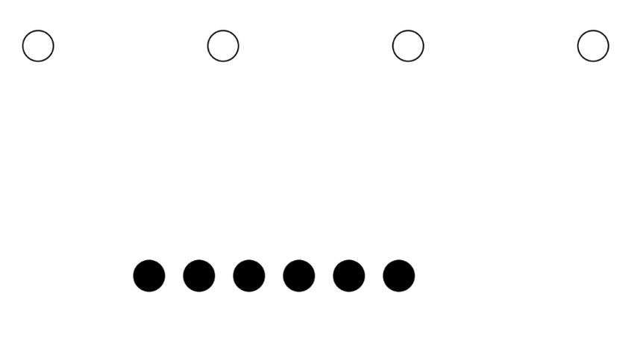
Let’s compare

Slide 2
Let’s compare

Slide 3
Let’s compare

Slide 4
Let’s compare

Slide 5
Let’s compare

Slide 6
There are more filled dots

Slide 7
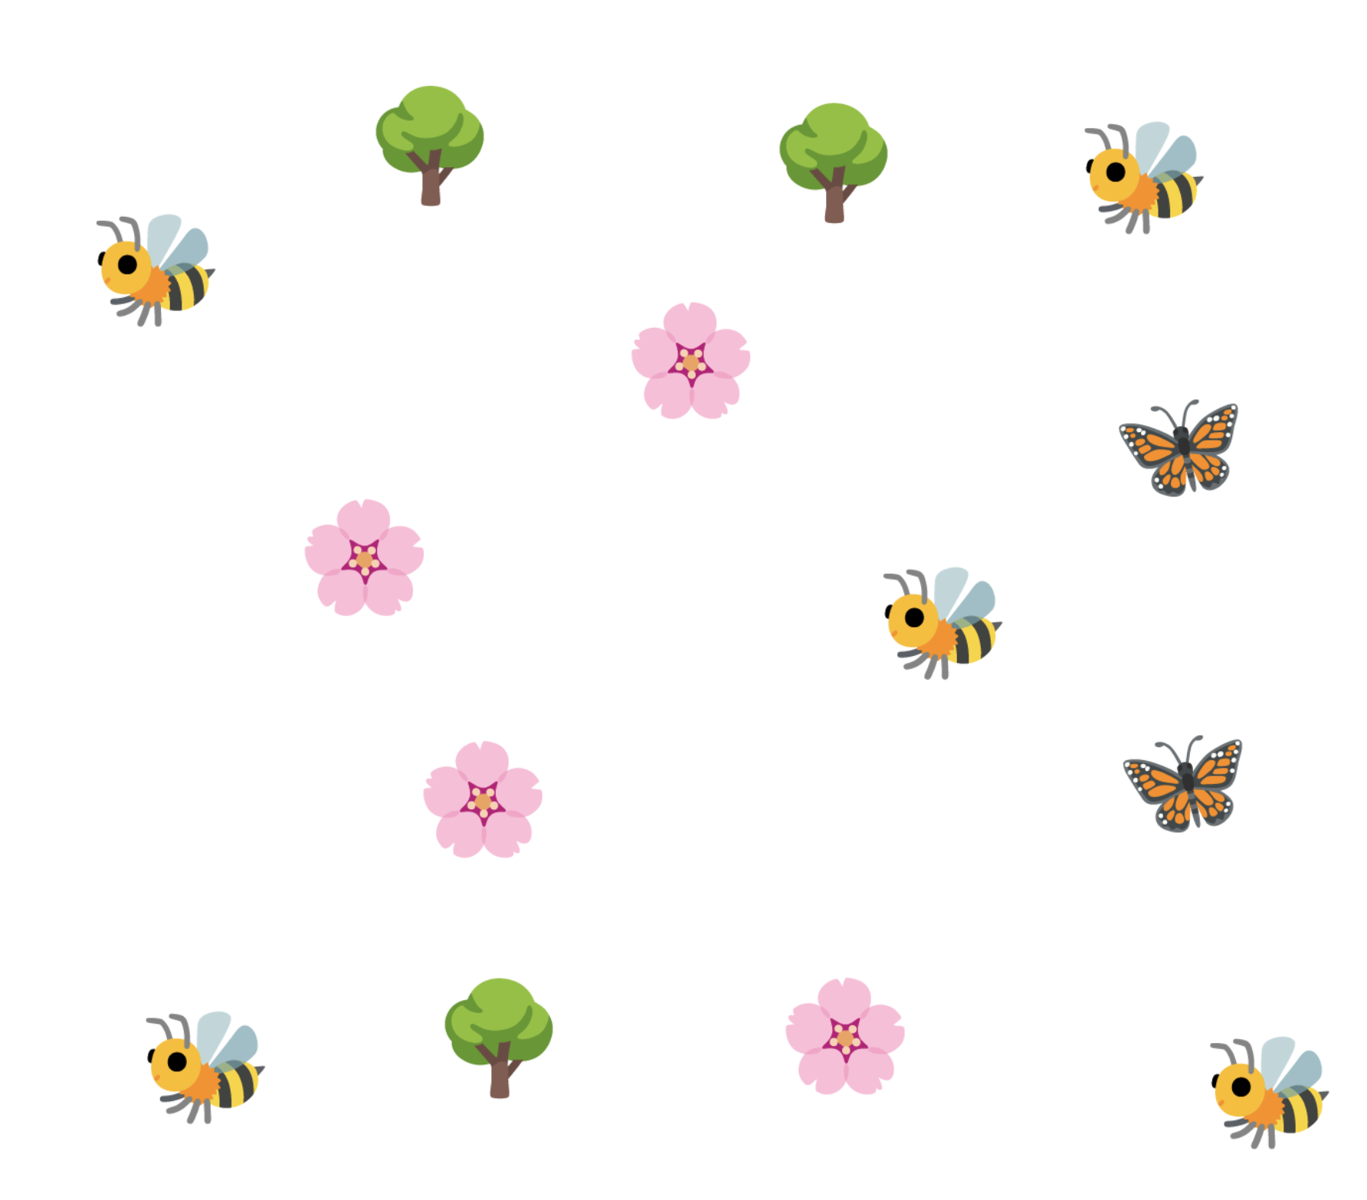
Let’s compare

Slide 8
Let’s compare

Slide 9
Let’s compare

Slide 10
Let’s compare

Slide 11
Let’s compare

Slide 12
Let’s compare

Slide 13
Let’s compare

Slide 14
Let’s compare

Slide 15
Which has more?

Slide 16
There are more butterflies

Slide 17
EXTEND: Let’s choose two objects to compare

Slide 18
Bee

Slide 19
Bee and tree

Slide 20
Bee and tree

Slide 21
Bee and tree

Slide 22
Bee and tree

Slide 23
Bee and tree

Slide 24
Bee is more than tree

