Slide 1
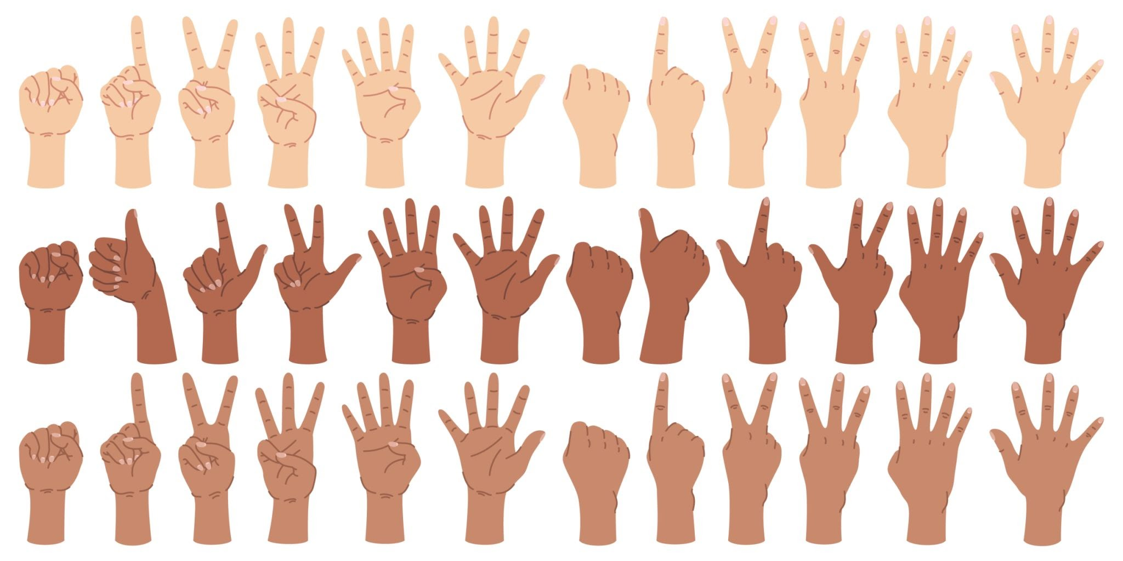
10
ten

Slide 2
9
nine

Slide 3
8
eight

Slide 4
7
seven

Slide 5
6
six

Slide 6
5
five

Slide 7
4
four

Slide 8
3
three

Slide 9
2
two

Slide 10
1
one

Slide 11
0
zero

Slide 12
How many flowers?

Slide 13
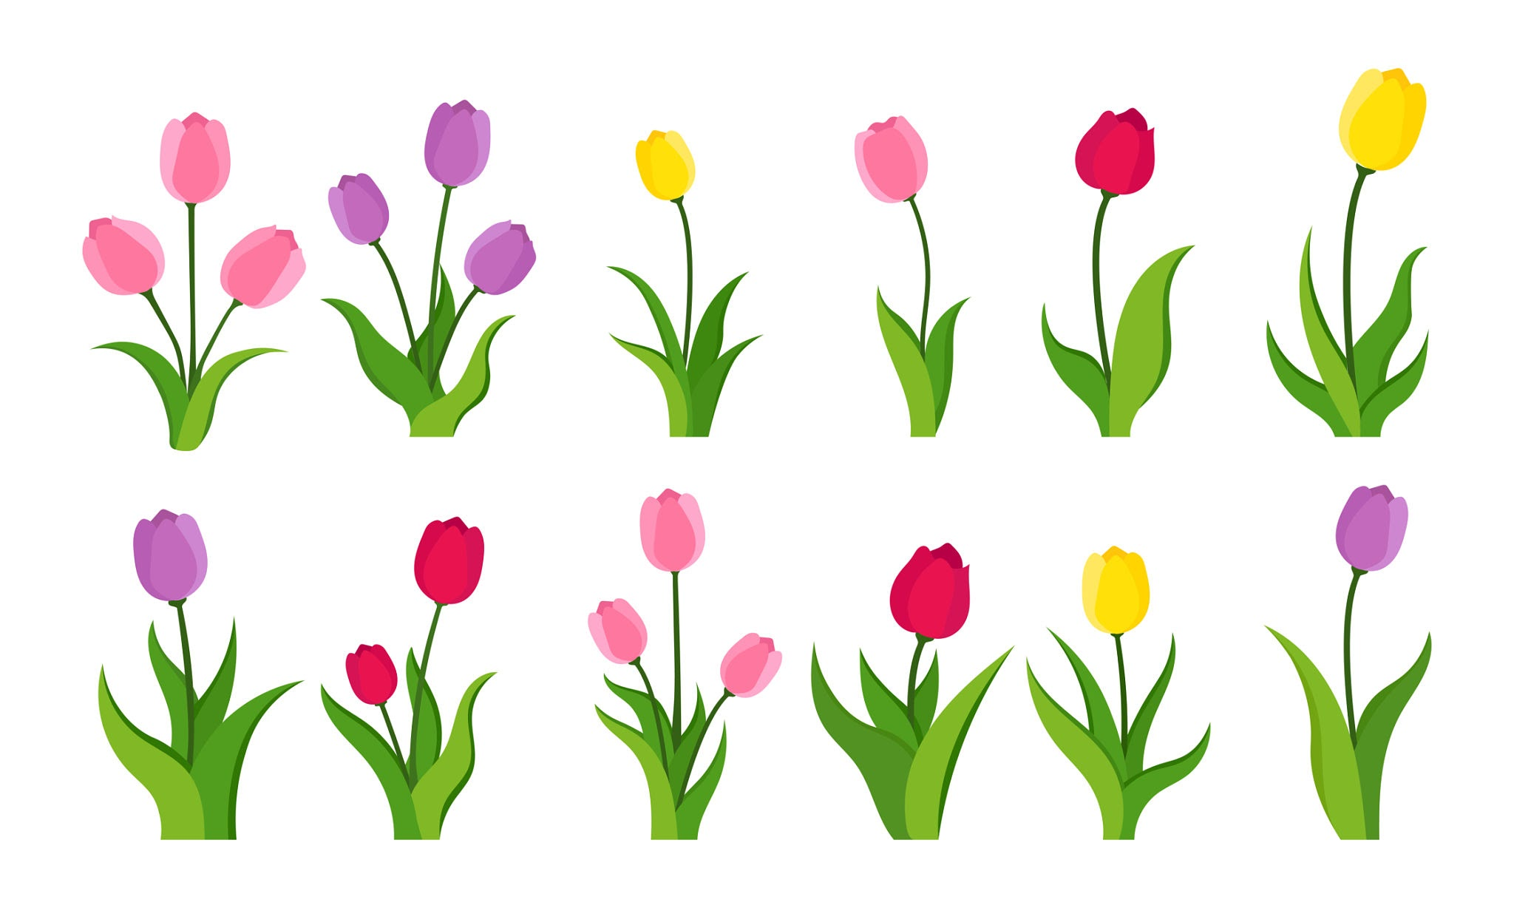
How many flowers?

Slide 14
10

Slide 15
9

Slide 16
8

Slide 17
7

Slide 18
6

Slide 19
5

Slide 20
4

Slide 21
3

Slide 22
2

Slide 23
1

Slide 24
0

Slide 25
How many ants?

Slide 26
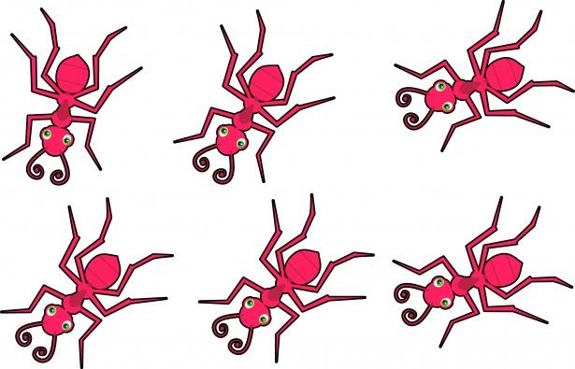
10

Slide 27
9

Slide 28
8

Slide 29
7

Slide 30
6

Slide 31
5

Slide 32
4

Slide 33
3

Slide 34
2

Slide 35
1

Slide 36
0

Slide 37
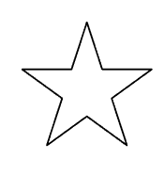

Slide 48
10

Slide 49
10 9

Slide 50
10 9 8

Slide 51
10 9 8 7

Slide 52
10 9 8 7 6

Slide 53
10 9 8 7 6 5

Slide 54
10 9 8 7 6 5 4

Slide 55
10 9 8 7 6 5 4 3

Slide 56
10 9 8 7 6 5 4 3 2

Slide 57
10 9 8 7 6 5 4 3 2 1

Slide 58
10 9 8 7 6 5 4 3 2 1 0

Slide 60
ten

Slide 61
ten
nine

Slide 62
ten
nine
eight

Slide 63
ten
nine
eight
seven

Slide 64
ten
nine
eight
seven
six

Slide 65
ten
nine
eight
seven
six
five

Slide 66
ten
nine
eight
seven
six
five
four

Slide 67
ten
nine
eight
seven
six
five
four
three

Slide 68
ten
nine
eight
seven
six
five
four
three
two

Slide 69
ten
nine
eight
seven
six
five
four
three
two
one

Slide 70
ten
nine
eight
seven
six
five
four
three
two
one
zero

