Slide 1
Grouping: Remainders

Slide 2

There are 7 basketballs

Slide 3
There are 7 basketballs
Share them into 2 groups

Slide 4
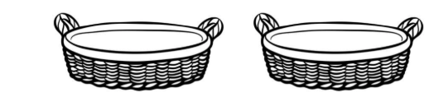
There are 7 basketballs
Share them into 2 groups

Slide 5
There are 7 basketballs
Share them into 2 groups

Slide 6
There are 7 basketballs
Share them into 2 groups

Slide 7
There are 7 basketballs
Share them into 2 groups

Slide 8
There are 7 basketballs
Share them into 2 groups

Slide 9
There are 7 basketballs
Share them into 2 groups

Slide 10
There are 7 basketballs
Share them into 2 groups

Slide 12
There are 3 in each group

Slide 13
There is 1 extra
There are 3 in each group

Slide 14
We call this a remainder
There are 3 in each group

Slide 15





Share the lollies equally between the children

Slide 16
Share the lollies equally between the children

Slide 17
Share the lollies equally between the children

Slide 18
Share the lollies equally between the children

Slide 19
Share the lollies equally between the children

Slide 20
Share the lollies equally between the children

Slide 21
Share the lollies equally between the children

Slide 22
Share the lollies equally between the children

Slide 23
Share the lollies equally between the children

Slide 24
There isn’t enough for everyone to have another

Slide 25
There are 4 groups of 2

Slide 26
There is a remainder of 2

