Slide 1
How many ants?

Slide 2
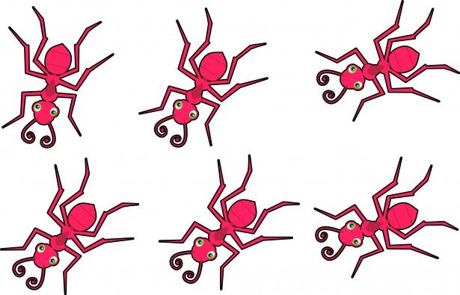
20

Slide 3
19

Slide 4
18

Slide 5
17

Slide 6
16

Slide 7
15

Slide 8
14

Slide 9
13

Slide 10
12

Slide 11
11

Slide 12
10

Slide 13
9

Slide 14
8

Slide 15
7

Slide 16
6

Slide 17
5

Slide 18
4

Slide 19
3

Slide 20
2

Slide 21
1

Slide 22
0

Slide 23
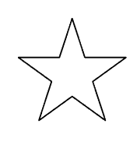

Slide 24
twenty

Slide 25
nineteen

Slide 26
eighteen

Slide 27
seventeen

Slide 28
sixteen

Slide 29
fifteen

Slide 30
fourteen

Slide 31
thirteen

Slide 32
twelve

Slide 33
eleven

Slide 34
ten

Slide 35
nine

Slide 36
eight

Slide 37
seven

Slide 38
six

Slide 39
five

Slide 40
four

Slide 41
three

Slide 42
two

Slide 43
one

Slide 44
zero

Slide 45
20

Slide 46
20 19

Slide 47
20 19 18

Slide 48
20 19 18 17

Slide 49
20 19 18 17 16

Slide 50
20 19 18 17 16 15

Slide 51
20 19 18 17 16 15 14

Slide 52
20 19 18 17 16 15 14 13

Slide 53
20 19 18 17 16 15 14 13 12

Slide 54
20 19 18 17 16 15 14 13 12 11

Slide 55
20 19 18 17 16 15 14 13 12 11
10

Slide 56
20 19 18 17 16 15 14 13 12 11
10 9

Slide 57
20 19 18 17 16 15 14 13 12 11
10 9 8

Slide 58
20 19 18 17 16 15 14 13 12 11
10 9 8 7

Slide 59
20 19 18 17 16 15 14 13 12 11
10 9 8 7 6

Slide 60
20 19 18 17 16 15 14 13 12 11
10 9 8 7 6 5

Slide 61
20 19 18 17 16 15 14 13 12 11
10 9 8 7 6 5 4

Slide 62
20 19 18 17 16 15 14 13 12 11
10 9 8 7 6 5 4 3

Slide 63
20 19 18 17 16 15 14 13 12 11
10 9 8 7 6 5 4 3 2

Slide 64
20 19 18 17 16 15 14 13 12 11
10 9 8 7 6 5 4 3 2 1

Slide 65
20 19 18 17 16 15 14 13 12 11
10 9 8 7 6 5 4 3 2 1 0

Slide 67
20 19 18 17 16 15 14 13 12 11 10 9 8 7 6 5 4 3 2 1 0

Slide 68
20 19 18 17 16 15 14 13 12 11 10 9 8 7 6 5 4 3 2 1 0

Slide 69
20 19 18 17 16 15 14 13 12 11 10 9 8 7 6 5 4 3 2 1 0

Slide 70
20 19 18 17 16 15 14 13 12 11 10 9 8 7 6 5 4 3 2 1 0

Slide 71
20 19 18 17 16 15 14 13 12 11 10 9 8 7 6 5 4 3 2 1 0

Slide 72
20 19 18 17 16 15 14 13 12 11 10 9 8 7 6 5 4 3 2 1 0

Slide 73
20 19 18 17 16 15 14 13 12 11 10 9 8 7 6 5 4 3 2 1 0

Slide 74
20 19 18 17 16 15 14 13 12 11 10 9 8 7 6 5 4 3 2 1 0

Slide 75
20 19 18 17 16 15 14 13 12 11 10 9 8 7 6 5 4 3 2 1 0

Slide 76
20 19 18 17 16 15 14 13 12 11 10 9 8 7 6 5 4 3 2 1 0

Slide 77
20 19 18 17 16 15 14 13 12 11 10 9 8 7 6 5 4 3 2 1 0

Slide 78
20 19 18 17 16 15 14 13 12 11 10 9 8 7 6 5 4 3 2 1 0

Slide 79
20 19 18 17 16 15 14 13 12 11 10 9 8 7 6 5 4 3 2 1 0

Slide 80
20 19 18 17 16 15 14 13 12 11 10 9 8 7 6 5 4 3 2 1 0

Slide 81
20 19 18 17 16 15 14 13 12 11 10 9 8 7 6 5 4 3 2 1 0

Slide 82
20 19 18 17 16 15 14 13 12 11 10 9 8 7 6 5 4 3 2 1 0

Slide 83
20 19 18 17 16 15 14 13 12 11 10 9 8 7 6 5 4 3 2 1 0

Slide 84
20 19 18 17 16 15 14 13 12 11 10 9 8 7 6 5 4 3 2 1 0

Slide 85
20 19 18 17 16 15 14 13 12 11 10 9 8 7 6 5 4 3 2 1 0

Slide 86
20 19 18 17 16 15 14 13 12 11 10 9 8 7 6 5 4 3 2 1 0

Slide 87
20 19 18 17 16 15 14 13 12 11 10 9 8 7 6 5 4 3 2 1 0

Slide 88
twenty

Slide 89
nineteen

Slide 90
eighteen

Slide 91
seventeen

Slide 92
sixteen

Slide 93
fifteen

Slide 94
fourteen

Slide 95
thirteen

Slide 96
twelve

Slide 97
eleven

Slide 98
ten

Slide 99
nine

Slide 100
eight

Slide 101
seven

Slide 102
six

Slide 103
five

Slide 104
four

Slide 105
three

Slide 106
two

Slide 107
one

Slide 108
zero

