Slide 1
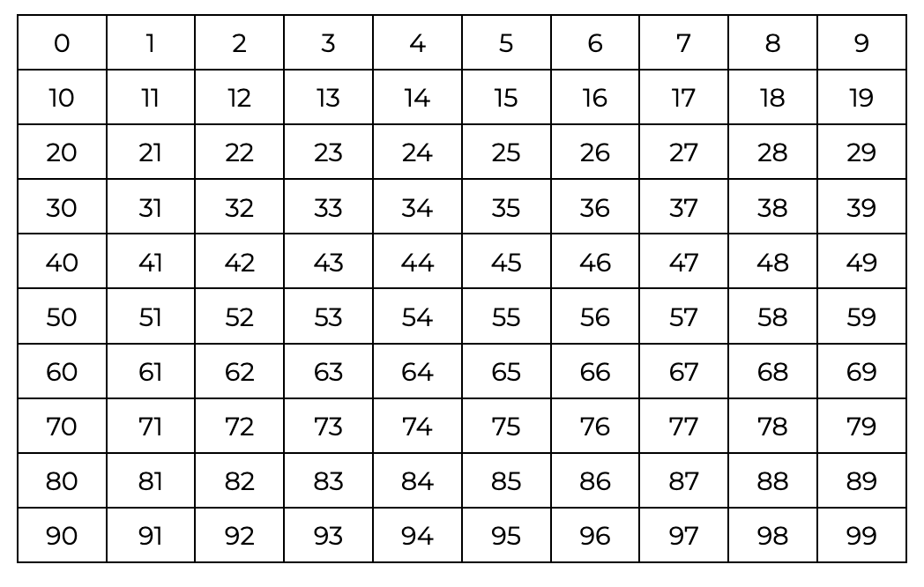
What patterns do you notice?

Slide 2
What patterns do you notice?

Slide 3
What patterns do you notice?

Slide 4
What patterns do you notice?

Slide 6
Use the patterns to work out the number in the box

Slide 7
Use the patterns to work out the number in the box
_ _

Slide 8
Use the patterns to work out the number in the box
_ _

Slide 9
Use the patterns to work out the number in the box
_ 6

Slide 10
Use the patterns to work out the number in the box
_ 6

Slide 11
Use the patterns to work out the number in the box
46

Slide 12
Use the patterns to work out the number in the box
46

Slide 13
Use the patterns to work out the number in the box
46
_ _

Slide 14
Use the patterns to work out the number in the box
46
_ 1

Slide 15
Use the patterns to work out the number in the box
46
51

Slide 16
Here is the 0 - 99 grid

Slide 17
Let’s cut a part of it out

Slide 18
Let’s cut a part of it out

Slide 19
And remove some numbers

Slide 20
And remove some numbers

Slide 21
What are the missing numbers?

Slide 22
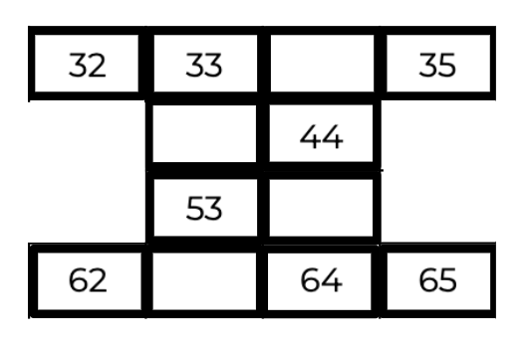
What are the missing numbers?

Slide 23
Let’s try another

Slide 24
Let’s try another

Slide 25
Let’s try another

Slide 26
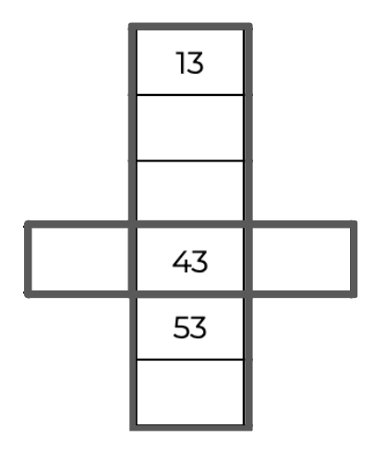
Let’s try another

Slide 27
Let’s try another

Slide 28
Let’s try another

Slide 29
Let’s try another

Slide 30
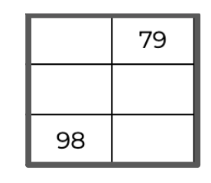
Let’s try another

Slide 31
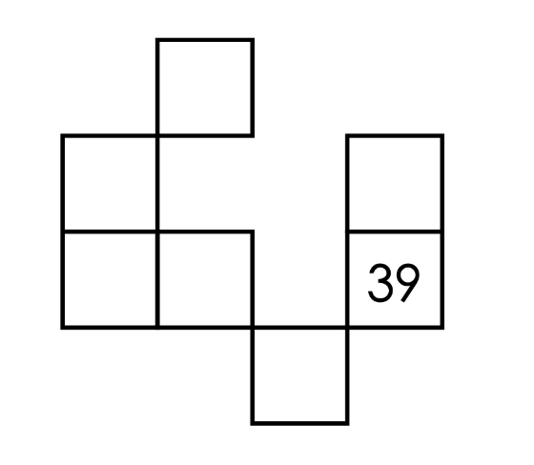
CHALLENGE

Slide 32
_ _

Slide 33
_9

Slide 34
29

Slide 35
29
_ _

Slide 36
29
_8

Slide 37
29
48

Slide 38
Keep going…
29
48

