Slide 1
Language
part
whole
join
Bar Model

Slide 2
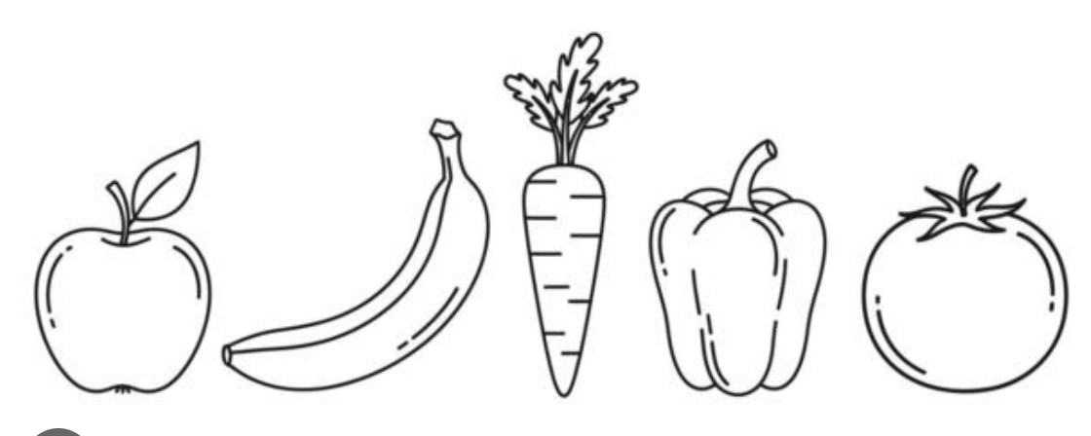
whole
5
part
part
3
2

Slide 3
whole
5
part
part
3
2
The parts are 3 and 2

Slide 4
whole
5
part
part
3
2
Join the parts together

Slide 5
whole
5
Join the parts together

Slide 6
whole
5
3 and 2 is ___ ?

Slide 7
whole
5
3 and 2 is 5

Slide 8
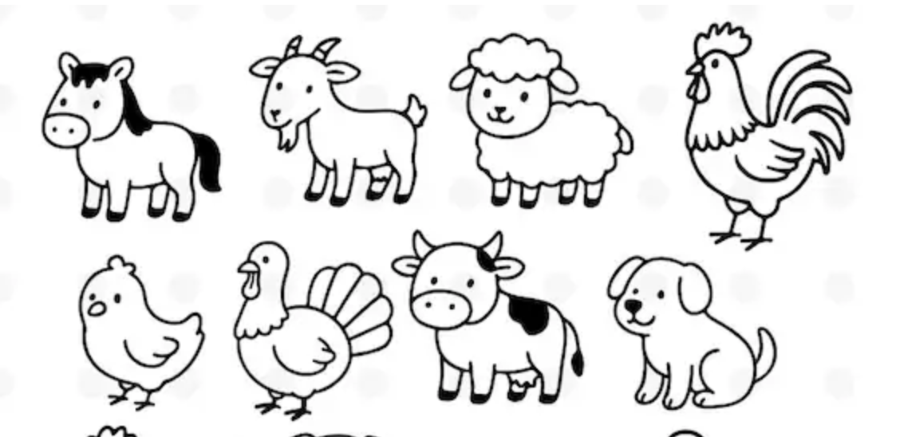
whole 7
7
part
part
5
2

Slide 9
whole 7
7
part
part
5
2
The parts are 5 and 2

Slide 10
whole 7
7
part
part
5
2
Join the parts together

Slide 11
whole 7
7
Join the parts together

Slide 12
whole 7
7
5 and 2 is ___ ?

Slide 13
whole 7
7
5 and 2 is 7

Slide 14

whole
6
part
part
2
4

Slide 15
whole
6
part
part
2
4
The parts are 2 and 4

Slide 16
whole
6
Join the parts together

Slide 17
whole
6
4 and 2 is ___ ?

Slide 18
whole
6
4 and 2 is 6

Slide 19
whole 6
part
part
3
3

Slide 20
whole 6
part
part
3
3
The parts are 3 and 3

Slide 21
whole 6
part
part
3
3
Join the parts

Slide 22
whole 6
Join the parts

Slide 23
whole 6
3 and 3 is ___ ?

Slide 24
whole 6
3 and 3 is 6

Slide 25
whole
5
part
part
3
2

Slide 26
whole
5
part
part
3
2
The parts are 3 and 2

Slide 27
whole
5
part
part
3
2
Join the parts

Slide 28
whole
5
Join the parts

Slide 29
whole
5
3 and 2 is ___ ?

Slide 30
whole
5
3 and 2 is 5

Slide 31

whole
10
part
part
1
9

Slide 32
whole
10
part
part
1
9
The parts are 3 and 2

Slide 33
whole
10
part
part
1
9
Join the parts

Slide 34
whole
10
Join the parts

Slide 35
whole
10
1 and 9 is ___ ?

Slide 36
whole
10
1 and 9 is 10

Slide 37
whole
10
part
part
3
7

Slide 38
whole
10
part
part
3
7
The parts are 3 and 7

Slide 39
whole
10
part
part
3
7
Join the parts

Slide 40
whole
10
Join the parts

Slide 41
whole
10
1 and 9 is ___ ?

Slide 42
whole
10
1 and 9 is 10

Slide 43
whole
10
part
part
5
5

Slide 44
whole
10
part
part
5
5
The parts are 5 and 5

Slide 45
whole
10
part
part
5
5
Join the parts

Slide 46
whole
10
Join the parts

Slide 47
whole
10
1 and 9 is ___ ?

Slide 48
whole
10
1 and 9 is 10

