Slide 1


Slide 2
Put 2 basketballs in each basket

Slide 3
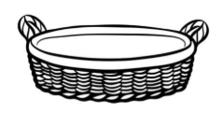
Put 2 basketballs in each basket

Slide 4
Put 2 basketballs in each basket

Slide 5
Put 2 basketballs in each basket

Slide 6
Put 2 basketballs in each basket

Slide 7
How many baskets are needed?

Slide 8
3
How many baskets are needed?

Slide 9
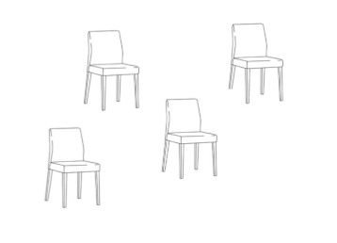

Slide 10
Put 4 chairs at each table

Slide 11
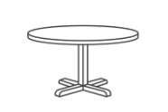
Put 4 chairs at each table

Slide 12
Put 4 chairs at each table

Slide 13
Put 4 chairs at each table

Slide 14
How many tables are needed?

Slide 15
How many tables are needed?
3

Slide 16
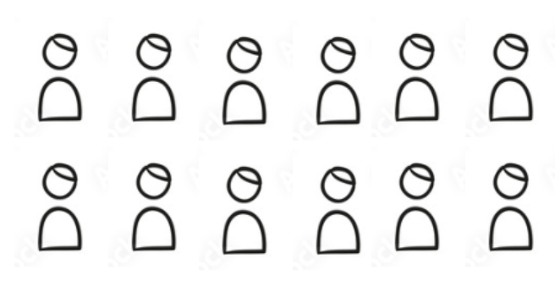
Give each team 4 players.

Slide 17
Give each team 4 players.

Slide 18
Give each team 4 players.

Slide 19
Give each team 4 players.

Slide 20
Give each team 4 players.

Slide 21
How many teams are there?

Slide 22
4
How many teams are there?

