Slide 1
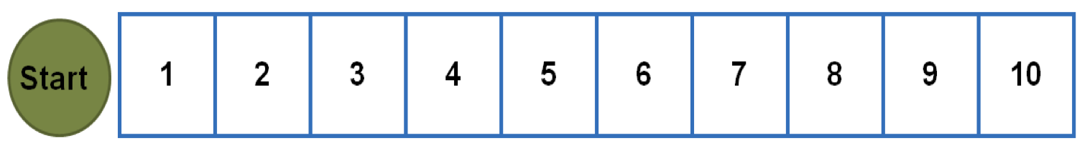

Moving on a board game
Show a roll of 2

Slide 2
Show a roll of 2

Slide 3
Show a roll of 2

Slide 4
Show a roll of 2

Slide 5
Show a roll of 2
Show a roll of 4

Slide 6

Show a roll of 2
Show a roll of 4

Slide 7
Show a roll of 2
Show a roll of 4

Slide 8
Show a roll of 2
Show a roll of 4

Slide 9
Show a roll of 2
Show a roll of 4

Slide 10
Show a roll of 2
Show a roll of 4

Slide 11
We can move on a number line also
`

Slide 12
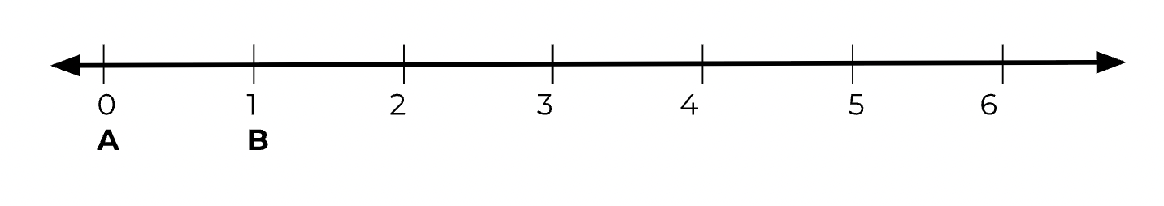
We can move on a number line also
`

Slide 13
Start at A
`

Slide 14
Start at A
`

Slide 15
Start at A
Move to B

Slide 16
Start at A
Move to B

Slide 17
Which direction did you move?

Slide 18
Which direction did you move?
FORWARD
BACK

Slide 19
Which direction did you move?
FORWARD
BACK

Slide 20
Which direction did you move?
FORWARD

Slide 21
How many did you count?

Slide 22
How many did you count?
1

Slide 23
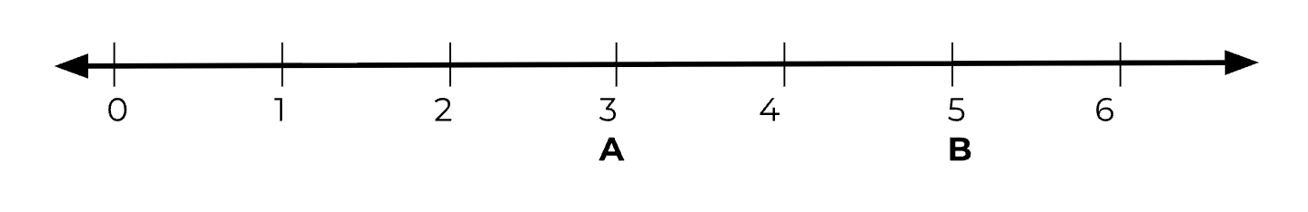

Slide 24
Start at B
`

Slide 25
Start at B
`

Slide 26
Start at B
Move to A

Slide 27
Start at B
Move to A

Slide 28
Start at B
Move to A

Slide 29
Which direction did you move?

Slide 30
Which direction did you move?
FORWARD
BACK

Slide 31
Which direction did you move?
BACK

Slide 32
How many did you count?

Slide 33
How many did you count?
1

Slide 34
How many did you count?
2
1

Slide 35
Start at A
Move to B

Slide 36
Start at A
Move to B

Slide 37
Start at A
Move to B

Slide 38
Start at A
Move to B
FORWARD
BACK

Slide 39
Start at A
Move to B
FORWARD

Slide 40



Start at A
Move to B

Slide 41
Start at A
Move to B

Slide 42
Start at A
Move to B

Slide 43
Start at A
Move to B

Slide 44
Start at A
Move to B

Slide 45
Start at A
Move to B
FORWARD

Slide 46
How many jumps?

Slide 47
How many jumps?
1

Slide 48
How many jumps?
1 2

Slide 49
How many jumps?
1 2 3

Slide 50
How many jumps?
1 2 3 4

