Slide 1
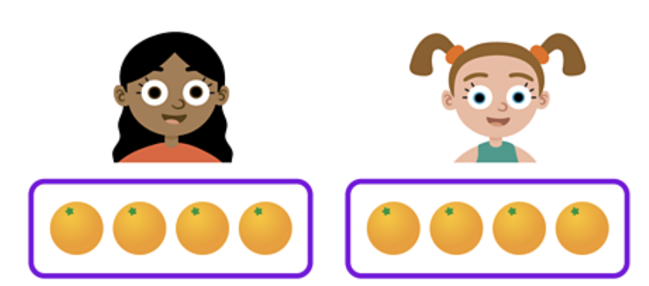

Slide 2
Is this a fair share?

Slide 3
Is this a fair share?
We need to work out if the share is equal. Do they both have the same amount?

Slide 4
Is this a fair share?
We need to work out if the share is equal. Do they both have the same amount?
1

Slide 5
Is this a fair share?
We need to work out if the share is equal. Do they both have the same amount?
1 2

Slide 6
Is this a fair share?
We need to work out if the share is equal. Do they both have the same amount?
1 2 3

Slide 7
Is this a fair share?
We need to work out if the share is equal. Do they both have the same amount?
1 2 3 4

Slide 8
Is this a fair share?
We need to work out if the share is equal. Do they both have the same amount?
1 2 3 4 1

Slide 9
Is this a fair share?
We need to work out if the share is equal. Do they both have the same amount?
1 2 3 4 1 2

Slide 10
Is this a fair share?
We need to work out if the share is equal. Do they both have the same amount?
1 2 3 4 1 2 3

Slide 11
Is this a fair share?
We need to work out if the share is equal. Do they both have the same amount?
1 2 3 4 1 2 3 4

Slide 12
Is this a fair share?
Each has 4. They have the same.
1 2 3 4 1 2 3 4

Slide 13
Is this a fair share? YES
1 2 3 4 1 2 3 4

Slide 14
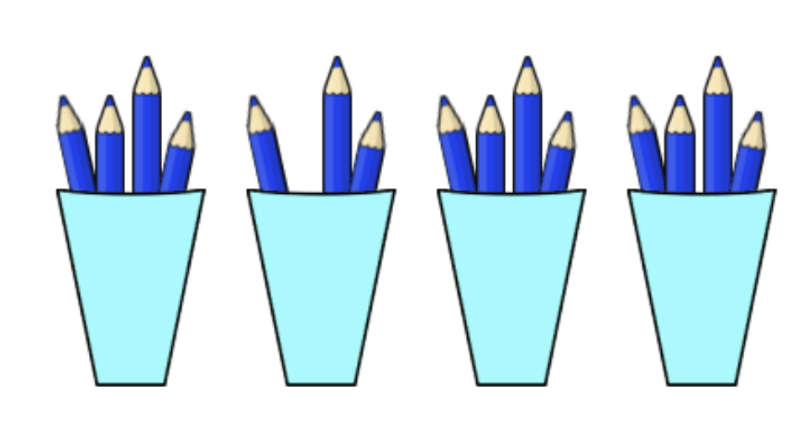

Slide 15
Is this a fair share?

Slide 16
Is this a fair share?
We need to work out if the share is equal. Do they all have the same amount?

Slide 17
Is this a fair share?
We need to work out if the share is equal. Do they all have the same amount?
1
1

Slide 18
Is this a fair share?
We need to work out if the share is equal. Do they all have the same amount?
1,2
1

Slide 19
Is this a fair share?
We need to work out if the share is equal. Do they all have the same amount?
1,2,3
1

Slide 20
Is this a fair share?
We need to work out if the share is equal. Do they all have the same amount?
1,2,3,4
1

Slide 21
Is this a fair share?
We need to work out if the share is equal. Do they all have the same amount?
1,2,3,4 1
1

Slide 22
Is this a fair share?
We need to work out if the share is equal. Do they all have the same amount?
1,2,3,4 1,2
1

Slide 23
Is this a fair share?
We need to work out if the share is equal. Do they all have the same amount?
1,2,3,4 1,2,3
1

Slide 24
Is this a fair share?
They are not the same.
1,2,3,4 1,2,3
1

Slide 25
Is this a fair share? NO
1,2,3,4 1,2,3
1

Slide 27
Is this a fair share?

Slide 28
Is this a fair share?
Is this a fair share?
We need to work out if the share is equal. Do they both have the same amount?

Slide 29
Is this a fair share?
Is this a fair share?
We need to work out if the share is equal. Do they both have the same amount?
8

Slide 30
Is this a fair share?
Is this a fair share?
We need to work out if the share is equal. Do they both have the same amount?
8
8

Slide 31
Is this a fair share?
Is this a fair share? YES
8
8

Slide 32
Is this a fair share?
Is this a fair share?

Slide 33




Is this a fair share?
Is this a fair share?

Slide 34
Is this a fair share?
Is this a fair share?
6

Slide 35
Is this a fair share?
Is this a fair share?
6
6

Slide 36
Is this a fair share?
Is this a fair share?
6
6
8

Slide 37
Is this a fair share?
Is this a fair share?
6
6
8
6

Slide 38
Is this a fair share?
Is this a fair share? NO
6
6
8
6

Slide 39

Is this a fair share?
Is this a fair share?
6
8

Slide 40

Is this a fair share?
Is this a fair share?

Slide 41
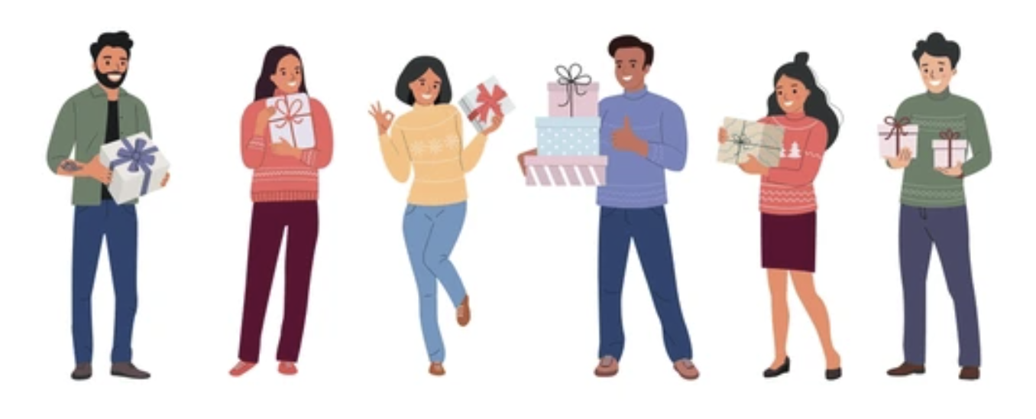
Is this a fair share?
Is this a fair share?

Slide 42

Is this a fair share?
Is this a fair share?

Slide 43

Is this a fair share?
Is this a fair share?

