Slide 1
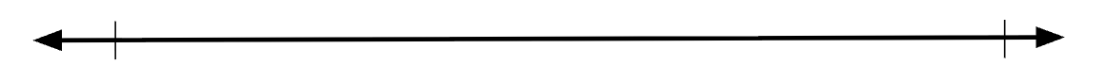
0
100

Slide 2
Where is 50?
0
100

Slide 3
Where is 50?
0
100

Slide 4
Where is 50?
0
50
100

Slide 5
Where is 50?
0
50
100
0
120

Slide 6
Where is 50?
0
50
100
0
120

Slide 7
Where is 50?
0
50
100
0
120

Slide 8
Where is 50?
0
50
100
0
120

Slide 9
Where is 50?
0
50
100
0
50
120

Slide 10
Where is 10?
0
100

Slide 11
Where is 10?
0
100

Slide 12
Where is 10?
0
10
100

Slide 13
Where is 10?
0
10
100
0
120

Slide 14
Where is 10?
0
10
100
0
120

Slide 15
Where is 10?
0
10
100
0
120

Slide 16
Where is 10?
0
10
100
0
120

Slide 17
Where is 10?
0
10
100
0
10
120

Slide 18
0
100
0
120

