Slide 1
Counting to 120: Counting sequence 120

Slide 2
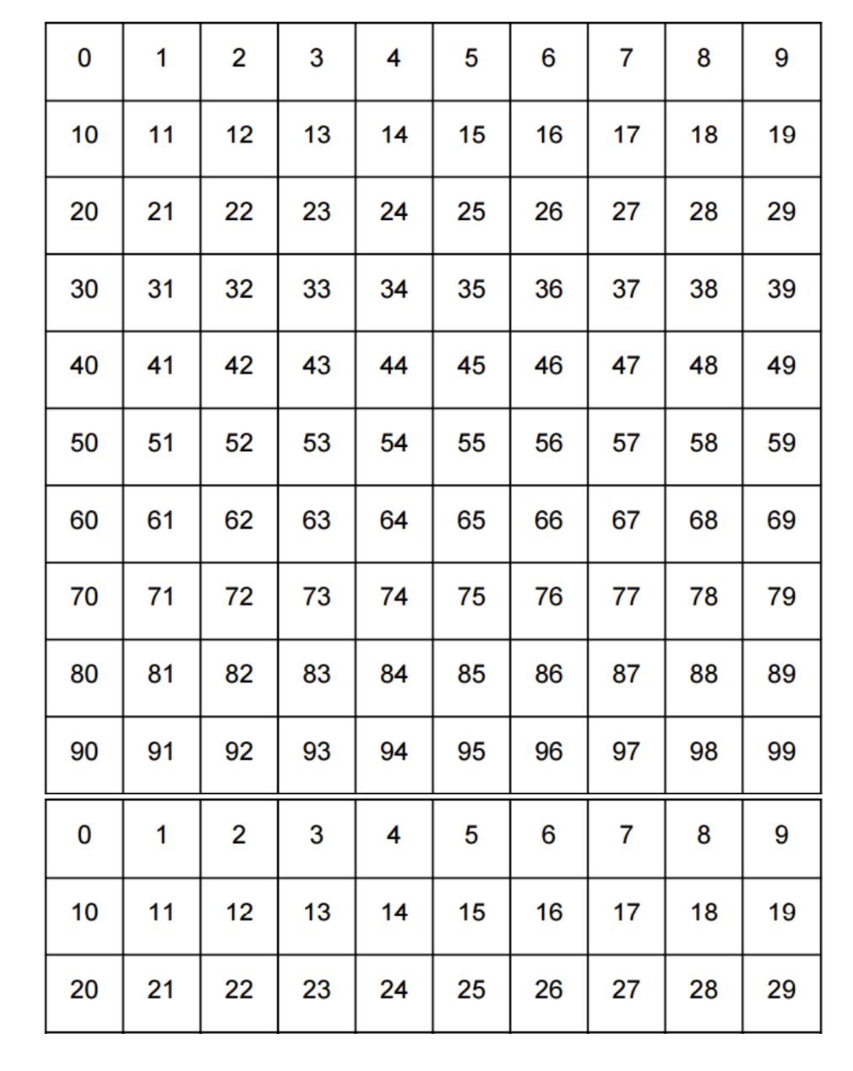
What happens next?

Slide 3
What if we start the pattern again?

Slide 4
What if we start the pattern again?

Slide 5
What if we start the pattern again?

Slide 6
What if we start the pattern again?

Slide 7
We can add numbers using a pattern

Slide 8
We can add numbers using a pattern

Slide 9
We can add numbers using a pattern

Slide 10
We can add numbers using a pattern
18 ->

Slide 11
We can add numbers using a pattern
18 -> 118

Slide 12

We can add numbers using a pattern
18 -> 118

Slide 13
We can add numbers using a pattern

Slide 14
We can add numbers using a pattern

Slide 15

We can add numbers using a pattern

Slide 16
We can add numbers using a pattern

Slide 17
We can add numbers using a pattern

Slide 18

We can add numbers using a pattern

Slide 19
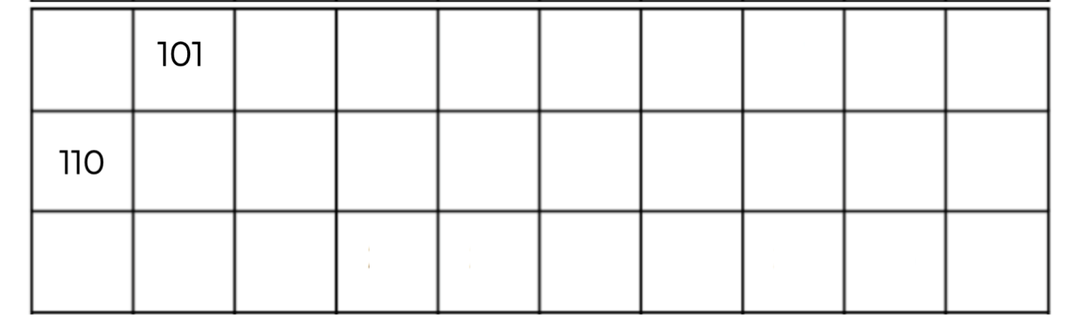
What happens next?

Slide 21
What pattern do you notice?

Slide 22

What pattern do you notice?

Slide 23
Let’s count

Slide 24
Let’s count

Slide 25
Let’s count
102

Slide 26
Let’s count
102
103

Slide 27
Let’s count
102
103
104

Slide 28
Let’s count
102
103
104
105

Slide 29
Let’s count
102
103
104
105
106

Slide 30
Let’s count
102
103
104
105
106
107

Slide 31
Let’s count
102
103
104
105
106
107
108

Slide 32
Let’s count
102
103
104
105
106
107
108
109

Slide 33
Let’s count
102
103
104
105
106
107
108
109

Slide 34
Let’s count
102
103
104
105
106
107
108
109
111

Slide 35
Let’s count
102
103
104
105
106
107
108
109
111
112

Slide 36
Let’s count
102
103
104
105
106
107
108
109
111
112
113

Slide 37
Let’s count
102
103
104
105
106
107
108
109
111
112
113
114

Slide 38
Let’s count
102
103
104
105
106
107
108
109
111
112
113
114
115

Slide 39
Let’s count
102
103
104
105
106
107
108
109
111
112
113
114
115
116

Slide 40
Let’s count
102
103
104
105
106
107
108
109
111
112
113
114
115
116
117

Slide 41
Let’s count
102
103
104
105
106
107
108
109
111
112
113
114
115
116
117
118

Slide 42
Let’s count
102
103
104
105
106
107
108
109
111
112
113
114
115
116
117
118
119

Slide 43
Look at the patterns->
What will go here? ->
102
103
104
105
106
107
108
109
111
112
113
114
115
116
117
118
119

Slide 44
102
103
104
105
106
107
108
109
111
112
113
114
115
116
117
118
119
120

Slide 45
VOCABULARY:
102
103
104
105
106
107
108
109
111
112
113
114
115
116
117
118
119
120

Slide 46
VOCABULARY: What number comes after 103?
102
103
104
105
106
107
108
109
111
112
113
114
115
116
117
118
119
120

Slide 47
VOCABULARY: What number comes after 103?
102
103
104
105
106
107
108
109
111
112
113
114
115
116
117
118
119
120

Slide 48
VOCABULARY: What number comes after 90?
102
103
104
105
106
107
108
109
111
112
113
114
115
116
117
118
119
120

Slide 49
VOCABULARY: What number comes after 90?
102
103
104
105
106
107
108
109
111
112
113
114
115
116
117
118
119
120

Slide 50
VOCABULARY: What number comes after 119?
102
103
104
105
106
107
108
109
111
112
113
114
115
116
117
118
119
120

Slide 51
VOCABULARY: What number comes after 119?
102
103
104
105
106
107
108
109
111
112
113
114
115
116
117
118
119
120

Slide 52
VOCABULARY:
102
103
104
105
106
107
108
109
111
112
113
114
115
116
117
118
119
120

Slide 53
VOCABULARY: What number comes before 103?
102
103
104
105
106
107
108
109
111
112
113
114
115
116
117
118
119
120

Slide 54
VOCABULARY: What number comes before 103?
102
103
104
105
106
107
108
109
111
112
113
114
115
116
117
118
119
120

Slide 55
VOCABULARY: What number comes before 119?
102
103
104
105
106
107
108
109
111
112
113
114
115
116
117
118
119
120

Slide 56
VOCABULARY: What number comes before 119?
102
103
104
105
106
107
108
109
111
112
113
114
115
116
117
118
119
120

Slide 57
VOCABULARY: What number comes before 90?
102
103
104
105
106
107
108
109
111
112
113
114
115
116
117
118
119
120

Slide 58
VOCABULARY: What number comes before 90?
102
103
104
105
106
107
108
109
111
112
113
114
115
116
117
118
119
120

