Slide 1
These are called tally marks

Slide 2
This represents the number ten
10

Slide 3
This represents the number five
5

Slide 4
Let’s start with ten
10

Slide 5
Ten and one more
10 1

Slide 6
Ten and two more
10 2

Slide 7
Ten and three more
10 3

Slide 8
Ten and four more
10 4

Slide 9
Ten and five more
10 5

Slide 10
Ten and six more
10 6

Slide 11
Ten and seven more
10 7

Slide 12
Ten and eight more
10 8

Slide 13
Ten and nine more
10 9

Slide 14
Ten and ten more
10 10

Slide 15
10

Slide 16
11

Slide 17
12

Slide 18
13

Slide 19
14

Slide 20
15

Slide 21
16

Slide 22
17

Slide 23
18

Slide 24
19

Slide 25
20

Slide 26
How many?

Slide 27
How many?

Slide 28
How many?

Slide 29
How many?

Slide 30
How many?

Slide 31
How many?

Slide 32
How many?

Slide 33
How many?

Slide 34
How many?

Slide 35
How many?

Slide 36
How many?

Slide 37
How many?

Slide 38
How many?

Slide 39
How many?

Slide 40
How many?

Slide 41
How many?

Slide 42
How many?

Slide 43
How many?

Slide 44
How many?

Slide 45
How many?

Slide 46
How many?

Slide 47
How many?

Slide 48
How many?

Slide 49
How many?

Slide 50
How many?

Slide 51
How many?

Slide 52
How many?

Slide 53
How many?

Slide 54
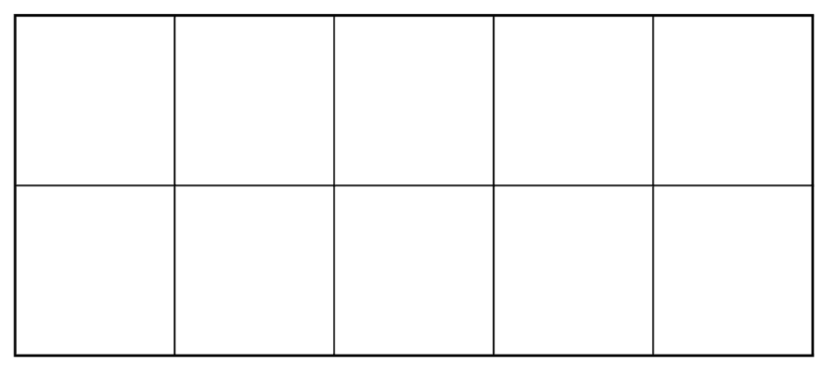
Practice drawing after counting

Slide 55
Practice drawing after counting

Slide 56
Practice drawing after counting

Slide 57
Practice drawing after counting

Slide 58
Practice drawing after counting

Slide 59
Practice drawing after counting

Slide 60
Practice drawing after counting

Slide 61
Practice drawing after counting

Slide 62
Practice drawing after counting

Slide 63
Practice drawing after counting

Slide 64
Practice drawing after counting

Slide 65
Practice drawing after counting

Slide 66
Practice drawing after counting

Slide 67
Practice drawing after counting

Slide 68
Practice drawing after counting

Slide 69
Practice drawing after counting

Slide 70
Practice drawing after counting

Slide 71
Practice drawing after counting

Slide 72
Practice drawing after counting

Slide 73
Practice drawing after counting

