Slide 1
Language
part
whole
remove
Bar Model

Slide 2
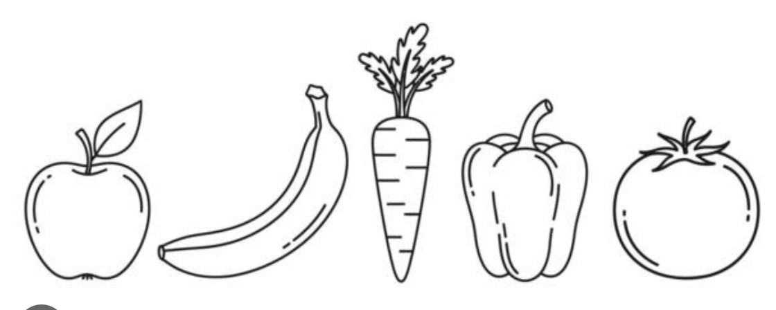
whole
5
part
part
3
2

Slide 3
whole
5
The whole is 5
part
part
3
2

Slide 4
whole
5
I remove the part 2
part
part
3
2

Slide 5
whole
part
2
5
I remove the part 2
part
part
3
2

Slide 6
whole
I remove the part 2
part
3

Slide 7
whole
Now there is only the part 3
part
3

Slide 8
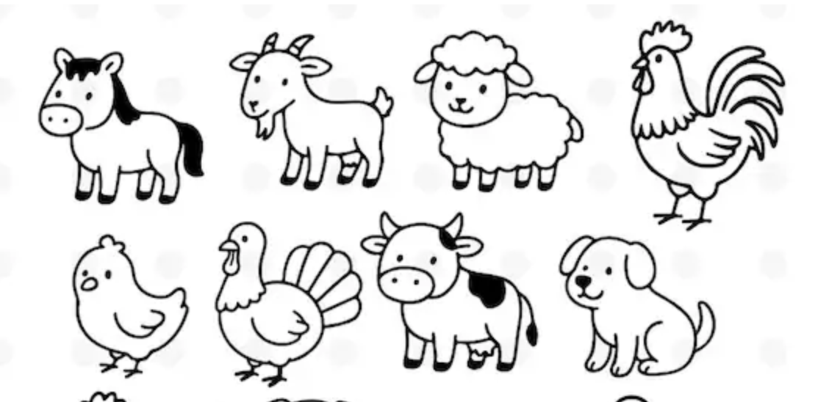
whole 7
7
part
part
5
2

Slide 9
whole 7
7
The whole is 5
part
part
5
2

Slide 10
whole 7
7
I remove the part 5
part
part
5
2

Slide 11
whole 7
7
I remove the part 5
part
part
5
2

Slide 12
whole 7
5
7
I remove the part 5
part
part
5
2

Slide 13
I remove the part 5
part
2

Slide 14
Now there is only the part 2
part
2

Slide 15

whole
6
part
part
2
4

Slide 16
whole
6
_____ remove ______ is _____
whole part part
part
part
2
4

Slide 17
whole
6
6 remove ______ is _____
whole part part
part
part
2
4

Slide 18
whole
6
6 remove 4 is _____
whole part part
part
part
2
4

Slide 19
whole
6
4
6 remove 4 is _____
whole part part
part
part
2
4

Slide 20
6 remove 4 is 2
whole part part
part
2

Slide 21
6
2
4

Slide 22
6
2
4
_____ remove ______ is _____
whole part part

Slide 23
6
2
4
6 remove ______ is _____
whole part part

Slide 24
2
6
2
4
6 remove 2 is _____
whole part part

Slide 25
4
6 remove 2 is _____
whole part part

Slide 26
4
6 remove 2 is 4
whole part part

Slide 27

whole
10
part
part
1
9

Slide 28
10
1
9

Slide 29
10
1
9
_____ remove ______ is _____

Slide 30
10
1
9
10 remove ______ is _____

Slide 31
10
1
9
10 remove ______ is _____

Slide 32
10
1
9
10 remove 1 is _____

Slide 33
10
9
10 remove 1 is _____

Slide 34
10
9
10 remove 1 is 9

Slide 35
10
1
9
10 remove ______ is _____

Slide 36
10
1
9
10 remove ______ is _____

Slide 37
10
1
9
10 remove 9 is _____

Slide 38
10
1
10 remove 9 is _____

Slide 39
10
1
10 remove 9 is 1

Slide 40
10
3
7

Slide 41
10
3
7
_____ remove ______ is _____

Slide 42
10
7
_____ remove ______ is _____

Slide 43
10
7
10 remove ______ is _____

Slide 44
10
7
10 remove 3 is _____

Slide 45
10
7
10 remove 3 is 7

