Slide 1
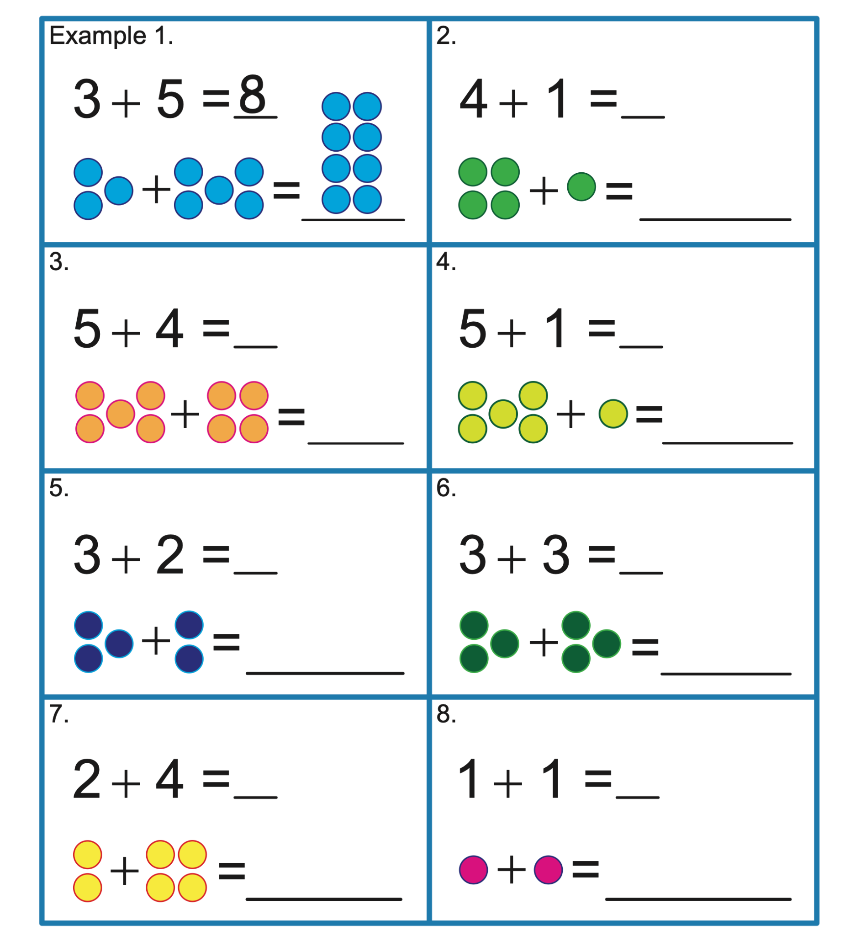

Slide 7
4

Slide 8
4

Slide 9
4 +

Slide 10
4 + 1

Slide 11
4 + 1 =

Slide 12
4 + 1 = 5

Slide 14
5

Slide 15
5

Slide 16
5 -

Slide 17
5 - 1

Slide 18
5 - 1 =

Slide 19
5 - 1 = 4

Slide 26
3

Slide 27
3

Slide 28
3 + 4

Slide 29
3 + 4 = 7

Slide 30
Now we do the reverse
3 + 4 = 7

Slide 31
7

Slide 32
7

Slide 33
7 -

Slide 34
7 - 4

Slide 35
7 - 4 =

Slide 36
7 - 4 = 3

Slide 37



Slide 43
8

Slide 44
8

Slide 45
8 +

Slide 46
8 + 3

Slide 47
8 + 3 =

Slide 48
8 + 3 = 11

Slide 50
11

Slide 51
11

Slide 52
11 -

Slide 53
11 - 3

Slide 54
11 - 3 =

Slide 55
11 - 3 = 8

Slide 56


Slide 64
2

Slide 65
2

Slide 66
2 +

Slide 67
2 + 1

Slide 68
2 + 1 =

Slide 69
2 + 1 = 3

Slide 71
3

Slide 72
3

Slide 73
3 -

Slide 74
3 - 1

Slide 75
3 - 1

Slide 76
3 - 1 =

Slide 77
3 - 1 = 2

Slide 84
6

Slide 85
6 -

Slide 86
6 -

Slide 87
6 - 4

Slide 88
6 - 4 =

Slide 89
6 - 4 = 2

Slide 90
Now we do the reverse
6 - 4 = 2

Slide 91
Now we do the reverse
6 - 4 = 2

Slide 92
Now we do the reverse
6 - 4 = 2
2

Slide 93
Now we do the reverse
6 - 4 = 2
2

Slide 94
Now we do the reverse
6 - 4 = 2
2 +

Slide 95
Now we do the reverse
6 - 4 = 2
2 + 4

Slide 96
Now we do the reverse
6 - 4 = 2
2 + 4 =

Slide 97
Now we do the reverse
6 - 4 = 2
2 + 4 = 6

Slide 98
Part Part Whole

Slide 103
3

Slide 104
3 2

Slide 105
3

Slide 106
3 2

Slide 107
2

Slide 108
3 2

Slide 109
2

Slide 110
3 2 5

Slide 111
2

Slide 112
3 2 5

Slide 113
3 2 5

Slide 114
We can describe add and remove using symbols
3

Slide 115
We can describe add and remove using symbols
3

Slide 116
We can describe add and remove using symbols
3 + 2

Slide 117
We can describe add and remove using symbols
3 + 2 = 5

Slide 118
We can describe add and remove using symbols

Slide 119
We can describe add and remove using symbols
5

Slide 120
We can describe add and remove using symbols
5

Slide 121
We can describe add and remove using symbols
5 - 2

Slide 122
We can describe add and remove using symbols
5 - 2 = 3

Slide 123
We can describe add and remove using symbols

Slide 124
We can describe add and remove using symbols
3

Slide 125
We can describe add and remove using symbols
3

Slide 126
We can describe add and remove using symbols
3 + 2

Slide 127
We can describe add and remove using symbols
3 + 2 = 5

Slide 128
We can describe add and remove using symbols

Slide 129
We can describe add and remove using symbols
5

Slide 130
We can describe add and remove using symbols
5

Slide 131
We can describe add and remove using symbols
5 -

Slide 132
We can describe add and remove using symbols
5 - 3

Slide 133
We can describe add and remove using symbols
5 - 3 =

Slide 134
We can describe add and remove using symbols
5 - 3 = 2

Slide 135
We can describe add and remove using symbols

Slide 136
We can describe add and remove using symbols
2

Slide 137
We can describe add and remove using symbols
2

Slide 138
We can describe add and remove using symbols
2 +

Slide 139
We can describe add and remove using symbols
2 + 3

Slide 140
We can describe add and remove using symbols
2 + 3 = 5

Slide 141
We can describe add and remove using symbols
2 + 3 =

Slide 152
1

Slide 153
1

Slide 154
1 +

Slide 155
1 + 6

Slide 156
1 + 6 =

Slide 157
1 + 6 = 7

Slide 159
7

Slide 160
7

Slide 161
7 -

Slide 162
7 - 6

Slide 163
7 - 6 =

Slide 164
7 - 6 = 1

Slide 166
1

Slide 167
1

Slide 168
1 +

Slide 169
1 + 6

Slide 170
1 + 6 =

Slide 171
1 + 6 = 7

Slide 173
7

Slide 174
7

Slide 175
7 -

Slide 176
7 - 1

Slide 177
7 - 1 =

Slide 178
7 - 1 = 6

Slide 180
6

Slide 181
6

Slide 182
6 +

Slide 183
6 + 1

Slide 184
6 + 1 =

Slide 185
6 + 1 = 7

Slide 186
What is missing?

Slide 187
What is missing?
1 + ___ = 7

Slide 188
What is missing?
6 + 1 = ___

Slide 189
What is missing?
7 - ___ = 6

