Slide 1
Language
part
whole
join
addition sign
equals sign

Slide 2
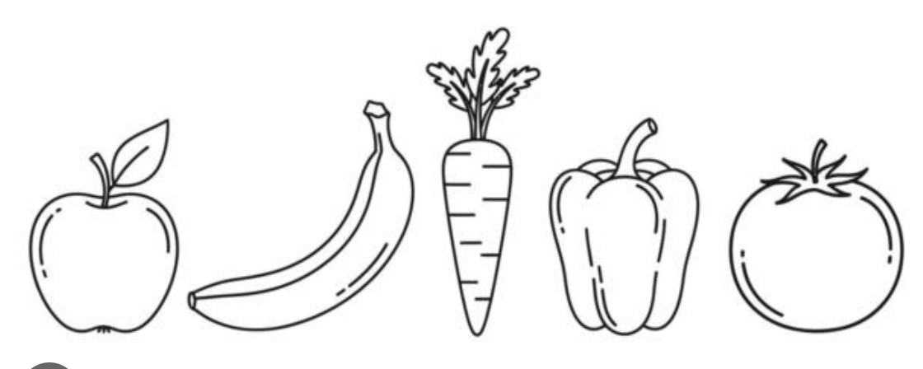
whole
5
part
part
3
2

Slide 3
part
part
whole
3
2
5

Slide 4
part
part
whole
3
2
=
5

Slide 5
Both are equal
part
part
whole
3
2
=
5

Slide 6
This is called the
equals sign
part
part
whole
3
2
=
5

Slide 7
If we join these parts
part
part
whole
3
2
=
5

Slide 8
This is called the
addition sign
3
+
2
=
5

Slide 9
It means join the parts
3
+
2
=
5

Slide 10
3
joined with
2
3
+
2
=
5

Slide 11
3
joined with
2
Is equal to
3
+
2
=
5

Slide 12
3
joined with
2
Is equal to
5
3
+
2
=
5

Slide 13
3
joined with
2
Is equal to
5
+
=

Slide 14
+
=

Slide 15
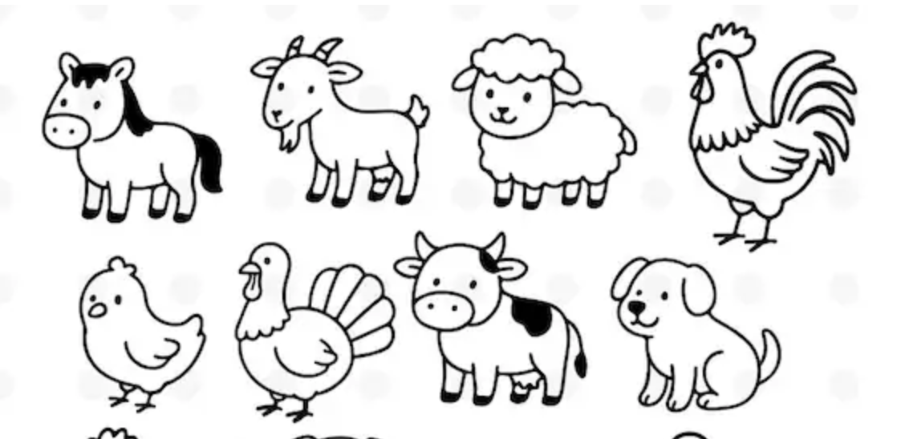
whole 7
7
part
part
5
2

Slide 16
part
part
whole 7
5
2
7

Slide 17
5
joined with
2
whole 7
5
2
7

Slide 18
5
joined with
2
whole 7
+
5
2
7

Slide 19
5
joined with
2
Is equal to
whole 7
+
5
2
7

Slide 20
5
joined with
2
Is equal to
whole 7
+
=
5
2
7

Slide 21
5
joined with
2
Is equal to
7
+
=
5
2
7

Slide 22
+
=
7

Slide 23

whole
6
part
part
2
4

Slide 24
part
part
whole
2
4
6

Slide 25
+
part
part
whole
2
4
6

Slide 26
+
part
part
whole
2
4
6

Slide 27
+
=
part
part
whole
2
4
6

Slide 28
+
=
part
part
whole
2
4
6

Slide 29
+
=
2
part
whole
2
4
6

Slide 30
+
=
2
4
whole
2
4
6

Slide 31
+
=
2
4
whole
6

Slide 32
+
=
2
4
6
6

Slide 33
+
=
2
4
6
2
4
6

Slide 34
+
=
2
4
6
6

Slide 35
whole 6
part
part
3
3

Slide 36
part
part
whole 6
3
3

Slide 37
+
=
part
part
whole
part
part
whole 6
3
3

Slide 38
+
=
3
3
6
part
part
whole 6
3
3

Slide 39
whole
5
part
part
3
2

Slide 40
part
part
whole
3
2
5

Slide 41
+
=
part
part
whole
part
part
whole
3
2
5

Slide 42
+
=
3
2
5
part
part
whole
3
2
5

Slide 43

whole
10
part
part
1
9

Slide 44
10
1
9

Slide 45
10
1
9
part
+
part
=
whole

Slide 46
10
1
9
part
+
part
=
whole

Slide 47
10
1
9
1
+
part
=
whole

Slide 48
10
1
9
1
+
part
=
whole

Slide 49
10
1
9
1
+
9
=
whole

Slide 50
10
1
9
1
+
9
=
whole

Slide 51
10
1
9
1
+
9
=
10

Slide 52
10
1
9
1
+
9
=
10

Slide 53
3
7
10

Slide 54
3
7
10
part
+
part
=
whole

Slide 55
3
7
10
part
+
part
=
whole

Slide 56
3
7
10
3
+
part
=
whole

Slide 57
3
7
10
3
+
part
=
whole

Slide 58
3
7
10
3
+
7
=
whole

Slide 59
3
7
10
3
+
7
=
whole

Slide 60
3
7
10
3
+
7
=
10

Slide 61
3
7
10
3
+
7
=
10

Slide 62
3
7
10
3
+
7
=
10

Slide 63
whole
10
part
part
5
5

Slide 64
10
part
part
5
5

Slide 65
10
5
part
5

Slide 66
10
5
5

Slide 67
10
5
5
part
+
part
=
whole

Slide 68
10
5
5
5
+
part
=
whole

Slide 69
10
5
5
5
+
5
=
whole

Slide 70
10
5
+
5
=
whole

Slide 71
10
5
+
5
=
10

Slide 72
10
1
9

Slide 73
10
1
9

Slide 74
10
1
9

Slide 75
10
1
9
part
+
part
=
whole

Slide 76
10
1
9
1
+
part
=
whole

Slide 77
10
1
9
1
+
9
=
whole

Slide 78
10
1 + 9
1
+
9
=
whole

Slide 79
10
1 + 9
1
+
9
=
10

Slide 80
10
1
9
1
+
9
=
10

Slide 81
whole
6
part
part
2
4

Slide 82
6
2
4

Slide 83
6
2
4

Slide 84
6
2
4

Slide 85
6
2
4

Slide 86
6
2
4

Slide 87
6
2
4
part
+
part
=
whole

Slide 88
6
2
4
part
+
part
=
whole

Slide 89
6
2
4
part
+
part
=
whole

Slide 90
6
2
4
4
+
part
=
whole

Slide 91
6
2
4
4
+
2
=
whole

Slide 92
6
2
4
4
+
2
=
6

Slide 93
6
2
4
4
+
2
=
6

Slide 94
whole 7
7
part
part
5
2

Slide 95
part
part
5
2
whole 7
7

Slide 96
part
part
5
2
whole 7
7

Slide 97
5
2
7

Slide 98
2
5
7

Slide 99
5
2
7

Slide 100
5
2
7

Slide 101
5
2
7
5
+
2
=
7

