Slide 1
Language
part
whole
missing part

Slide 2
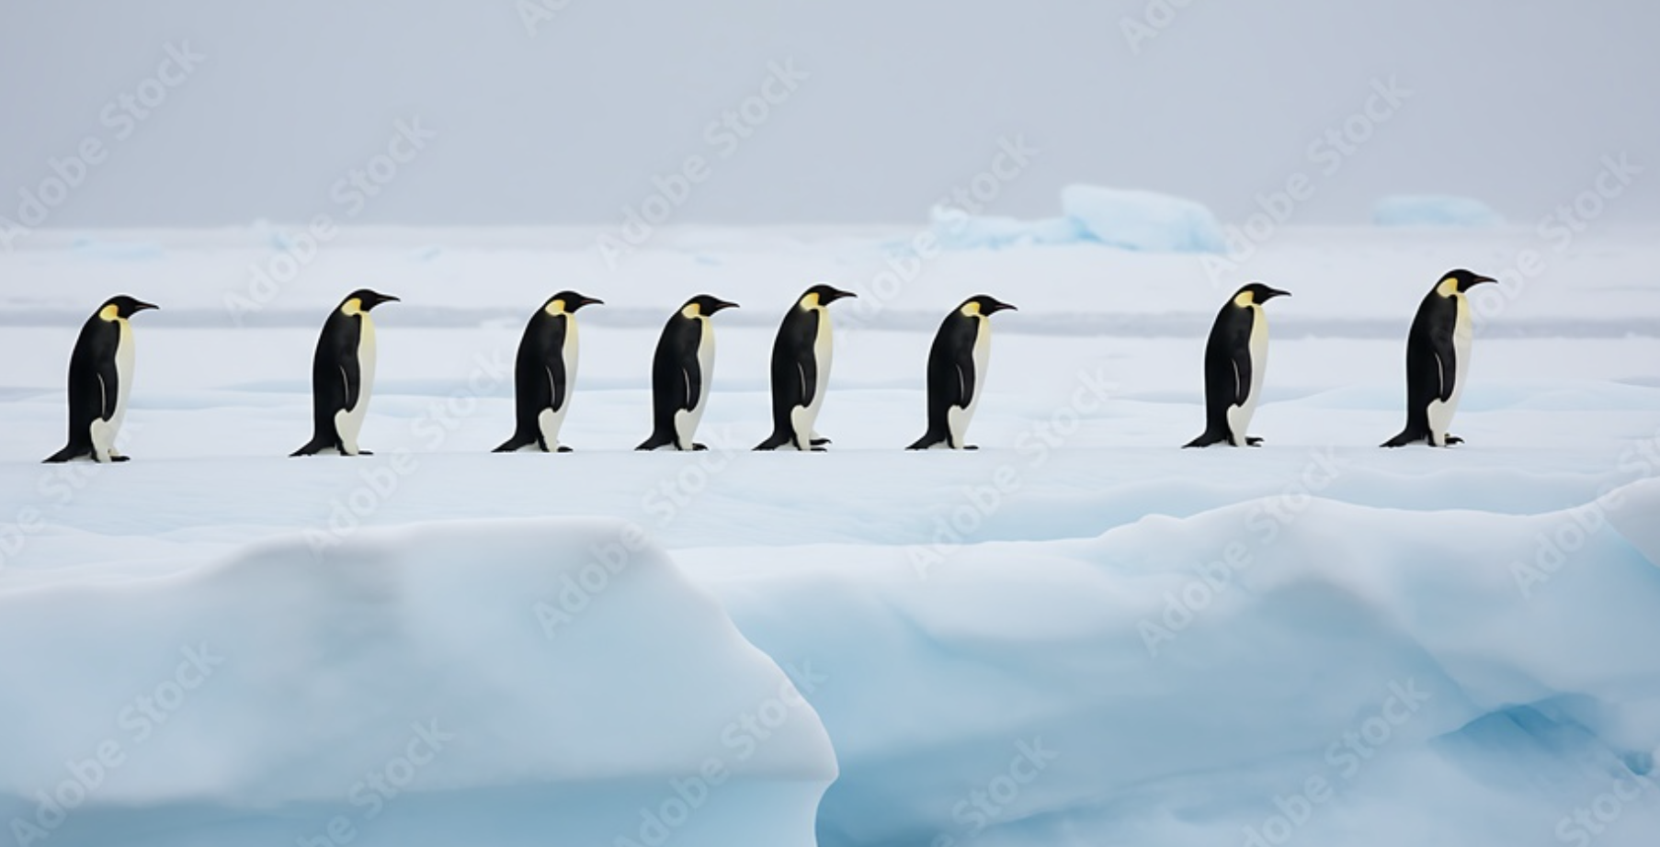
8 penguins

Slide 3
Some penguins jump in the water.
8 penguins

Slide 4
Some penguins jump in the water.
8 penguins

Slide 5
There are 5 penguins left.
8 penguins

Slide 6
8 penguins
5 penguins

Slide 7
8 penguins
5 penguins
How many?

Slide 8
8 penguins
5 penguins
3 penguins

Slide 9
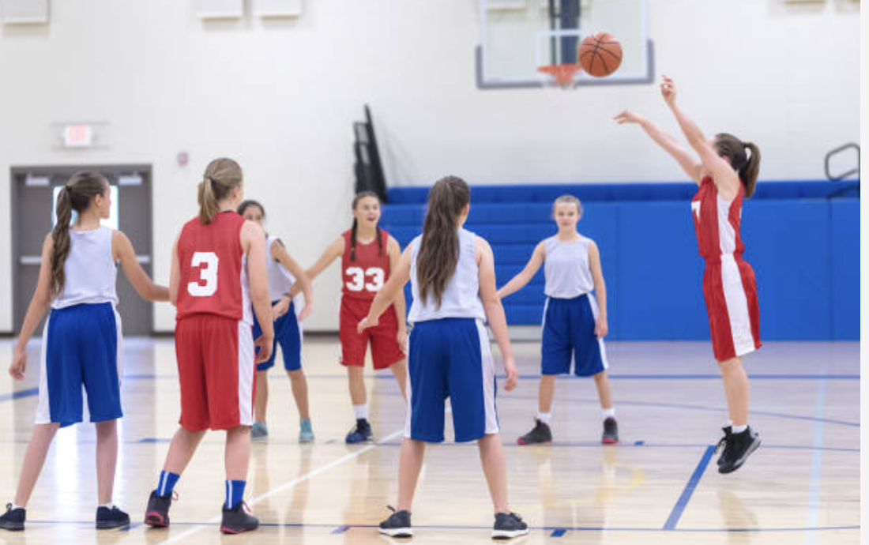
7 players

Slide 10
Some players go to the toilet.
7 players

Slide 11
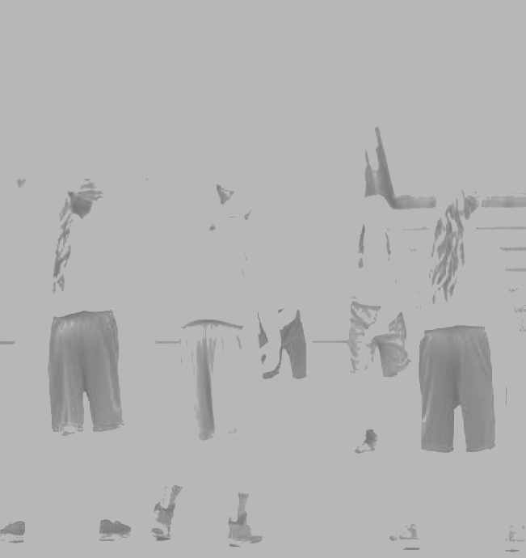
Some players go to the toilet.
7 players
Notes:
1

Slide 12
There are 2 players left.
7 players

Slide 13
7 players
2 players

Slide 14
7 players
How many?
2 players

Slide 15
7 players
5 players
2 players

Slide 16
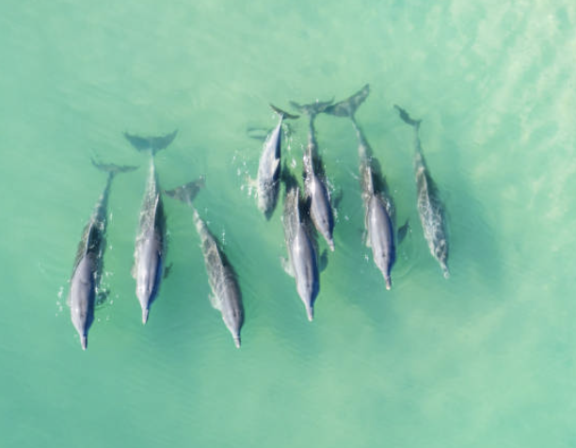
8 dolphins

Slide 17
Some dolphins go under the water.
8 dolphins

Slide 18

8 dolphins

Slide 19
8 dolphins
2 dolphins

Slide 20
8 dolphins
How many?
2 dolphins

Slide 21
8 dolphins
How many?
2 dolphins

Slide 22
8 dolphins
6 dolphins
2 dolphins

Slide 23
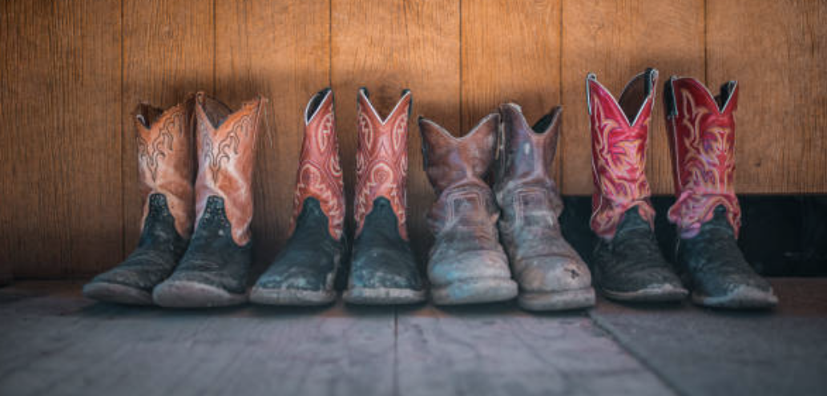
4 pairs of boots

Slide 24
Some pairs are put into a box.
4 pairs of boots
4 pairs of boots

Slide 25
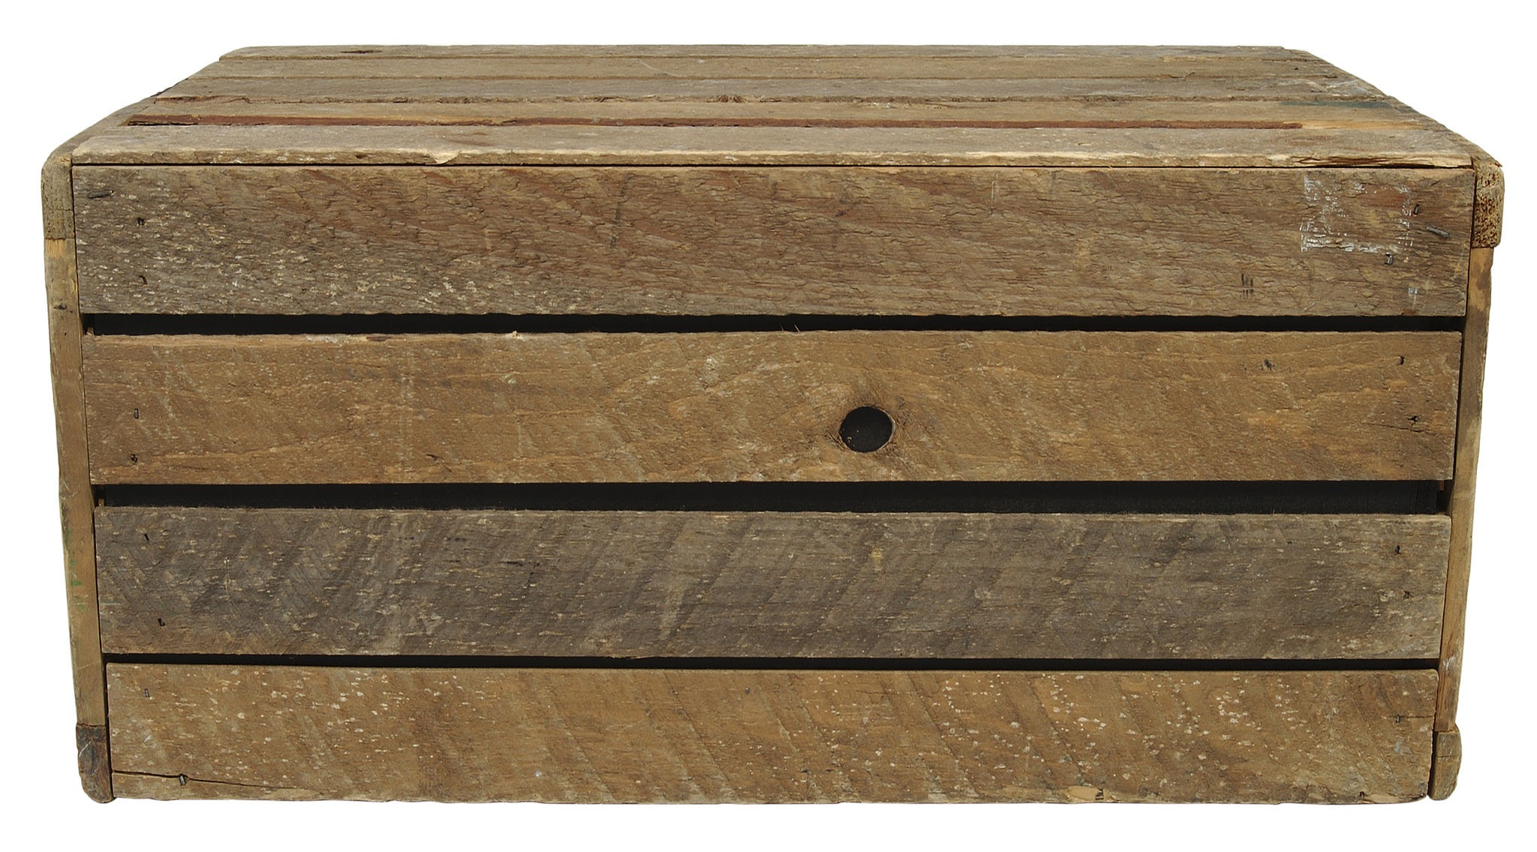
4 pairs of boots
4 pairs of boots

Slide 26
There are no pairs of boots left.
4 pairs of boots
4 pairs of boots

Slide 27
There are no pairs of boots left.
0 pairs of boots
4 pairs of boots
4 pairs of boots

Slide 28
0 pairs of boots
0 pairs of boots
4 pairs of boots
4 pairs of boots
How many?

Slide 29
0 pairs of boots
0 pairs of boots
4 pairs of boots
4 pairs of boots
How many?

Slide 30
0 pairs of boots
0 pairs of boots
4 pairs of boots
4 pairs of boots
4 pairs of boots

Slide 31
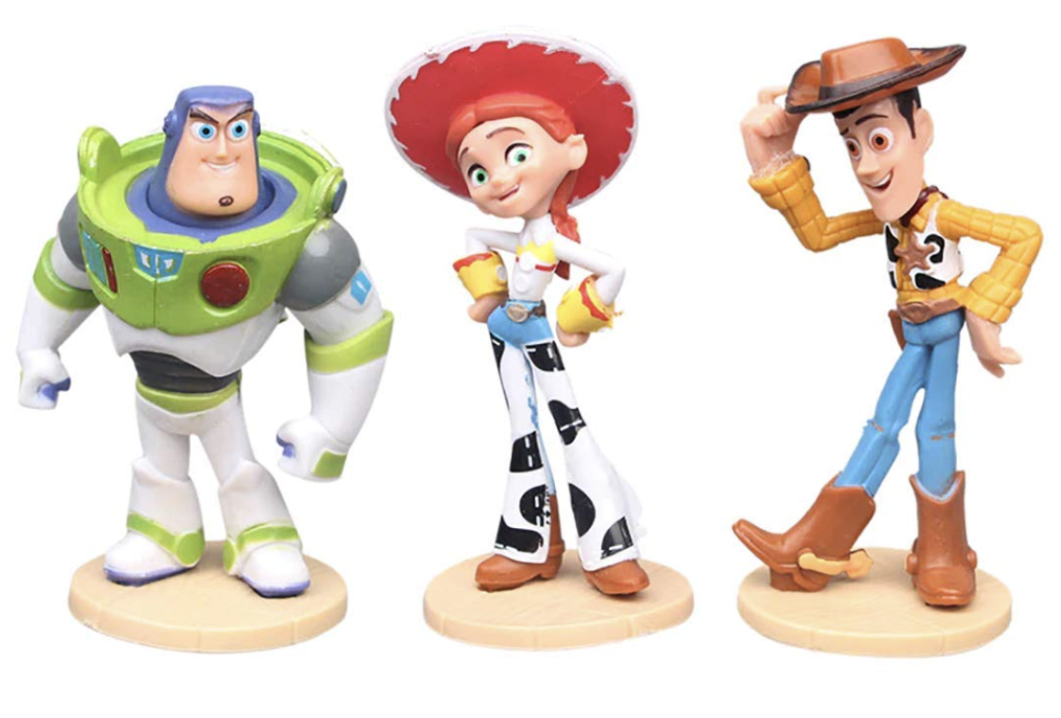
3 toys

Slide 32
Some toys are put into a box.
3 toys

Slide 33
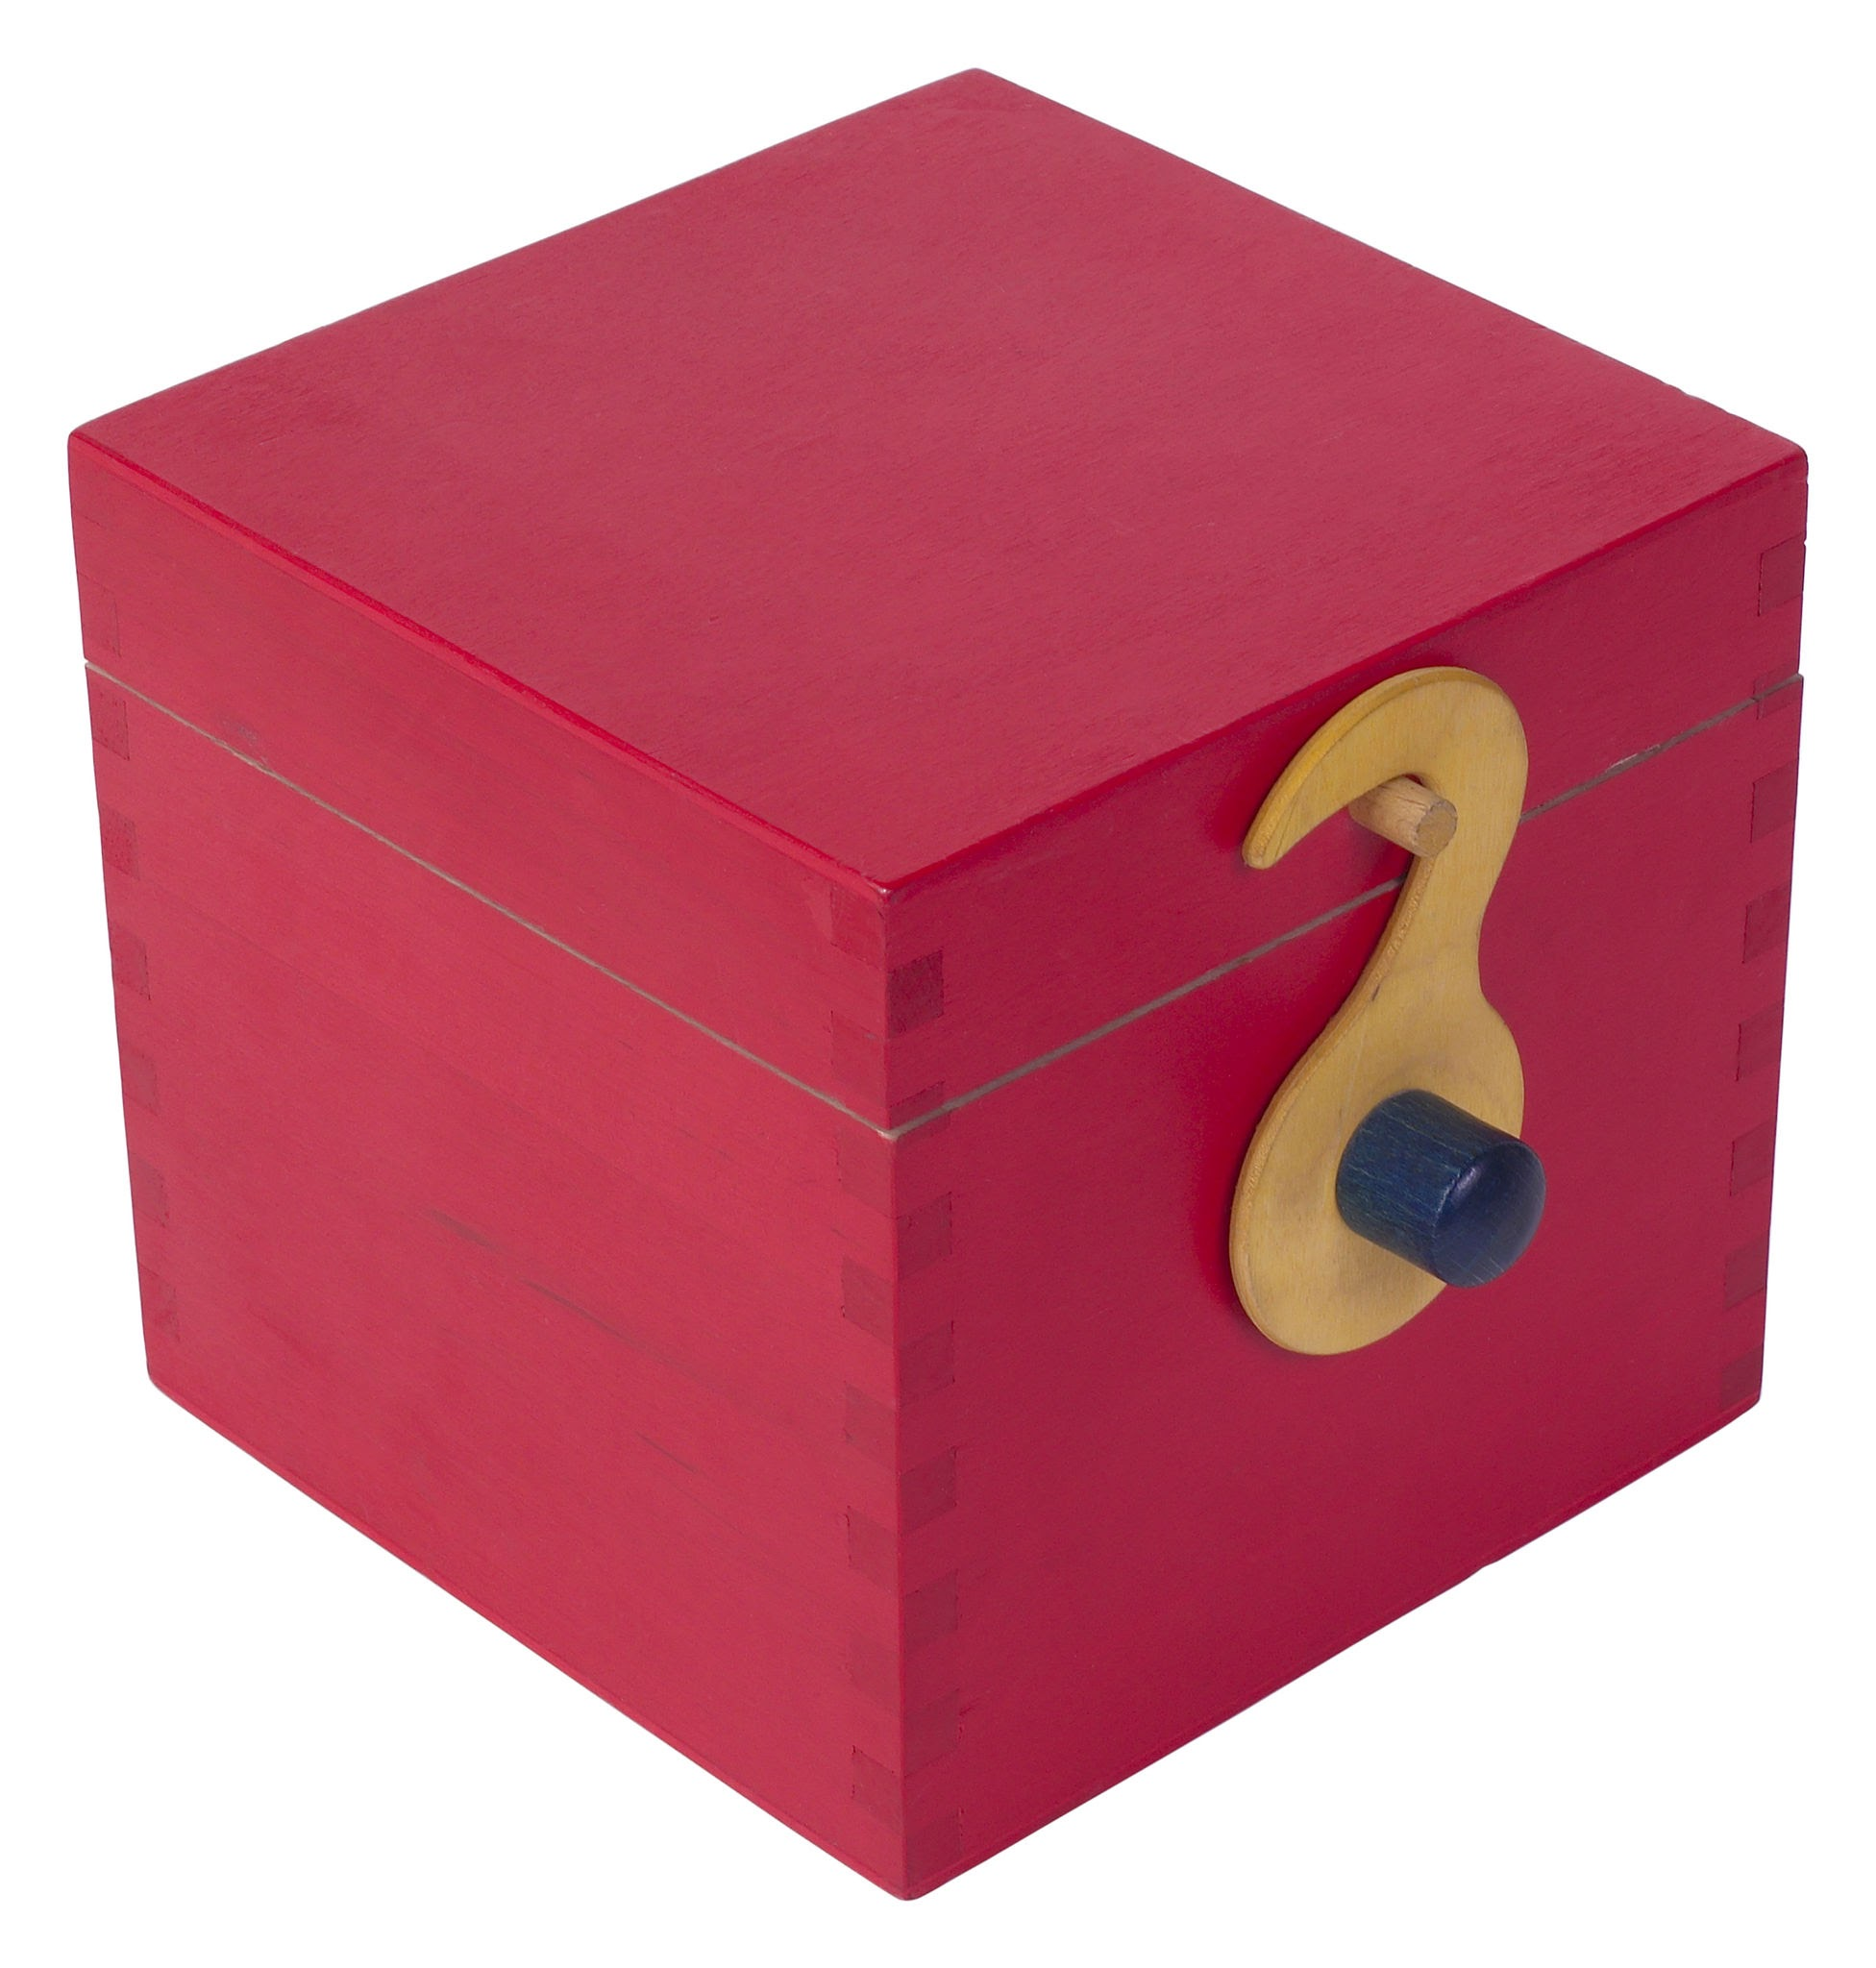
3 toys

Slide 34
2 toys
2 toys
3 toys

Slide 35
2 toys
2 toys
How many?
3 toys

Slide 36
2 toys
2 toys
How many?
3 toys

Slide 37
2 toys
2 toys
How many?
3 toys

Slide 38
2 toys
1 toy
3 toys

