Slide 1
This is an array

Slide 2
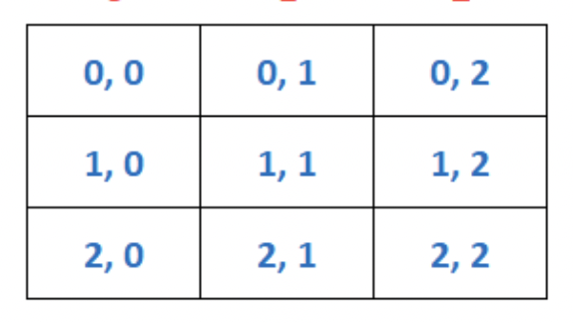
This is an array

Slide 3

This is an array

Slide 4

This is an array

Slide 5

This is an array

Slide 6
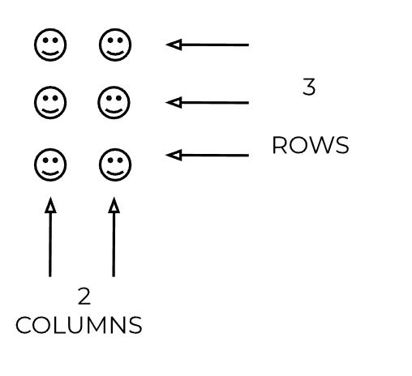
This is an array

Slide 7
It has rows

Slide 8
It has rows

Slide 9
It has rows

Slide 11
It has columns

Slide 12
It has columns

Slide 13
It has columns

Slide 15
How many rows?

Slide 16
How many rows?

Slide 17
3
rows

Slide 19
How many columns?

Slide 20
How many columns?

Slide 21
2
columns

Slide 23
Rows and column make EQUAL GROUPS

Slide 24
EQUAL GROUPS

Slide 25
EQUAL GROUPS

Slide 26
EQUAL GROUPS

Slide 27
EQUAL GROUPS

Slide 28
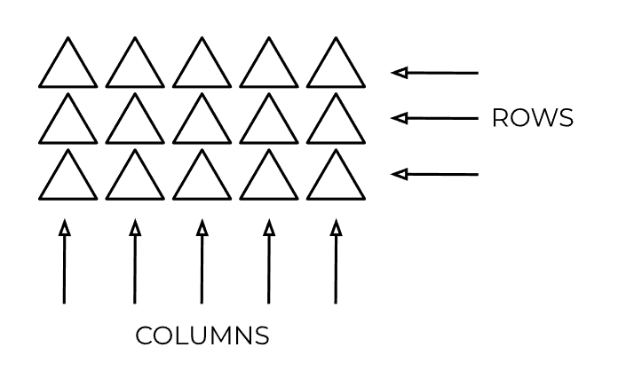
EQUAL GROUPS

Slide 29
EQUAL GROUPS

Slide 30
EQUAL GROUPS

Slide 31
EQUAL GROUPS

Slide 32
3 EQUAL GROUPS

Slide 33
EQUAL GROUPS

Slide 34
EQUAL GROUPS

Slide 35
EQUAL GROUPS

Slide 36
EQUAL GROUPS

Slide 37
EQUAL GROUPS

Slide 38
EQUAL GROUPS

Slide 39
5 EQUAL GROUPS

Slide 40
EQUAL GROUPS

Slide 41

EQUAL GROUPS

Slide 42
EQUAL GROUPS

Slide 43
EQUAL GROUPS

Slide 44
EQUAL GROUPS

Slide 45
EQUAL GROUPS

Slide 46
4 EQUAL GROUPS

Slide 47
EQUAL GROUPS

Slide 48
EQUAL GROUPS

Slide 49
1 EQUAL GROUP

Slide 50
The following slides can be used to introduce the Application activity

Slide 51
Draw an array with 3 columns and 2 rows

Slide 52
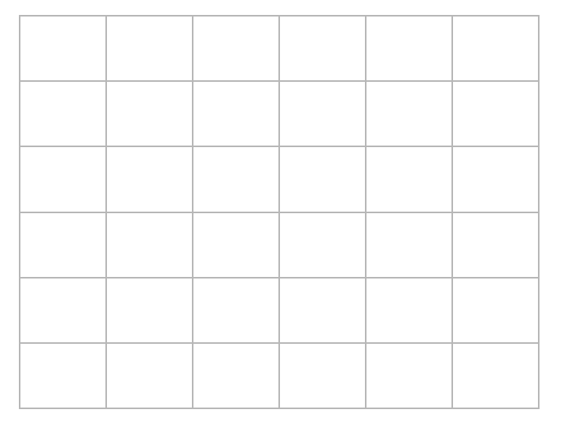
Draw an array with 3 columns and 2 rows

Slide 53
Draw an array with 3 columns and 2 rows

Slide 54
Draw an array with 3 columns and 2 rows

Slide 55
Draw an array with 3 columns and 2 rows

Slide 56
Draw an array with 3 columns and 2 rows

Slide 57
Draw an array with 3 columns and 2 rows

Slide 58
Draw an array with 2 columns and 4 rows

Slide 59
Draw an array with 2 columns and 4 rows

Slide 60
Draw an array with 2 columns and 4 rows

Slide 61
Draw an array with 2 columns and 4 rows

Slide 62
Draw an array with 2 columns and 4 rows

Slide 63
Draw an array with 2 columns and 4 rows

Slide 64
Draw an array with 1 column and 3 rows

Slide 65
Draw an array with 1 column and 3 rows

Slide 66
Draw an array with 1 column and 3 rows

Slide 67
Draw an array with 1 column and 3 rows

Slide 68
Draw an array with 1 column and 3 rows

Slide 69
Draw an array with 1 column and 3 rows

Slide 70
Draw an array with 5 columns and 2 rows

Slide 71
Draw an array with 5 columns and 2 rows

Slide 72
Draw an array with 5 columns and 2 rows

Slide 73
Draw an array with 5 columns and 2 rows

Slide 74
Draw an array with 5 columns and 2 rows

Slide 75
Draw an array with 5 columns and 2 rows

Slide 76
Another method…

Slide 77
Draw an array with 3 columns and 2 rows

Slide 78
Draw an array with 3 columns and 2 rows

Slide 79
Draw an array with 3 columns and 2 rows

Slide 80
Draw an array with 3 columns and 2 rows

Slide 81
Draw an array with 3 columns and 2 rows

Slide 82
Draw an array with 3 columns and 2 rows

Slide 83
Draw an array with 3 columns and 2 rows

Slide 84
Draw an array with 3 columns and 2 rows

