Slide 1
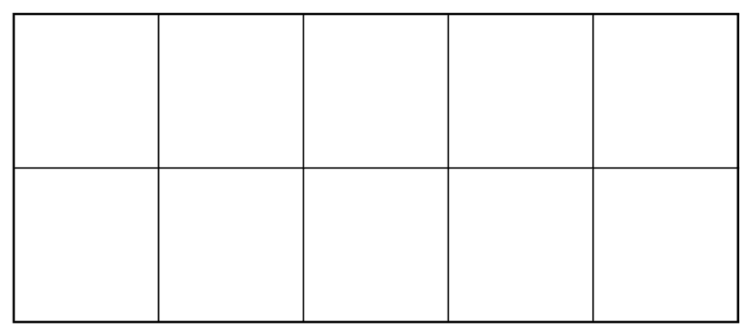
Remember

Slide 7
Let’s add another row

Slide 8
“5 and 1 more”

Slide 9
“5 and 2 more”

Slide 10
“5 and 3 more”

Slide 11
“5 and 3 more”

Slide 12
“5 and 4 more”

Slide 13
“5 and 5 more”

Slide 14
“This is 10”

Slide 15
What about 10 and

Slide 16
What about 10 and 1 more

Slide 17
What about 10 and 2 more

Slide 18
What about 10 and 3 more

Slide 19
What about 10 and 4 more

Slide 20
What about 10 and 5 more

Slide 21
What about 10 and 6 more

Slide 22
What about 10 and 7 more

Slide 23
What about 10 and 8 more

Slide 24
What about 10 and 9 more

Slide 25
What about 10 and 10 more

Slide 26
10

Slide 27
11

Slide 28
12

Slide 29
13

Slide 30
14

Slide 31
15

Slide 32
16

Slide 33
17

Slide 34
18

Slide 35
19

Slide 36
20

Slide 37
How many?

Slide 38
How many?

Slide 39
10 and 7 more

Slide 40
10 and 7 more
17

Slide 41
How many?

Slide 42
10 and 3 more

Slide 43
10 and 3 more
13

Slide 44
How many?

Slide 45
10 and 8 more

Slide 46
10 and 8 more
18

Slide 47
How many?

Slide 48
10 and 5 more

Slide 49
10 and 5 more
15

Slide 50
How many?

Slide 51
10 and 3 more

Slide 52
10 and 3 more
13

Slide 53
How many?

Slide 54
10 and 2 more

Slide 55
10 and 2 more
12

Slide 56
How many?

Slide 57
10 and 0 more

Slide 58
10 and 0 more
10

Slide 59
How many?

Slide 60
10 and 6 more

Slide 61
10 and 6 more
16

Slide 62
How many?

Slide 63
10 and 9 more

Slide 64
10 and 9 more
19

Slide 65
How many?

Slide 66
10 and 1 more

Slide 67
10 and 1 more
11

Slide 68
Practice

Slide 70
10 and 7 more

Slide 71
10 and 7 more
Say the number
Write the digit

Slide 72
10 and 3 more

Slide 73
10 and 3 more
Say the number
Write the digit

Slide 75
10 and 3 more

Slide 76
10 and 3 more
Say the number
Write the digit

Slide 78
10 and 8 more

Slide 79
10 and 8 more
Say the number
Write the digit

Slide 81
10 and 5 more

Slide 82
10 and 5 more
Say the number
Write the digit

Slide 84
10 and 4 more

Slide 85
10 and 4 more
Say the number
Write the digit

Slide 87
10 and 2 more

Slide 88
10 and 2 more
Say the number
Write the digit

Slide 90
10 and 0 more

Slide 91
10 and 0 more
Say the number
Write the digit

Slide 93
10 and 6 more

Slide 94
10 and 6 more
Say the number
Write the digit

Slide 96
10 and 9 more

Slide 97
10 and 9 more
Say the number
Write the digit

Slide 99
10 and 1 more

Slide 100
10 and 1 more
Say the number
Write the digit

Slide 102
10 and 10 more

Slide 103
10 and 10 more
Say the number
Write the digit

