Slide 1
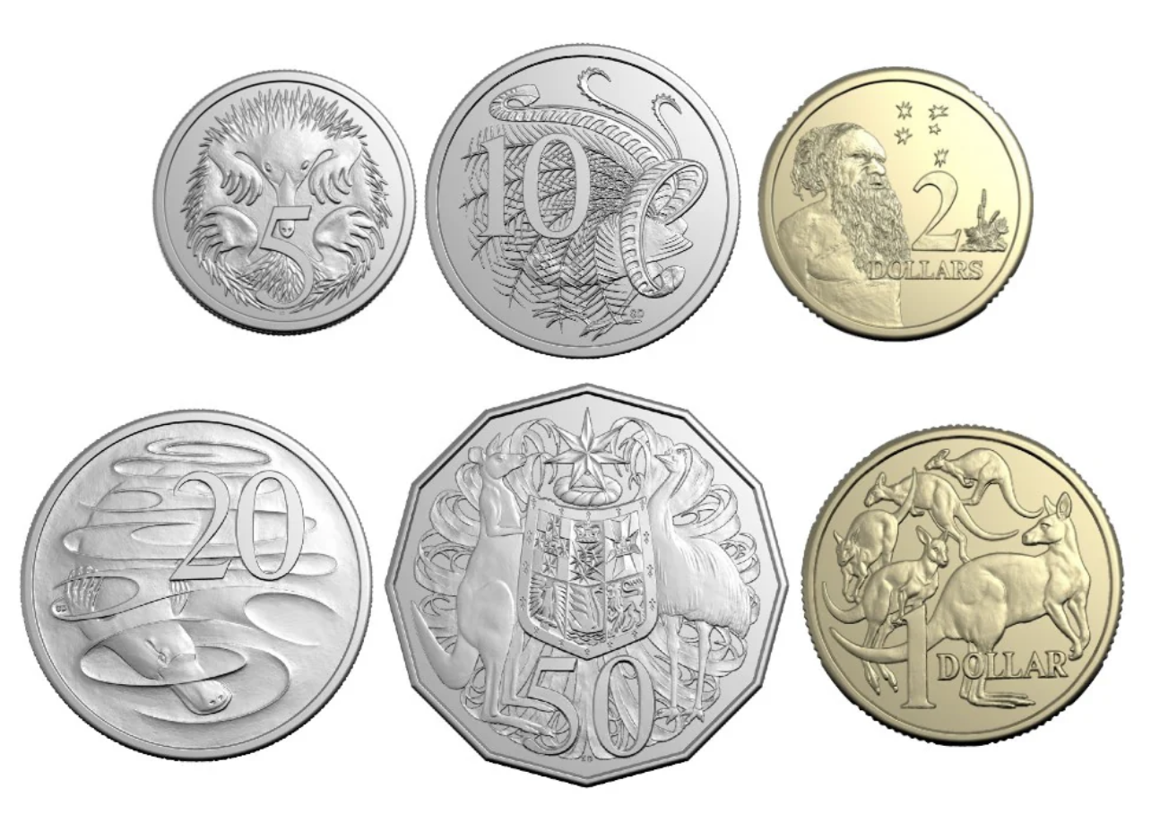
What coin is this?

Slide 2
What coin is this?
5 cents

Slide 3
What coin is this?
5 cents
5c

Slide 4
What picture is on this coin?

Slide 5
What picture is on this coin?
an echidna

Slide 6
What coin is this?

Slide 7
What coin is this?
10 cents

Slide 8
What coin is this?
10 cents
10c

Slide 9
What picture is on this coin?

Slide 10
What picture is on this coin?
a lyrebird

Slide 11
What coin is this?

Slide 12
What coin is this?
20 cents

Slide 13
What coin is this?
20 cents
20c

Slide 14
What picture is on this coin?

Slide 15
What picture is on this coin?
a platypus

Slide 16
What coin is this?

Slide 17
What coin is this?
50 cents

Slide 18
What coin is this?
50 cents
50c

Slide 19
What picture is on this coin?

Slide 20
What picture is on this coin?
a kangaroo and an emu
the Commonwealth coat of arms

Slide 21
What shape are these coins?

Slide 22
What shape are these coins?
Circles

Slide 23
What shape are these coins?
Circles
12 sides

Slide 24
What shape are these coins?
Circles
Dodecagon

Slide 25
Which coin has the highest value?

Slide 26
Which coin has the lowest value?

Slide 27
Which coin has the highest value?

Slide 28
Which coin has the lowest value?

Slide 29
Which coin has the highest value?

Slide 30
Which coin has the lowest value?

Slide 31
Which coin has the highest value?

Slide 32
Which coin has the lowest value?

Slide 33
What does the other side of this coin look like?

Slide 34
What does the other side of this coin look like?

Slide 35
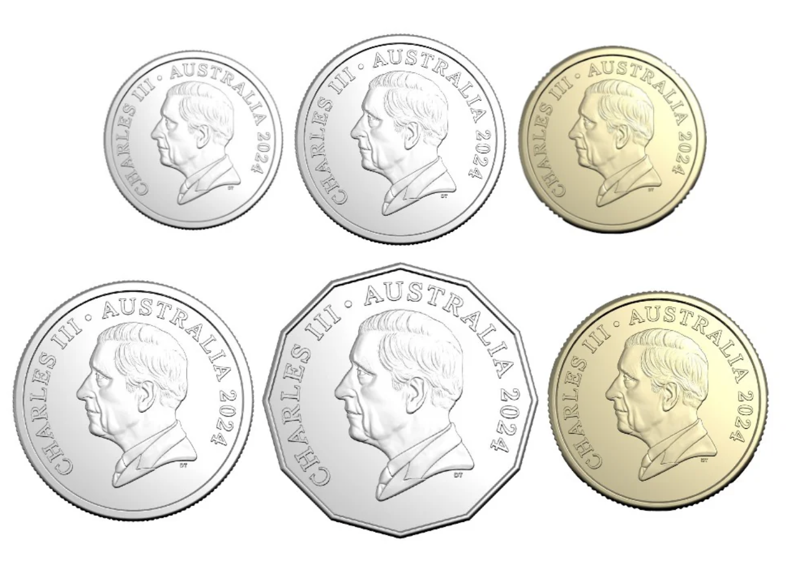
What does the other side of this coin look like?

Slide 36
What does the other side of this coin look like?

Slide 37
What does the other side of this coin look like?

Slide 38
What does the other side of this coin look like?

Slide 39
These are the two sides. What do we call the sides?

Slide 40
Tails

Slide 41
Tails
Heads

Slide 42
What coins can we use to make 30 cents?

Slide 43
What coins can we use to make 30 cents?

Slide 44
What coins can we use to make 30 cents?

Slide 45
What coins can we use to make 30 cents?

