Slide 1
Let’s describe this number using tens and ones

Slide 2
Let’s describe this number using tens and ones
37

Slide 3
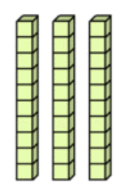
37

Slide 4
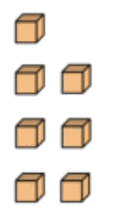
37

Slide 5
37
3 tens & 7 ones

Slide 6
Let’s describe this number using tens and ones

Slide 7
Let’s describe this number using tens and ones
48

Slide 8
48

Slide 9
48

Slide 10
48
4 tens & 8 ones

Slide 11
Let’s describe this number using tens and ones

Slide 12
Let’s describe this number using tens and ones
90

Slide 13
90

Slide 14
90
9 tens

Slide 15
Let’s describe this number using tens and ones

Slide 16
Let’s describe this number using tens and ones
5

Slide 17
5

Slide 18
5
5 ones

Slide 19
Let’s describe this number using tens and ones

Slide 20
Let’s describe this number using tens and ones
19

Slide 21
19

Slide 22
19

Slide 23
19
1 ten & 9 ones

