Slide 1


Slide 2
I have 3 pencils

Slide 3
I have 3 pencils. I find 2 more pencils.

Slide 4
I have 3 pencils. I find 2 more pencils.

Slide 5
3
I have 3 pencils. I find 2 more pencils.

Slide 6
3 +
I have 3 pencils. I find 2 more pencils.

Slide 7
3 + 2
I have 3 pencils. I find 2 more pencils.

Slide 8
3 + 2 = 5
I have 3 pencils. I find 2 more pencils.

Slide 9
Now I have 5 pencils.

Slide 10
Now I have 5 pencils. But I lose 2.

Slide 11

Now I have 5 pencils. But I lose 2.

Slide 12
5
Now I have 5 pencils. But I lose 2.

Slide 13
5 - 2
Now I have 5 pencils. But I lose 2.

Slide 14
5 - 2 = 3
Now I have 5 pencils. But I lose 2.

Slide 15
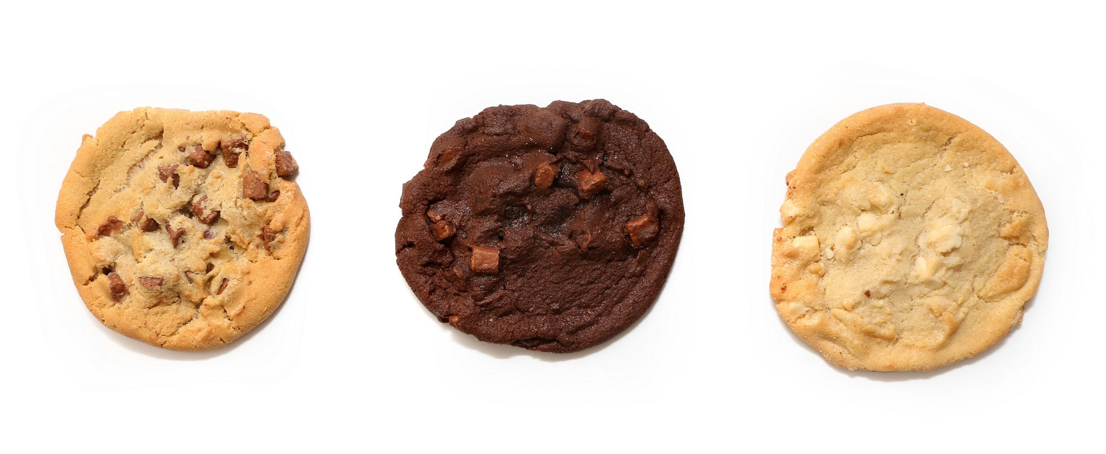
There is 1 cookie in a jar.

Slide 16
1
There is 1 cookie in a jar.

Slide 17
1
There is 1 cookie in a jar.

Slide 18
1
There is 1 cookie in a jar. 2 more cookies go into the jar.

Slide 19
1 + 2
There is 1 cookie in a jar. 2 more cookies go into the jar.

Slide 20
1 + 2 = 3
Now there are 3 cookies in the jar.

Slide 21
1 + 2 = 3
What do we need to do to have only 1 cookie in the jar again?

Slide 22
1 + 2 = 3
What do we need to do to have only 1 cookie in the jar again?

Slide 23
1 + 2 = 3
3
What do we need to do to have only 1 cookie in the jar again?

Slide 24
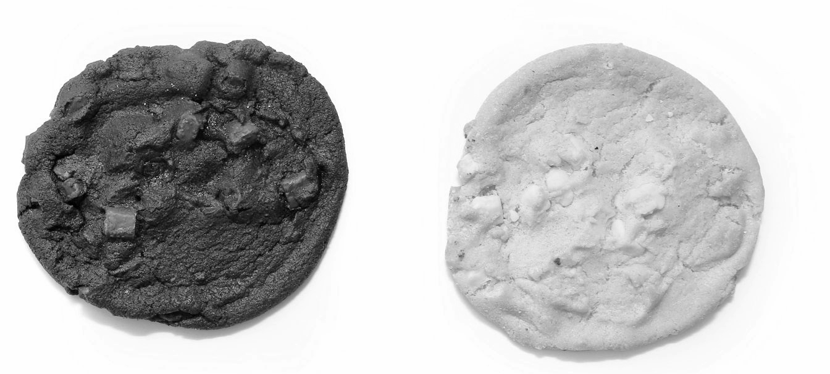
1 + 2 = 3
3
What do we need to do to have only 1 cookie in the jar again?

Slide 25
1 + 2 = 3
3 - 2
What do we need to do to have only 1 cookie in the jar again?

Slide 26
1 + 2 = 3
3 - 2
What do we need to do to have only 1 cookie in the jar again?

Slide 27
1 + 2 = 3
3 - 2 = 1
What do we need to do to have only 1 cookie in the jar again?

Slide 28
1 + 2 = 3
3 - 2 = 1
Look at these equations.

