Slide 1
These are called tally marks

Slide 2
This represents the number ten
10

Slide 3
This represents the number five
5

Slide 4
Let’s start with one
1

Slide 5
Let’s start with one
1

Slide 6
2

Slide 7
3

Slide 8
4

Slide 9
5

Slide 14
10

Slide 15
What number

Slide 44
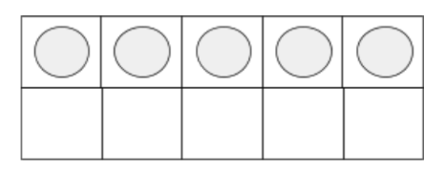
Practice drawing after counting

Slide 45
Practice drawing after counting

Slide 46
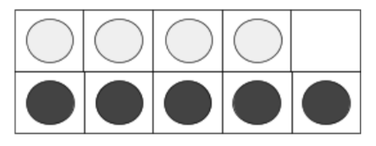
Practice drawing after counting

Slide 47
Practice drawing after counting

Slide 48
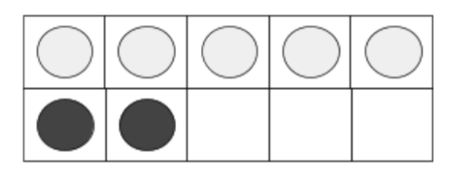
Practice drawing after counting

Slide 49
Practice drawing after counting

Slide 50
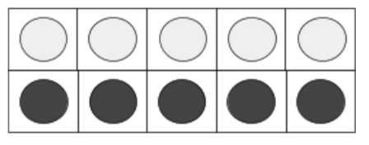
Practice drawing after counting

Slide 51
Practice drawing after counting

Slide 52
Draw this many stars

Slide 53
Draw this many circles

Slide 54
Draw this many dots

Slide 55
Draw this many people

Slide 56
Draw this many diamonds

Slide 57
Draw this many crosses

Slide 58
Draw this many hearts

Slide 59
Draw this many rectangles

