Slide 1
Count

Slide 2
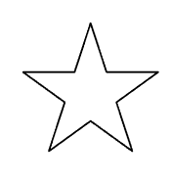


Slide 7
Count

Slide 9
1

Slide 10
2

Slide 11
3

Slide 12
4

Slide 13
5

Slide 14
How many stars?

Slide 15
Count

Slide 16
How many stars?
1

Slide 17
How many stars?
1 2

Slide 18
How many stars?
1 2 3

Slide 19
How many stars?
1 2 3 4

Slide 20
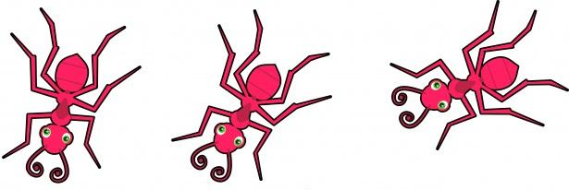
Count

Slide 21
1

Slide 22
1 2

Slide 23
1 2 3

Slide 24
Count

Slide 25
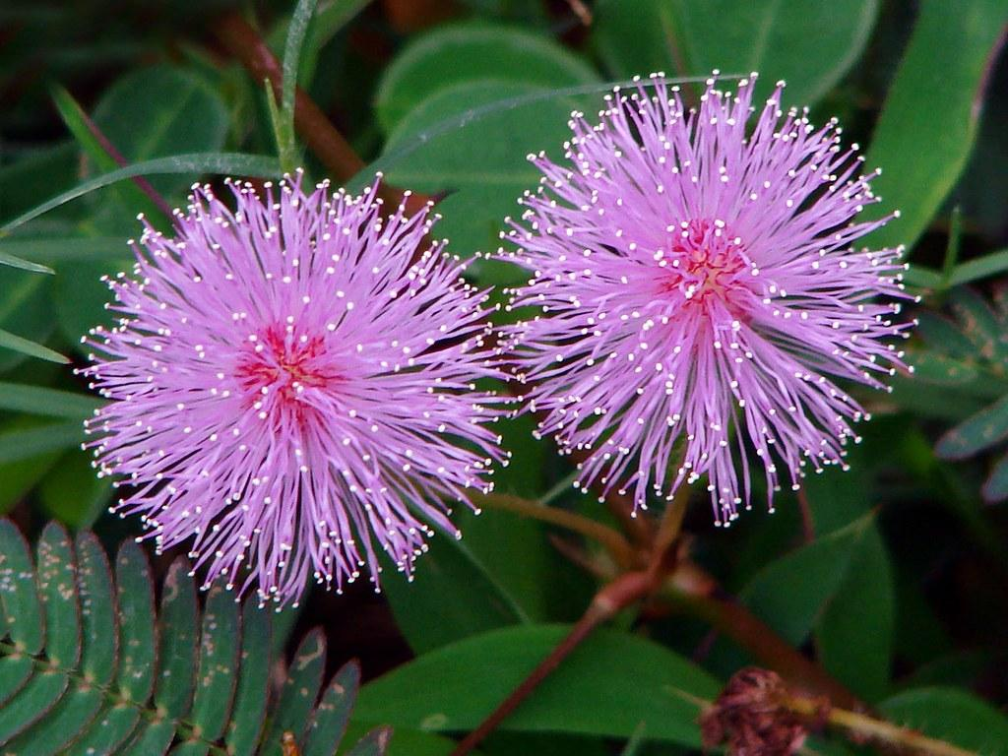
Count

Slide 26
1

Slide 27
1 2

Slide 28
Count

Slide 29
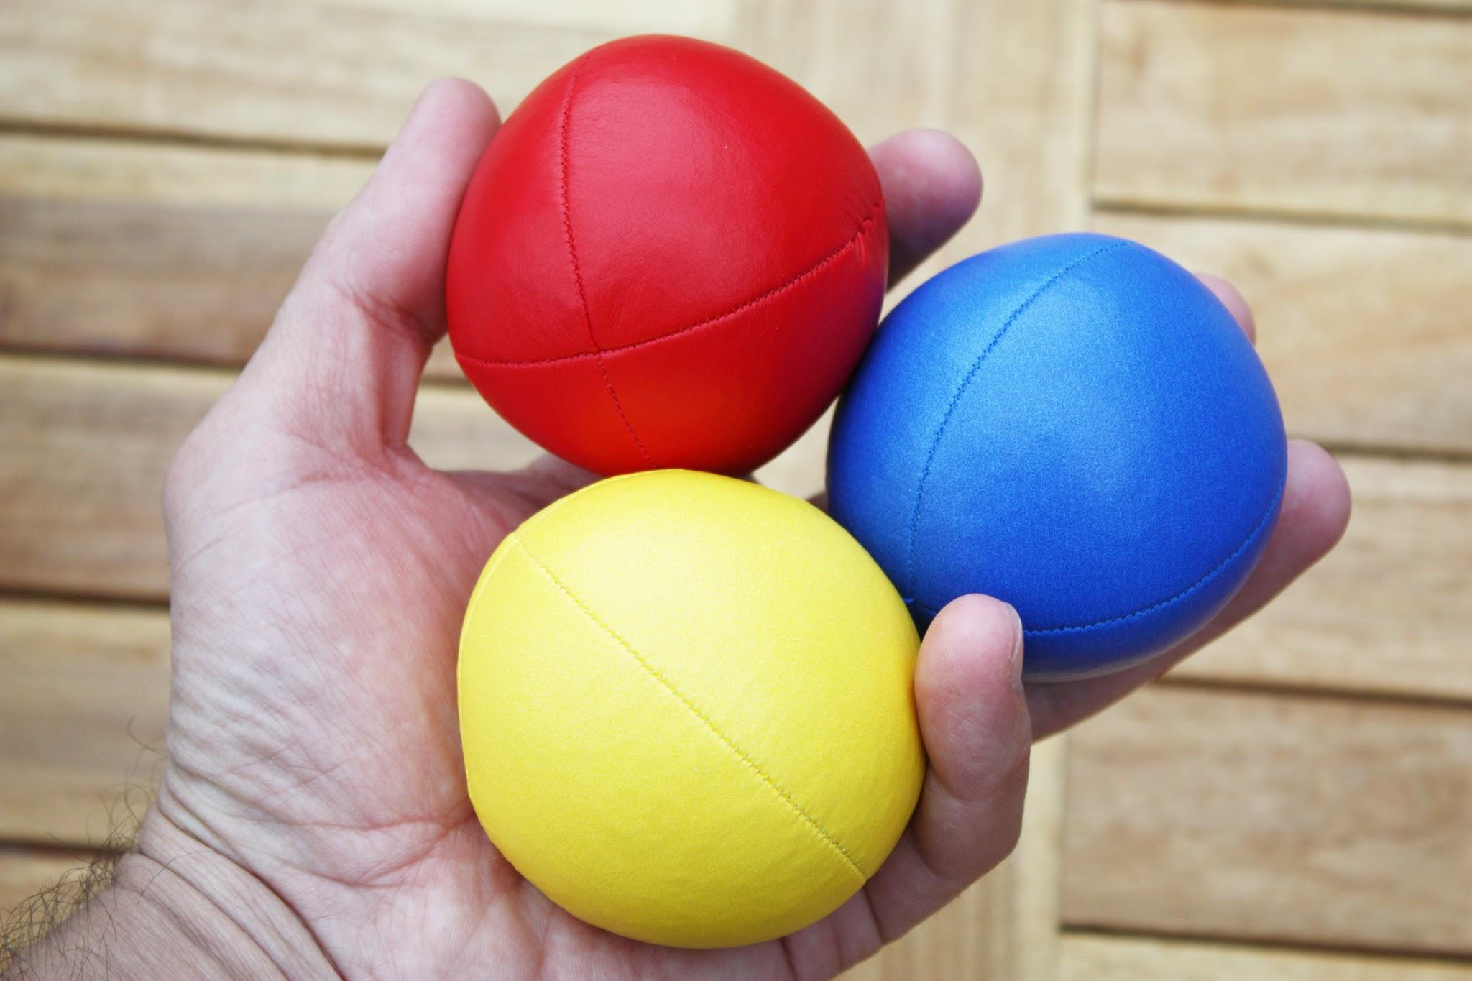
Count

Slide 30
1

Slide 31
1
2

Slide 32
1
2
3

Slide 33
Count

Slide 34
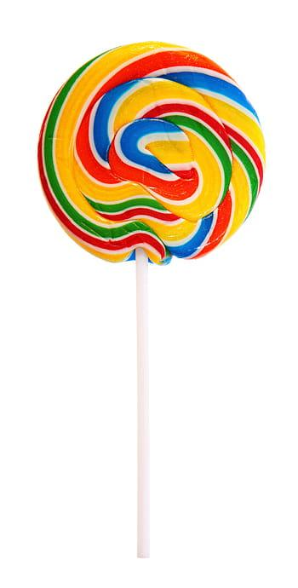
Count

Slide 35
1

Slide 36
Count

Slide 37
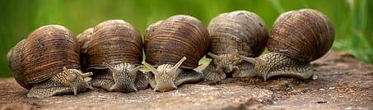
Count

Slide 38
1

Slide 39
1 2

Slide 40
1 2 3

Slide 41
1 2 3 4

Slide 42
1 2 3 4 5

