Slide 1
How many fingers?

Slide 2

0
zero

Slide 3
0 1
zero one

Slide 4
0 1 2
zero one two

Slide 5
0 1 2 3
zero one two three

Slide 6
0 1 2 3 4
zero one two three four

Slide 7
0 1 2 3 4 5
zero one two three four five

Slide 8
How many stars?

Slide 9
0
zero

Slide 10
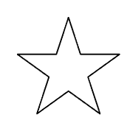
0 1
zero one

Slide 11
0 1 2
zero one two

Slide 12
0 1 2 3
zero one two three

Slide 13
0 1 2 3 4
zero one two three four

Slide 14
0 1 2 3 4 5
zero one two three four five

Slide 15
How many fingers?

Slide 16
0

Slide 17
1

Slide 18
2

Slide 19
3

Slide 20
4

Slide 21
5

Slide 22
How many stars?

Slide 23
How many stars?
Practice writing these digits

Slide 24
0

Slide 25
1

Slide 26
2

Slide 27
3

Slide 28
4

Slide 29
5

Slide 30
How many fingers?

Slide 32
0

Slide 33
0 1

Slide 34
0 1 2

Slide 35
0 1 2
3

Slide 36
How many stars?

Slide 37
How many stars?

Slide 38
How many stars?
0

Slide 39
How many stars?
0 1

Slide 40
How many stars?
0 1 2

Slide 41
How many stars?
0 1 2 3

Slide 42
How many stars?
0 1 2 3 4

Slide 43
How many ants?

Slide 44
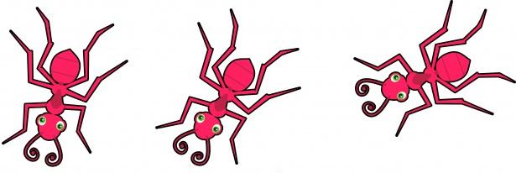
How many ants?

Slide 45
How many ants?
1

Slide 46
How many ants?
1 2

Slide 47
How many ants?
1 2 3

Slide 48
How many flowers?

Slide 49
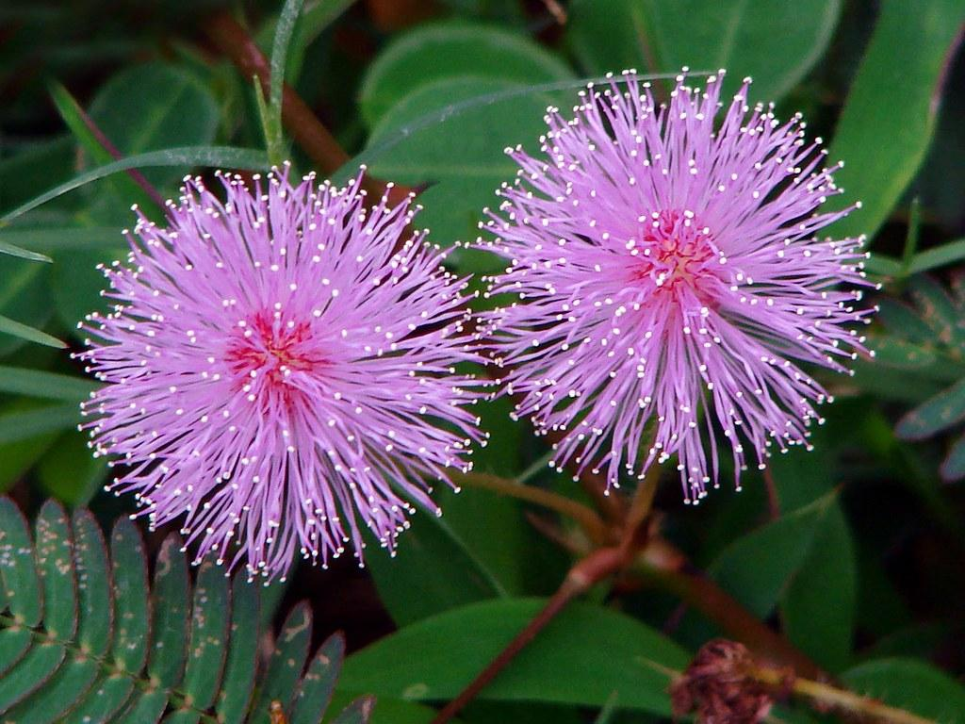
How many flowers?

Slide 50
How many flowers?
1

Slide 51
How many flowers?
1 2

Slide 52
How many balls?

Slide 53
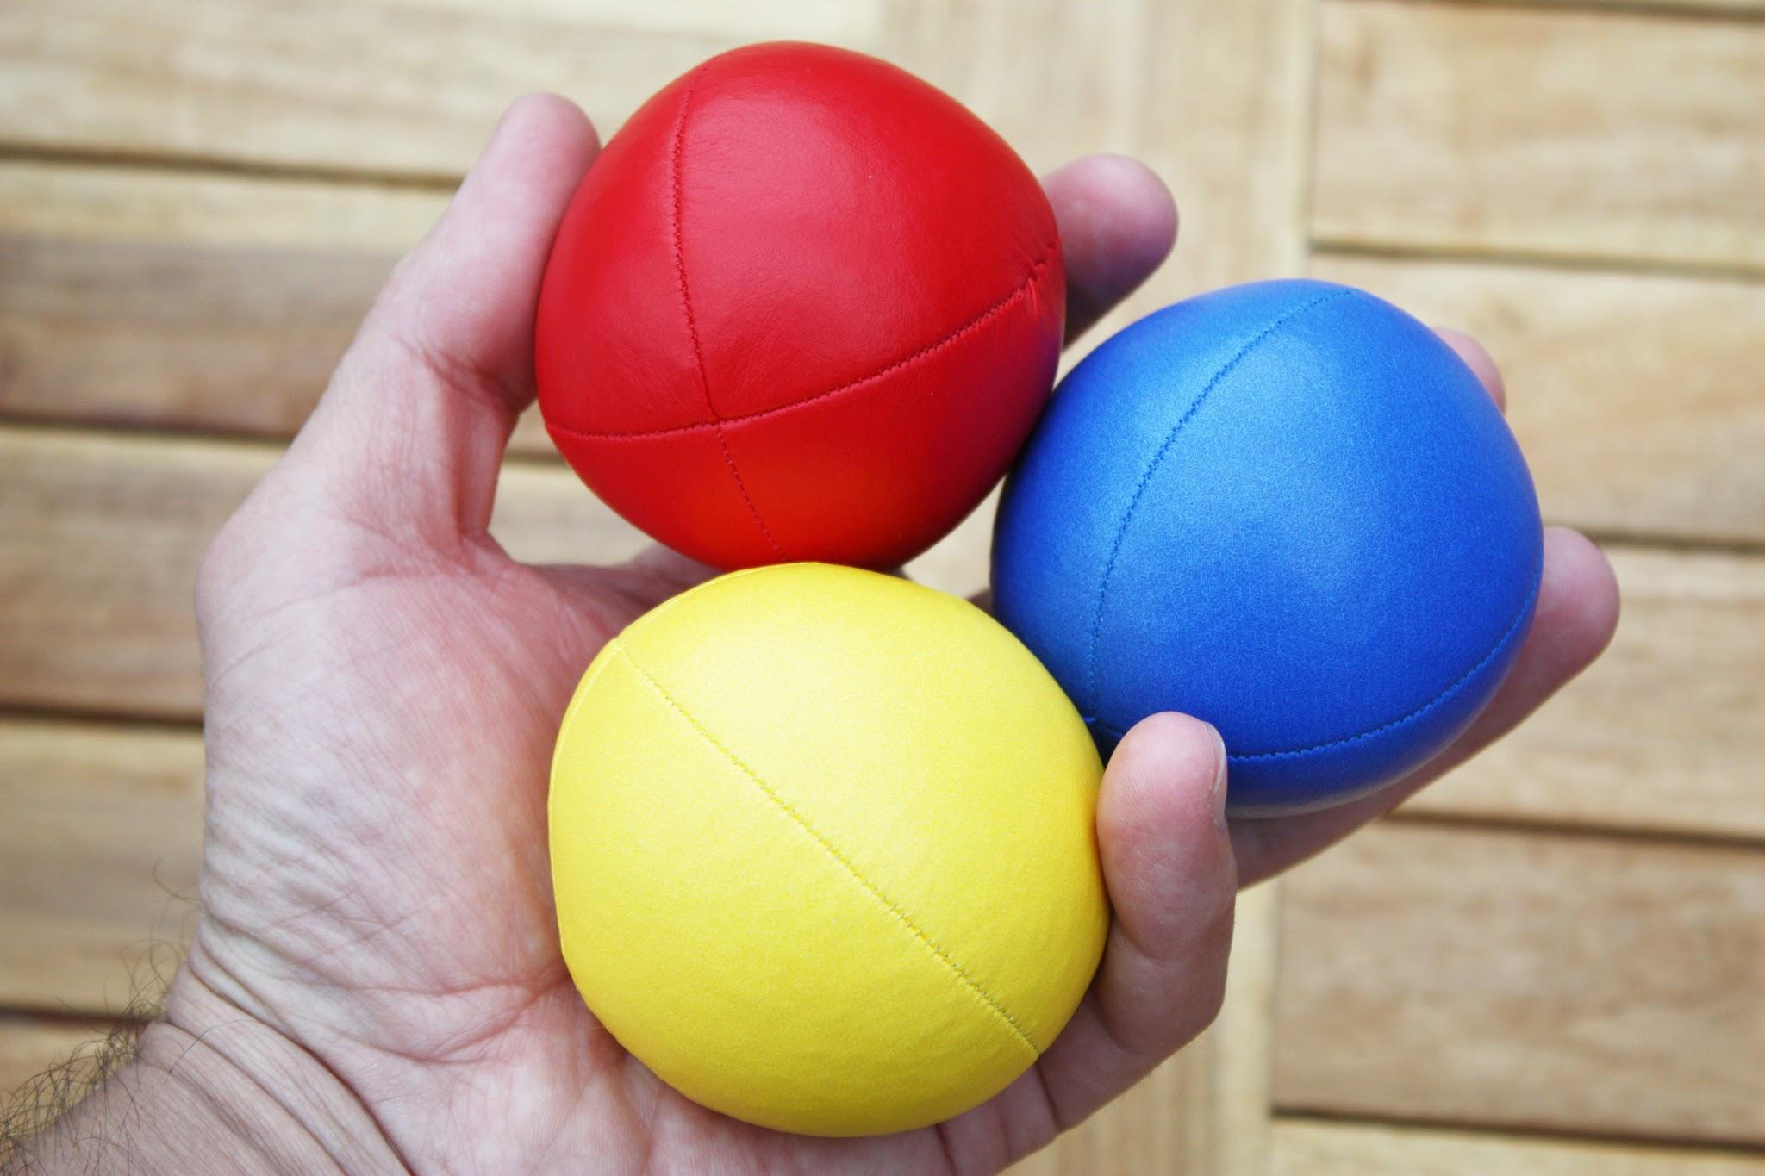
How many balls?

Slide 54
How many balls?
1

Slide 55
How many balls?
1
2

Slide 56
How many balls?
1
2
3

Slide 57
How many lollipops?

Slide 58
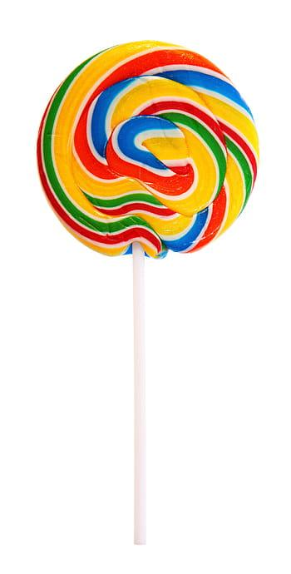
How many lollipops?

Slide 59
How many lollipops?
1

Slide 60
How many snails?

Slide 61
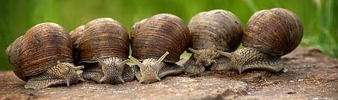
How many snails?

Slide 62
How many snails?
1

Slide 63
How many snails?
1 2

Slide 64
How many snails?
1 2 3

Slide 65
How many snails?
1 2 3 4

Slide 66
How many snails?
1 2 3 4 5

Slide 67
How many stars?

Slide 68
How many stars?
Practice writing these words

Slide 69
0 zero

Slide 70
1 one

Slide 71
2 two

Slide 72
3 three

Slide 73
4 four

Slide 74
5 five

Slide 75
How many fingers?

Slide 76
How many fingers?
Practice writing these words

Slide 78
zero
0

Slide 79
one
0 1

Slide 80
two
0 1 2

Slide 81
three
0 1 2
3

Slide 82
four
0 1 2
3
4

Slide 83
five
0 1 2
3
4
5

Slide 84
How many stars?

Slide 85
How many stars?
Practice writing these words

Slide 86
How many stars?

Slide 87
How many stars?
zero
0

Slide 88
How many stars?
one
0 1

Slide 89
How many stars?
two
0 1 2

Slide 90
How many stars?
three
0 1 2 3

Slide 91
How many stars?
four
0 1 2 3 4

Slide 92
How many stars?
five
0 1 2 3 4 5

Slide 93
How many ants?

Slide 94
How many ants?
Practice writing these words

Slide 95
How many ants?

Slide 96
How many ants?
1
one

Slide 97
How many ants?
1 2
two

Slide 98
How many ants?
1 2 3
three

Slide 99
How many snails?

Slide 100
How many snails?
Practice writing these words

Slide 101
How many snails?

Slide 102
How many snails?
1
one

Slide 103
How many snails?
1 2
two

Slide 104
How many snails?
1 2 3
three

Slide 105
How many snails?
1 2 3 4
four

Slide 106
How many snails?
1 2 3 4 5
five

