Slide 1
2 tens

Slide 2
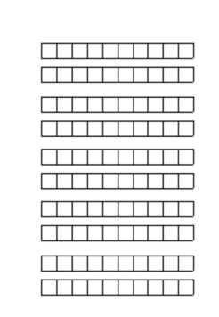
2 tens

Slide 3
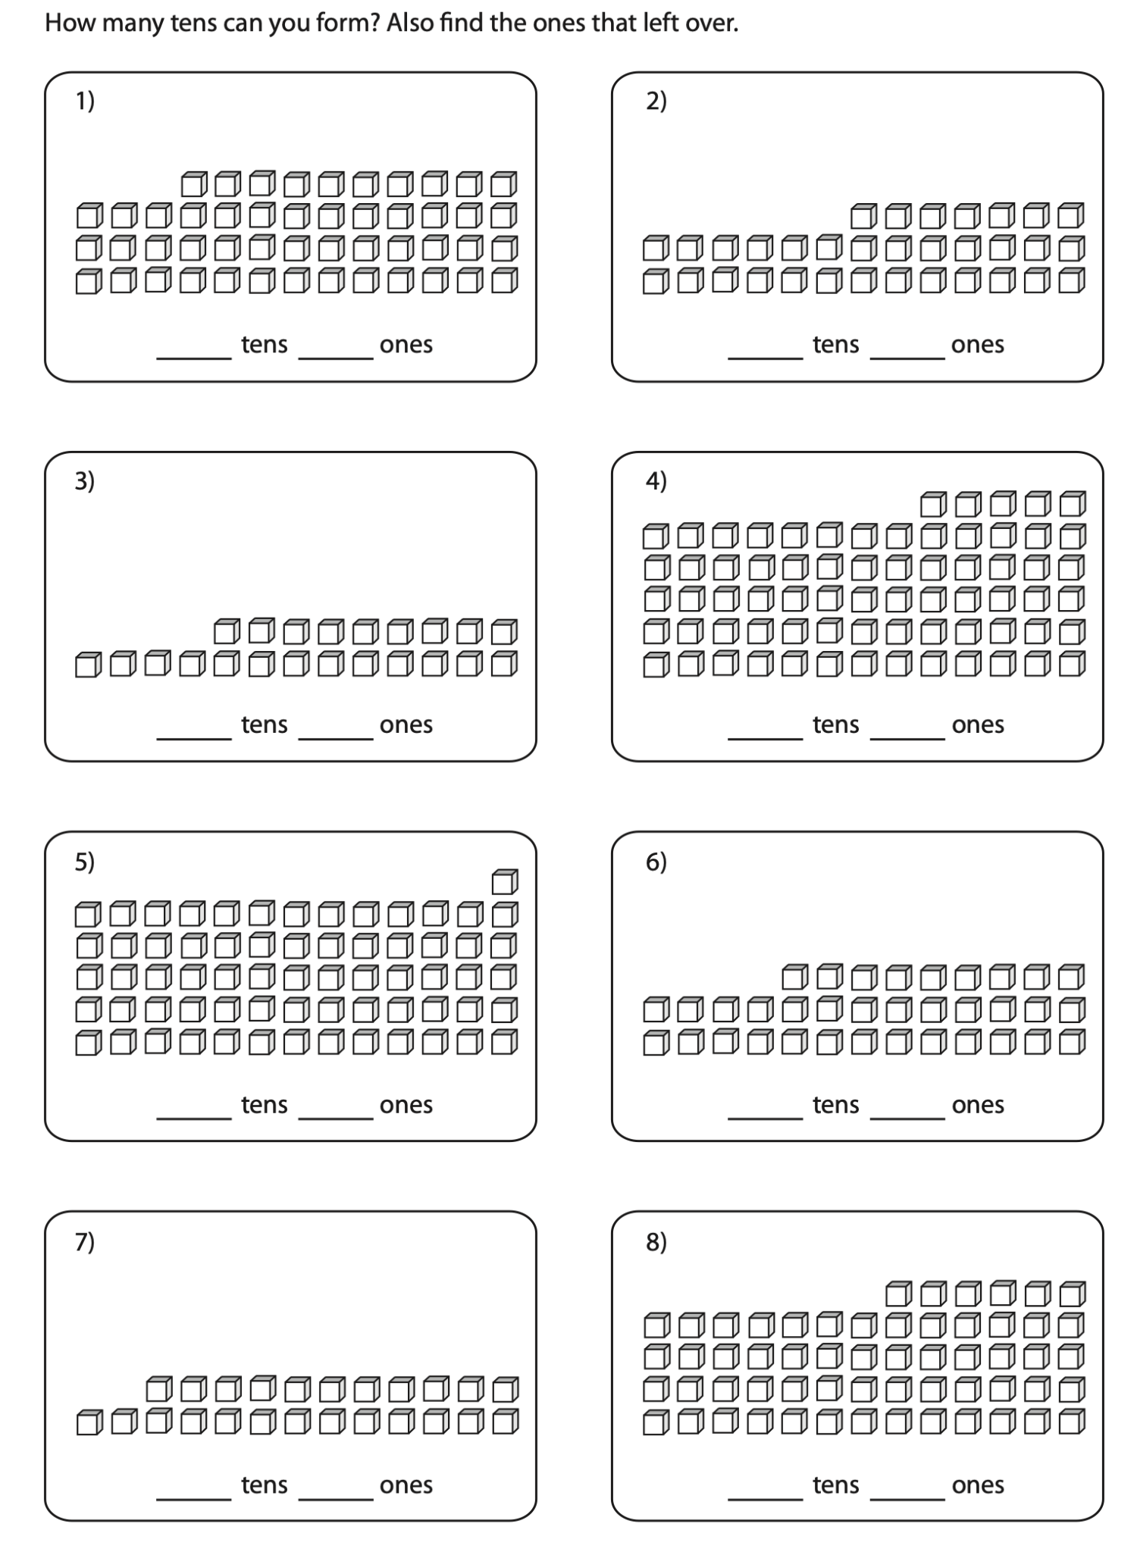
2 tens = ___ ones

Slide 4
2 tens = 20 ones

Slide 5
4 tens

Slide 6
4 tens = ___ ones

Slide 7
4 tens = 40 ones

Slide 8
5 tens

Slide 9
5 tens = ___ ones

Slide 10
5 tens = 50 ones

Slide 11
8 tens

Slide 12
8 tens = ___ ones

Slide 13
8 tens = 80 ones

Slide 14
60

Slide 15
60 = __ tens

Slide 16
60 = __ tens

Slide 17
60 = 60 tens

Slide 18
60 = __ ones

Slide 19
60 = __ ones

Slide 20
60 = 60 ones

Slide 21
40 ones

Slide 22
40 ones

Slide 23
40 ones = ____ tens

Slide 24

40 ones = ____ tens

Slide 25
40 ones = 4 tens

Slide 27
10 ones

Slide 28
10 ones

Slide 29
10 ones =

Slide 30
10 ones = 1 ten

