Slide 1


Compare these book collections using most

Slide 2
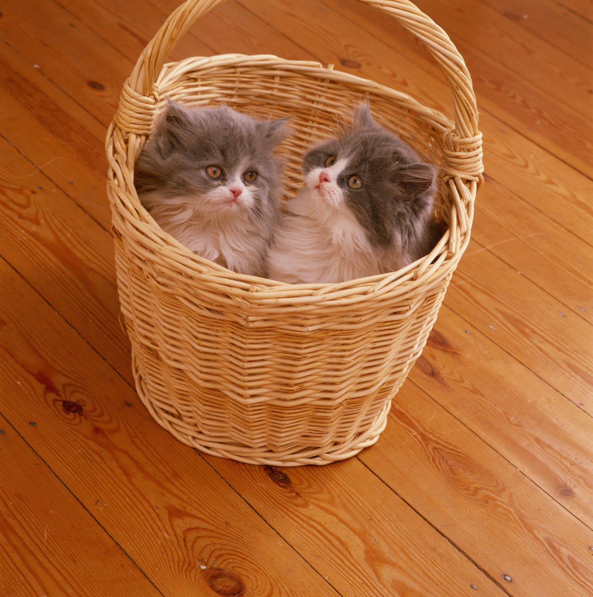
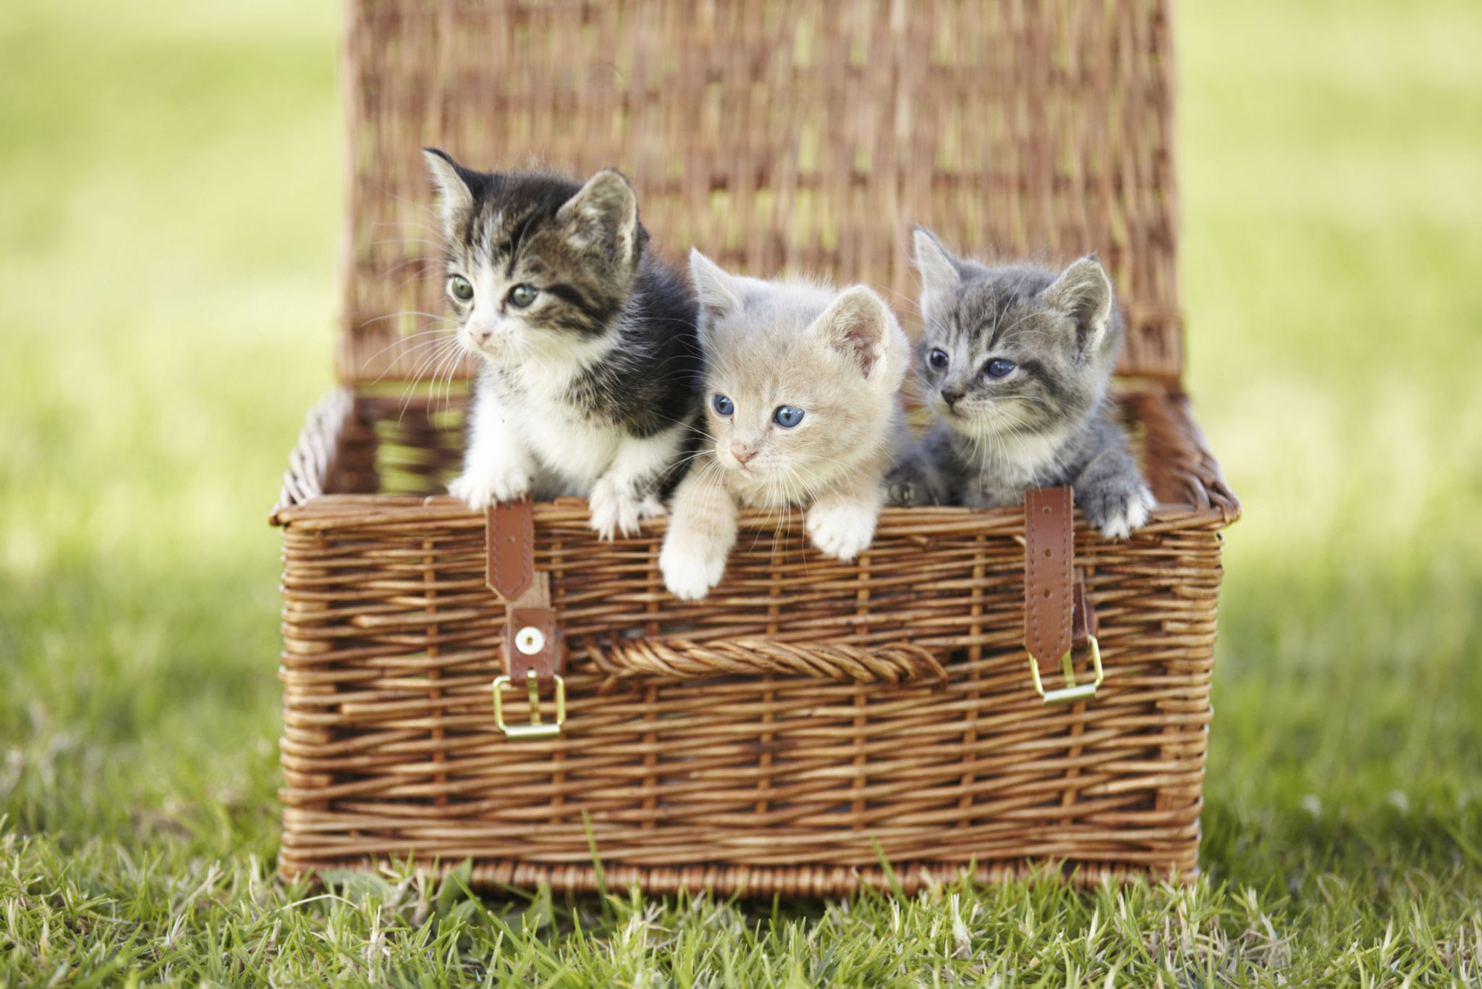
Compare these cat baskets using most

Slide 3
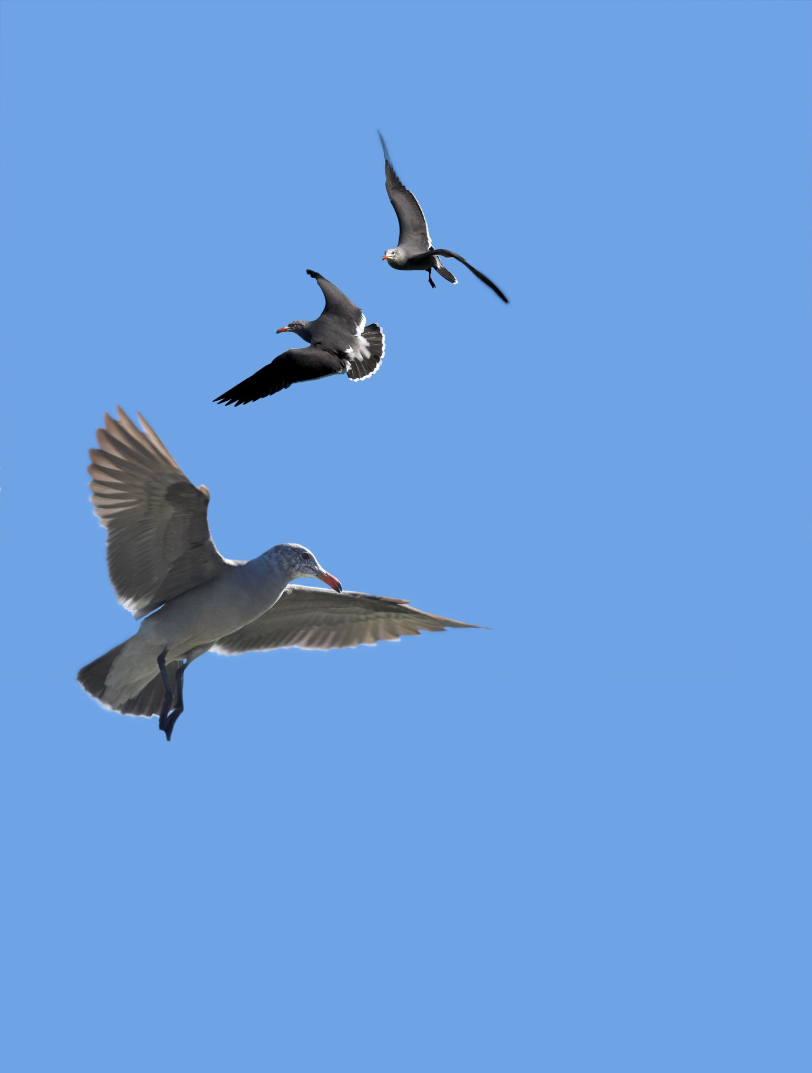

Compare these bird flocks using most

Slide 4
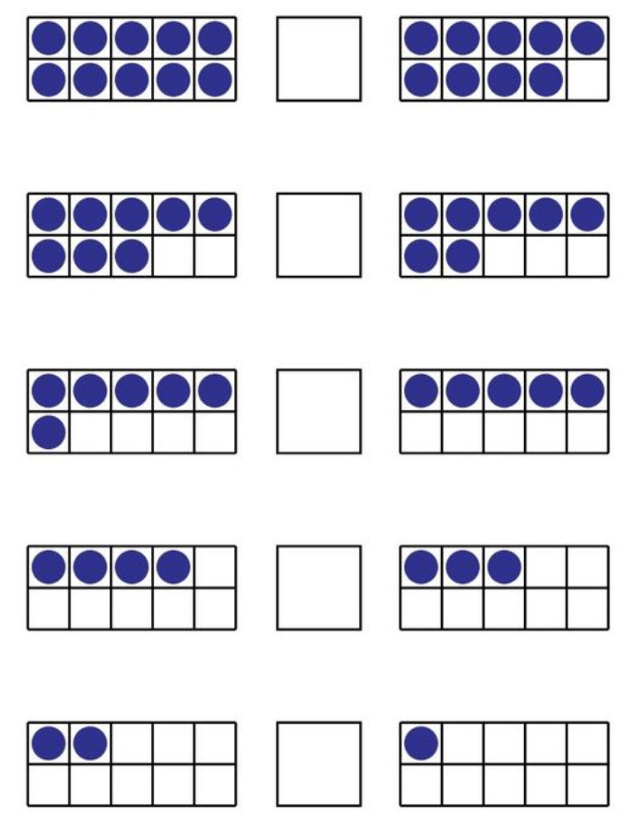
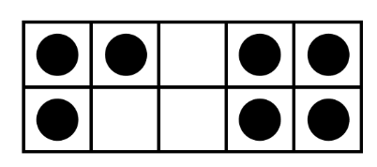
Compare these collections using most

Slide 5
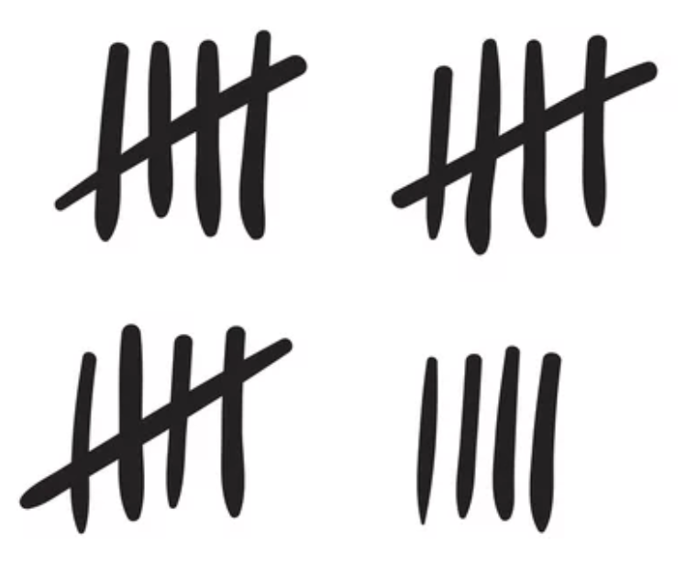
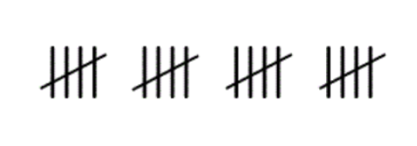
Compare these collections using most

Slide 6
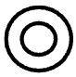
Compare these collections using most

Slide 7



Compare these collections using most

Slide 8
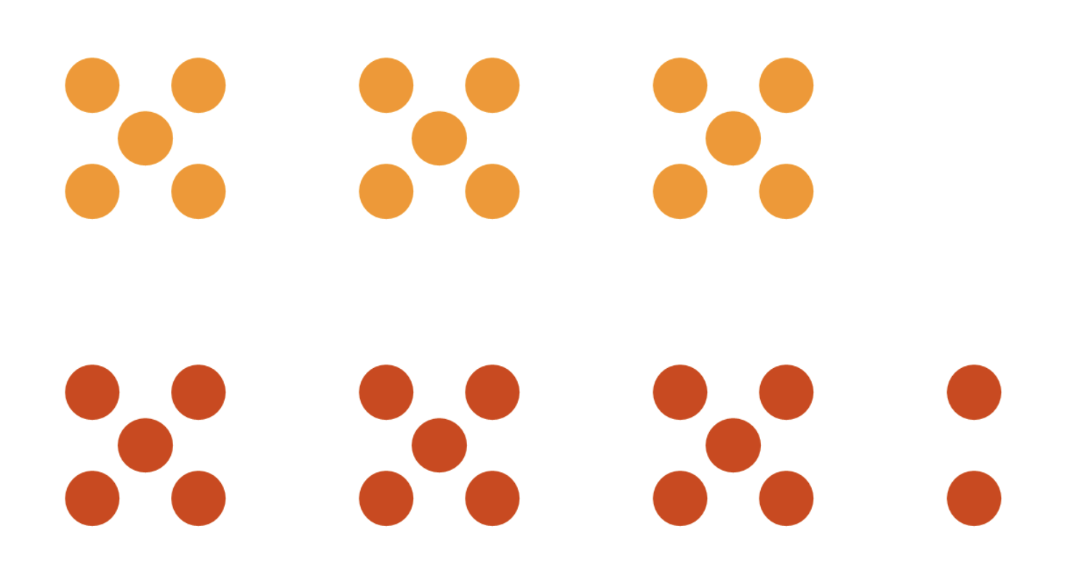
Compare these collections using most

Slide 9
Compare these book collections using least

Slide 10
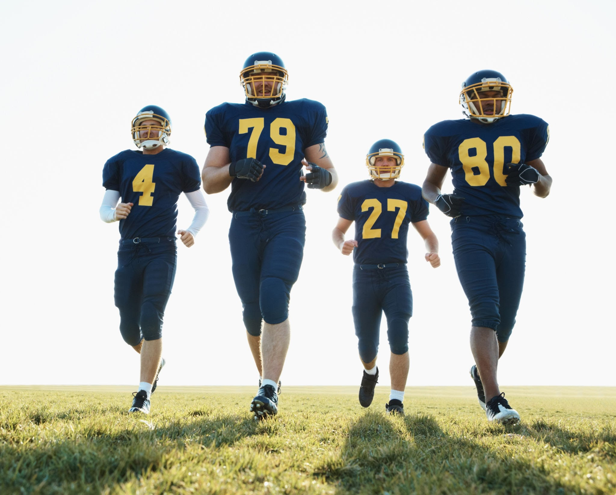
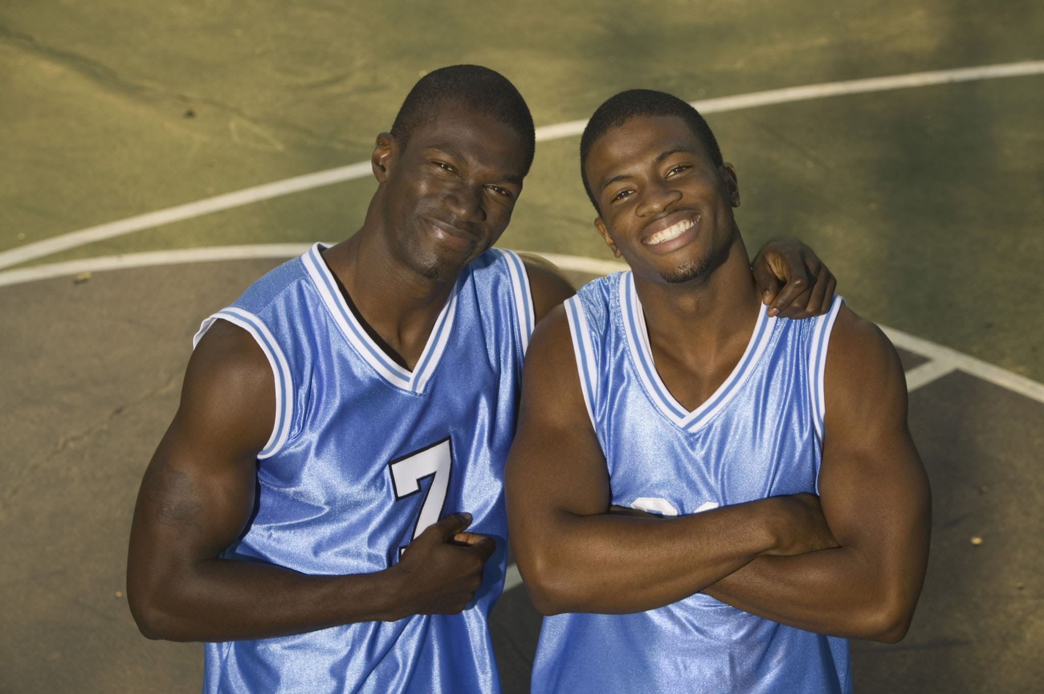
Compare these teams using least

Slide 11
Compare these collections using least

Slide 12
Compare these collections using least or fewest

Slide 13
Compare these collections using least or fewest

Slide 14
Compare these collections using least or fewest

Slide 15
Compare these collections using least or fewest

