Slide 1
Language
part
whole
Part Part Whole Model

Slide 2
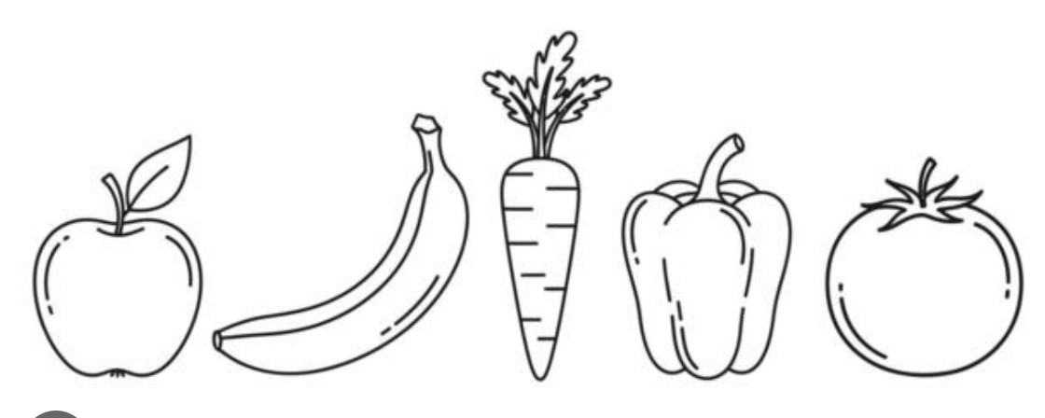
Split the fruit and vegetables into 2 parts.

Slide 3
part
3

Slide 4
part
part
3
2

Slide 5
part
part
3
2

Slide 6
part
3
2
part

Slide 7
part
2
part
3

Slide 8
2
part
part
3

Slide 9
part
part
3
2

Slide 10
whole
5
part
part
3
2

Slide 11
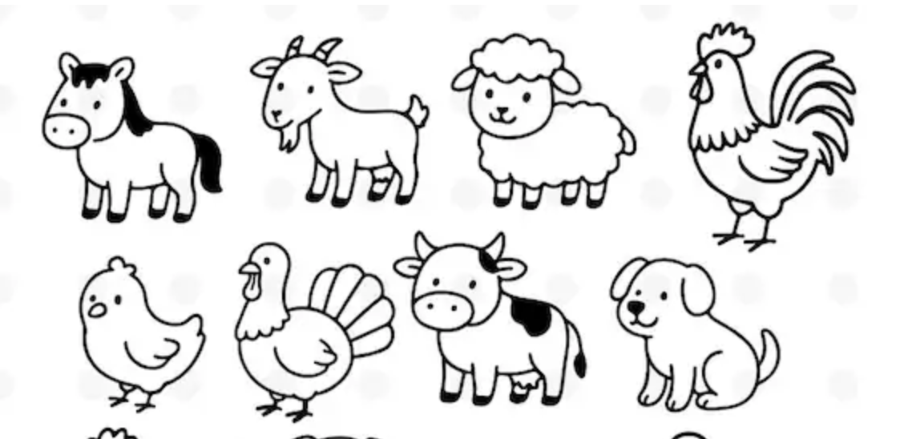
Split the animals into 2 parts.

Slide 12
part
5

Slide 13
part
part
5
2

Slide 14
part
part
5
2

Slide 15
part
5
2
part

Slide 16
part
2
part
5

Slide 17
2
part
part
5

Slide 18
part
part
5
2

Slide 19
whole
7
part
part
5
2

Slide 20

Split these penguins into 2 parts.

Slide 21
part
2

Slide 22
part
part
2
4

Slide 23
part
part
2
4

Slide 24
part
4
part

Slide 25
part
4
part
2

Slide 26
4
part
part
2

Slide 27
part
part
2
4

Slide 28
whole
6
part
part
2
4

Slide 29
Split these penguins into 2 parts.

Slide 30
part
3

Slide 31
part
part
3
3

Slide 32
part
part
3
3

Slide 33
part
3
3
part

Slide 34
part
3
part
3

Slide 35
3
part
part
3

Slide 36
part
part
3
3

Slide 37
whole
part
part
3
3

Slide 38
Split these penguins into 2 parts.

Slide 39
part
3

Slide 40
part
part
3
2

Slide 41
part
part
3
2

Slide 42
part
2
part

Slide 43
part
2
part
3

Slide 44
part
part
3

Slide 45
part
part
3
2

Slide 46
whole
5
part
part
3
2

Slide 47

Split these owls into 2 parts.

Slide 48
part
1

Slide 49
part
part
1
9

Slide 50
part
part
1
9

Slide 51
part
1
9
part

Slide 52
part
9
part
1

Slide 53
9
part
part
1

Slide 54
part
part
1
9

Slide 55
whole
10
part
part
1
9

Slide 56
Split these owls into 2 parts.

Slide 57
part
3

Slide 58
part
part
3
6

Slide 59
part
part
3
6

Slide 60
part
3
6
part

Slide 61
part
6
part
3

Slide 62
6
part
part
3

Slide 63
part
part
3
6

Slide 64
whole
10
part
part
3
6

Slide 65
Split these owls into 2 parts.

Slide 66
part
5

Slide 67
part
part
5
5

Slide 68
part
part
5
5

Slide 69
part
5
5
part

Slide 70
part
5
part
5

Slide 71
5
part
part
5

Slide 72
part
part
5
5

Slide 73
whole
10
part
part
5
5

Slide 74
whole
5
part
part

Slide 75
whole
5
part
part

Slide 76
whole
5
part
part

Slide 77
whole
7
part
part

Slide 78
whole
10
part
part

Slide 79
whole
5
part
part

