Slide 1
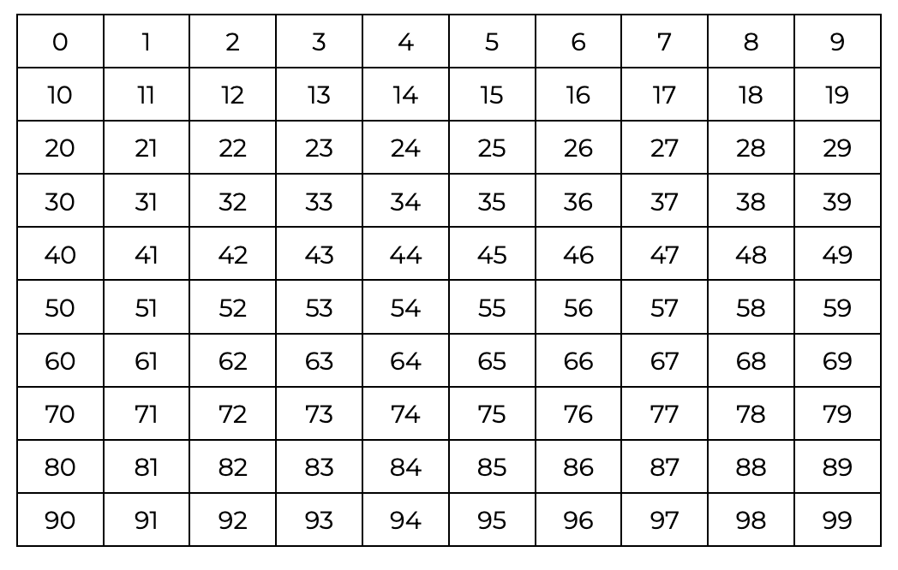

Slide 11
What patterns do you notice?

Slide 12
What patterns do you notice?

Slide 13
What patterns do you notice?

Slide 14
What patterns do you notice?

Slide 15
What patterns do you notice?

Slide 16
What patterns do you notice?

Slide 17
What patterns do you notice?

Slide 18
What patterns do you notice?

Slide 19
What patterns do you notice?

Slide 20
What patterns do you notice?

Slide 21
What patterns do you notice?

Slide 22
What patterns do you notice?

Slide 23
What patterns do you notice?

Slide 24
What patterns do you notice?

Slide 25
What patterns do you notice?

Slide 26
What patterns do you notice?

Slide 27
What patterns do you notice?

Slide 28
What patterns do you notice?

Slide 29
What patterns do you notice?

Slide 30
What patterns do you notice?

Slide 31
What patterns do you notice?

Slide 32
What patterns do you notice?

Slide 33
What patterns do you notice?

Slide 34
What patterns do you notice?

Slide 35
What patterns do you notice?

Slide 36
What patterns do you notice?

Slide 37
What patterns do you notice?

Slide 38
What patterns do you notice?

Slide 39
What patterns do you notice?

Slide 40
What patterns do you notice?

Slide 41
What patterns do you notice?

Slide 42
What patterns do you notice?

Slide 43
What patterns do you notice?

Slide 44
What patterns do you notice?

Slide 45
What patterns do you notice?

Slide 46
What patterns do you notice?

Slide 47
What patterns do you notice?

Slide 48
The ONES place

Slide 49
What patterns do you notice?

Slide 50
What patterns do you notice?

Slide 51
What patterns do you notice?

Slide 53
Use the patterns to work out the number in the box

Slide 54
Use the patterns to work out the number in the box
_ _

Slide 55
Use the patterns to work out the number in the box
_ _

Slide 56
Use the patterns to work out the number in the box
_ 6

Slide 57
Use the patterns to work out the number in the box
_ 6

Slide 58
Use the patterns to work out the number in the box
46

Slide 59
Use the patterns to work out the number in the box
46

Slide 60
Use the patterns to work out the number in the box
46
_ _

Slide 61
Use the patterns to work out the number in the box
46
_ 1

Slide 62
Use the patterns to work out the number in the box
46
51

Slide 63
Could you fill out these numbers using the pattern?
46
51

Slide 64
41
46
51
56
61
66
71
76
81
86
91
96

