Slide 1

20 and 0 more

Slide 2
twenty
20 and 0 more

Slide 3
twenty
20 and 0 more

Slide 4
20 and 1 more

Slide 5
20 and 1 more
21

Slide 6
twenty-one
20 and 1 more
21

Slide 7
20 and 2 more

Slide 8
20 and 2 more
22

Slide 9
twenty-two
20 and 2 more
22

Slide 10
20 and 3 more

Slide 11
20 and 3 more
23

Slide 12
twenty-three
20 and 3 more
23

Slide 13
20 and 4 more

Slide 14
20 and 4 more
24

Slide 15
twenty-four
20 and 4 more
24

Slide 16
20 and 5 more

Slide 17
20 and 5 more
25

Slide 18
twenty-five
20 and 5 more
25

Slide 19
20 and 6 more

Slide 20
20 and 6 more
26

Slide 21
twenty-six
20 and 6 more
26

Slide 22
20 and 7 more

Slide 23
20 and 7 more
27

Slide 24
twenty-seven
20 and 7 more
27

Slide 25
20 and 8 more

Slide 26
20 and 8 more
28

Slide 27
twenty-eight
20 and 8 more
28

Slide 28
20 and 9 more

Slide 29
20 and 9 more
29

Slide 30
twenty-nine
20 and 9 more
29

Slide 31
20 and 10 more

Slide 32
20 and 10 more
30

Slide 33
thirty
20 and 10 more
30

Slide 34
Spelling the numbers in their 20s

Slide 35
Spelling the numbers in their 20s
twenty

Slide 36
Spelling the numbers in their 20s
twenty
twenty-one

Slide 37
Spelling the numbers in their 20s
twenty
twenty-one
twenty-two

Slide 38
Spelling the numbers in their 20s
twenty
twenty-one
twenty-two
twenty-three

Slide 39
Spelling the numbers in their 20s
twenty
twenty-one
twenty-two
twenty-three
twenty-four

Slide 40
Spelling the numbers in their 20s
twenty
twenty-one
twenty-two
twenty-three
twenty-four
twenty-five

Slide 41
Spelling the numbers in their 20s
twenty
twenty-one
twenty-two
twenty-three
twenty-four
twenty-five

Slide 42
Spelling the numbers in their 20s
twenty
twenty-one
twenty-two
twenty-three
twenty-four
twenty-five
twenty-six

Slide 43
Spelling the numbers in their 20s
twenty
twenty-one
twenty-two
twenty-three
twenty-four
twenty-five
twenty-six
twenty-seven

Slide 44
Spelling the numbers in their 20s
twenty
twenty-one
twenty-two
twenty-three
twenty-four
twenty-five
twenty-six
twenty-seven
twenty-eight

Slide 45
Spelling the numbers in their 20s
twenty
twenty-one
twenty-two
twenty-three
twenty-four
twenty-five
twenty-six
twenty-seven
twenty-eight
twenty-nine

Slide 46
Spelling the numbers in their 20s
twenty
twenty-one
twenty-two
twenty-three
twenty-four
twenty-five
twenty-six
twenty-seven
twenty-eight
twenty-nine
thirty

Slide 47
How many plants?

Slide 48
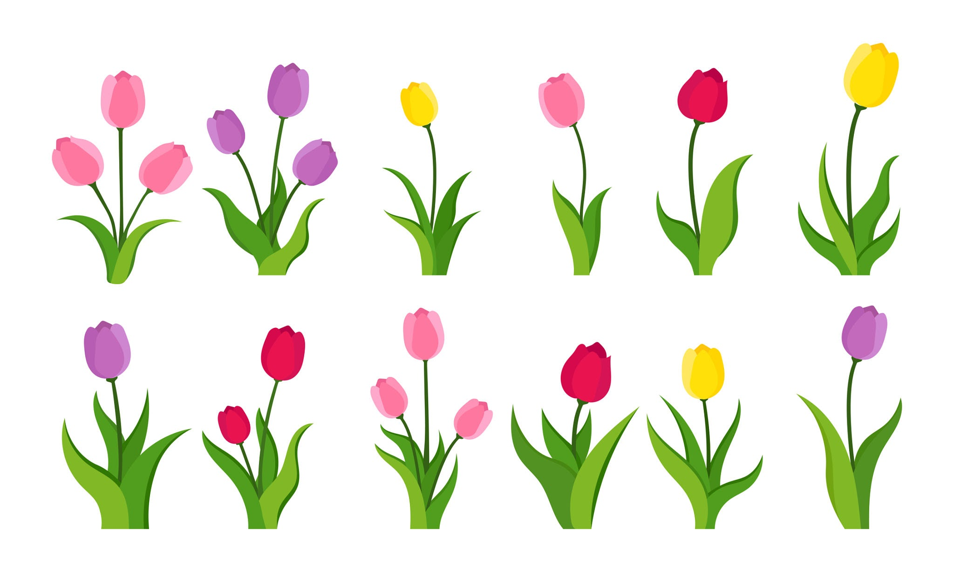
How many plants?
20

Slide 50
21

Slide 51
22

Slide 52
23

Slide 53
24

Slide 54
25

Slide 55
26

Slide 56
27

Slide 57
28

Slide 58
29

Slide 59
30

Slide 60
How many plants?

Slide 61
How many plants?
twenty

Slide 63
twenty-one

Slide 64
twenty-two

Slide 65
twenty-three

Slide 66
twenty-four

Slide 67
twenty-five

Slide 68
twenty-six

Slide 69
twenty-seven

Slide 70
twenty-eight

Slide 71
twenty-nine

Slide 72
thirty

Slide 73
How many ants?

Slide 74
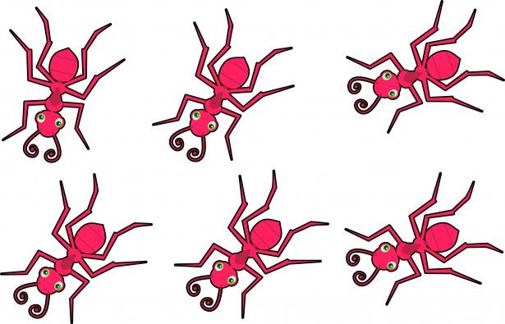
20 twenty

Slide 75
21 twenty-one

Slide 76
22 twenty-two

Slide 77
23 twenty-three

Slide 78
24 twenty-four

Slide 79
25 twenty-five

Slide 80
26 twenty-six

Slide 81
27 twenty-seven

Slide 82
28 twenty-eight

Slide 83
29 twenty-nine

Slide 84
30 thirty

Slide 85
How many stars?

Slide 86
How many stars?

Slide 87
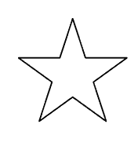
20 twenty

Slide 88
21 twenty-one

Slide 89
22 twenty-two

Slide 90
23 twenty-three

Slide 91
24 twenty-four

Slide 92
25 twenty-five

Slide 93
26 twenty-six

Slide 94
27 twenty-seven

Slide 95
28 twenty-eight

Slide 96
29 twenty-nine

Slide 97
30 thirty

