Slide 1
Let’s practice: groups of language

Slide 2


Slide 3
How many groups of balloons?

Slide 4
How many groups of balloons?

Slide 5
How many groups of balloons?

Slide 6
How many groups of balloons? 2

Slide 7
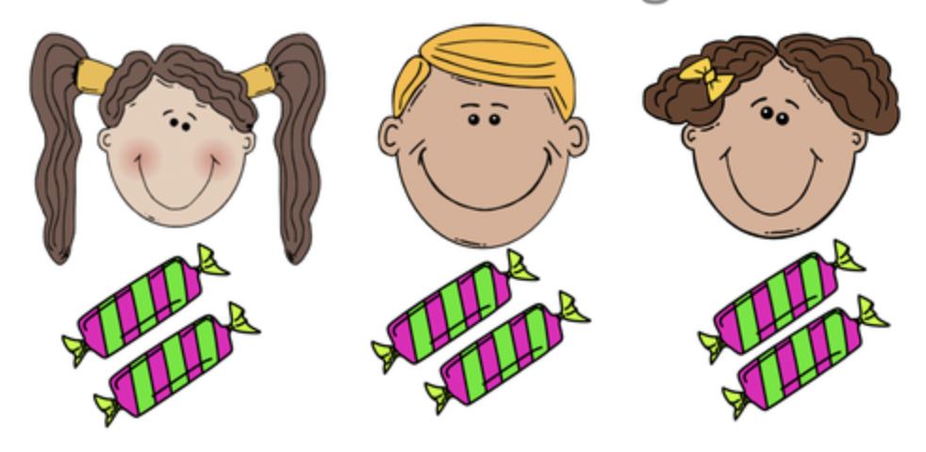

Slide 8
How many groups of lollies?

Slide 9
How many groups of lollies?

Slide 10
How many groups of lollies?

Slide 11
How many groups of lollies?

Slide 12
How many groups of lollies? 3

Slide 13


Slide 14
How many groups of balloons?

Slide 15
How many groups of balloons?

Slide 16
How many groups of balloons? 5

Slide 17
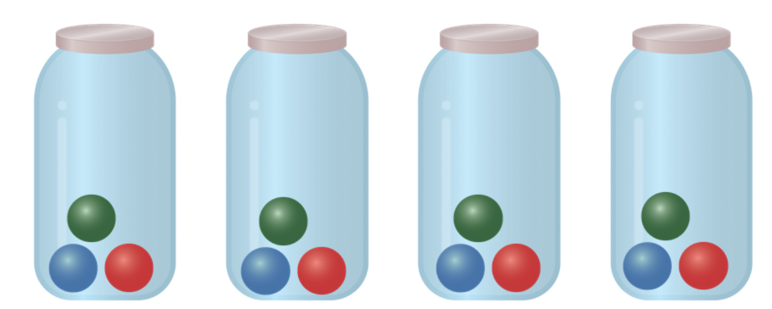

Slide 18
How many groups of balls?

Slide 19
How many groups of balls?

Slide 20
How many groups of balls? 4

Slide 21
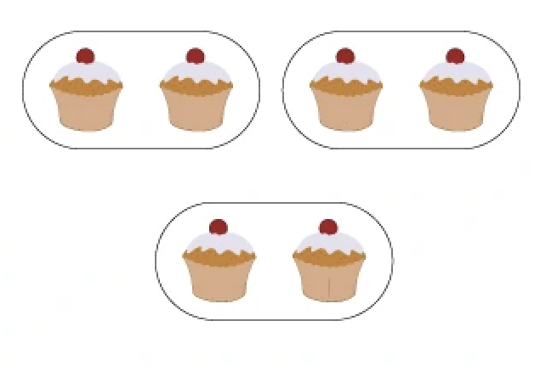

Slide 22
How many groups of cupcakes?

Slide 23
How many groups of cupcakes?

Slide 24
How many groups of cupcakes? 3

Slide 26
How many groups of stars?

Slide 27
How many groups of stars? 1

Slide 28
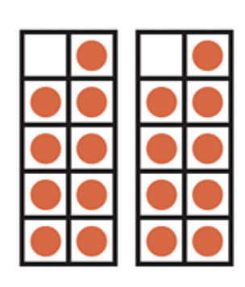

Slide 29
How many groups of dots?

Slide 30
How many groups of dots? 2

Slide 31
Let’s practice: groups of ___
Also need to incorporate the word each

Slide 33
The balloons are in groups of ____

Slide 34
The balloons are in groups of ____
1

Slide 35
The balloons are in groups of ____
1
2

Slide 36
The balloons are in groups of ____
1
2
3

Slide 37
The balloons are in groups of ____
1
2
3
4

Slide 38
The balloons are in groups of ____
1
2
3
4
5

Slide 39
The balloons are in groups of ____
1
2
3
4
5
6

Slide 40
The balloons are in groups of ____
1
2
3
4
5
6
7

Slide 41
The balloons are in groups of 7
1
2
3
4
5
6
7

Slide 42
There are 7 in each group
1
2
3
4
5
6
7

Slide 44
The lollies are in groups of ____

Slide 45
The lollies are in groups of ____
1

Slide 46
The lollies are in groups of ____
1
2

Slide 47
The lollies are in groups of 2
1
2

Slide 48
There are 2 in each group
1
2

Slide 50
The lollies are in groups of ____

Slide 51
The lollies are in groups of 1

Slide 52
There is 1 in each group

Slide 53

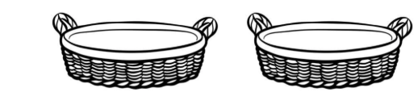

Slide 54
The basketballs are in groups of ____

Slide 55
The basketballs are in groups of 3

Slide 56
There are 3 in each group

Slide 57
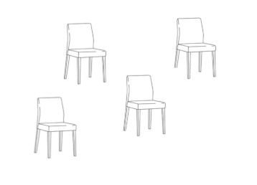
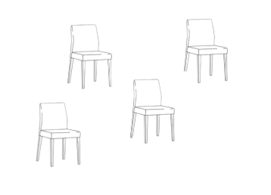
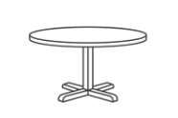

Slide 58
The chairs are in groups of ____

Slide 59
The chairs are in groups of 4

Slide 60
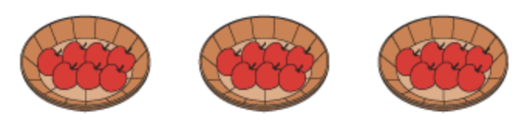

Slide 61
The apples are in groups of ____

Slide 62
The apples are in groups of 7

Slide 63
Let’s practice: ___ groups of ___

Slide 65
___ groups of ___

Slide 66
3 groups of ___

Slide 67
3 groups of 2

Slide 68


Slide 69
___ groups of ___

Slide 70
2 groups of ___

Slide 71
2 groups of 5

Slide 73
___ groups of ___

Slide 74
1 group of ___

Slide 75
1 group of 9

Slide 77
___ groups of ___

Slide 78
4 groups of ___

Slide 79
4 groups of 3

Slide 81
___ groups of ___

Slide 82
2 groups of ___

Slide 83
2 groups of 9

Slide 84
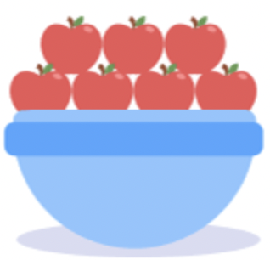

Slide 85
___ groups of ___

Slide 86
3 groups of ___

Slide 87
3 groups of 7

Slide 88
Draw a model to show this

Slide 89
Draw a model to show this
4 groups of 2 buttons

Slide 90
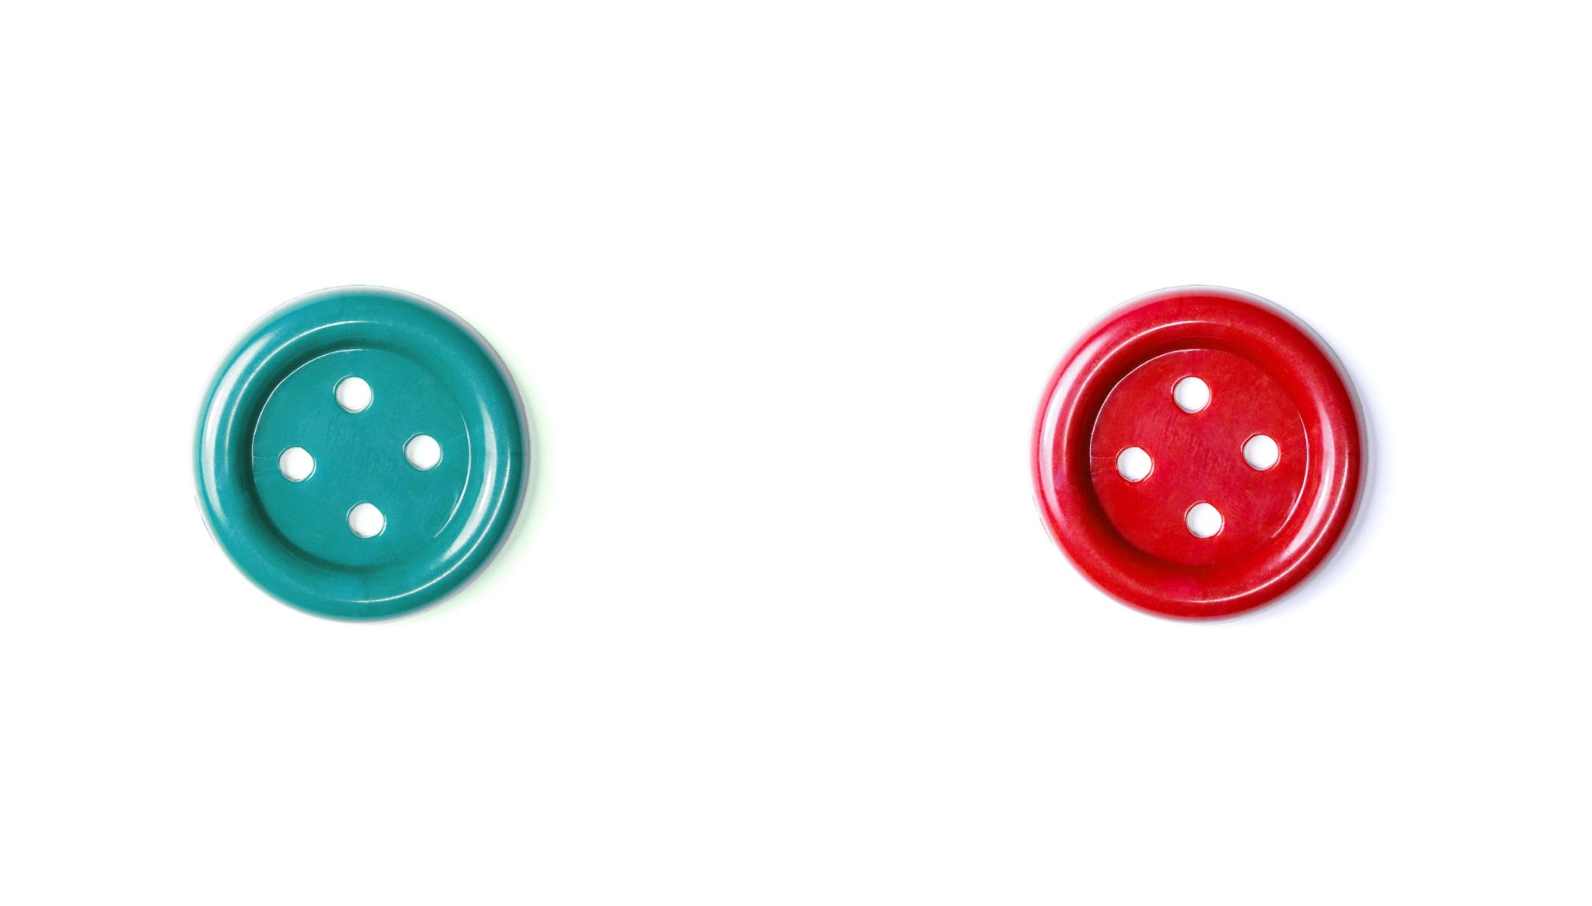
Draw a model to show this
4 groups of 2 buttons

Slide 91
Draw a model to show this
4 groups of 2 buttons

Slide 92
Draw a model to show this

Slide 93
Draw a model to show this
1 group of 4 coins

Slide 94
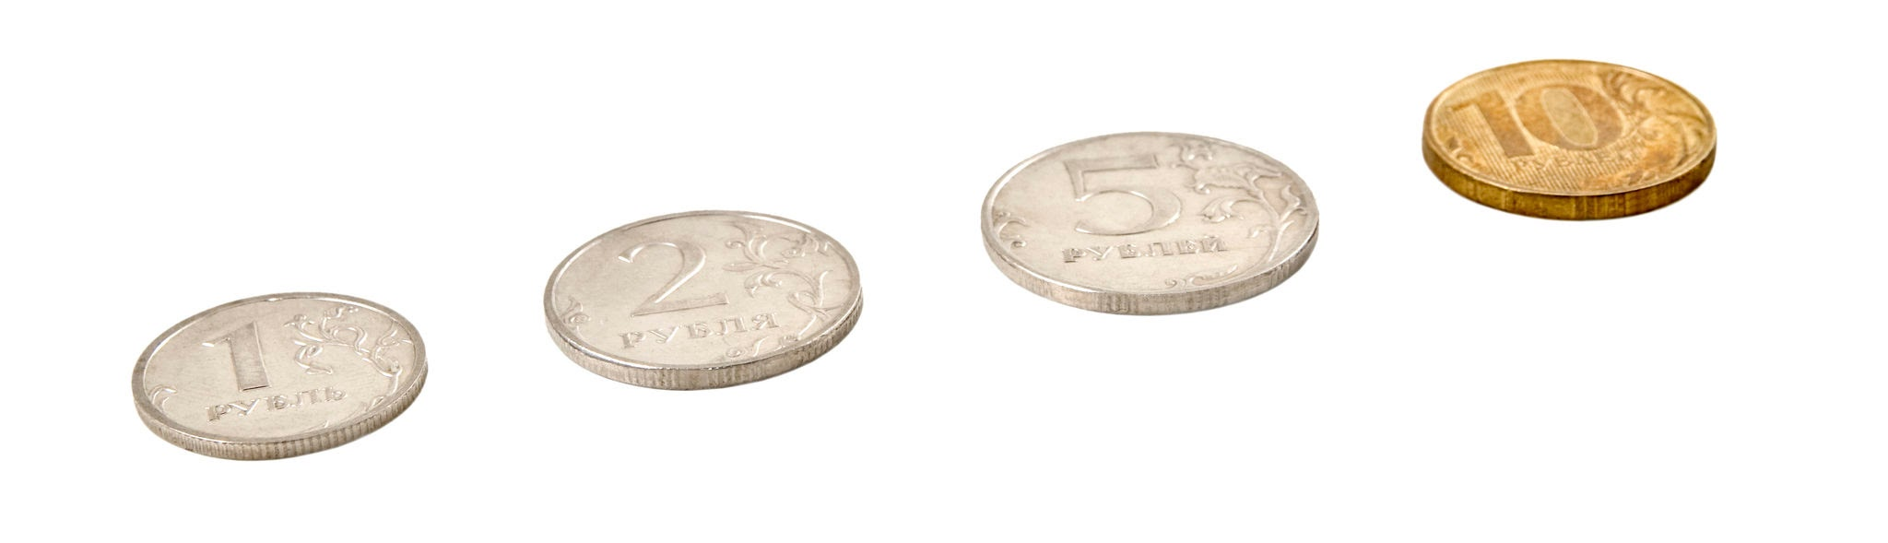
Draw a model to show this
1 group of 4 coins

Slide 95
Draw a model to show this
1 group of 4 coins

Slide 96
Draw a model to show this

Slide 97
Draw a model to show this
4 groups of 3

Slide 98
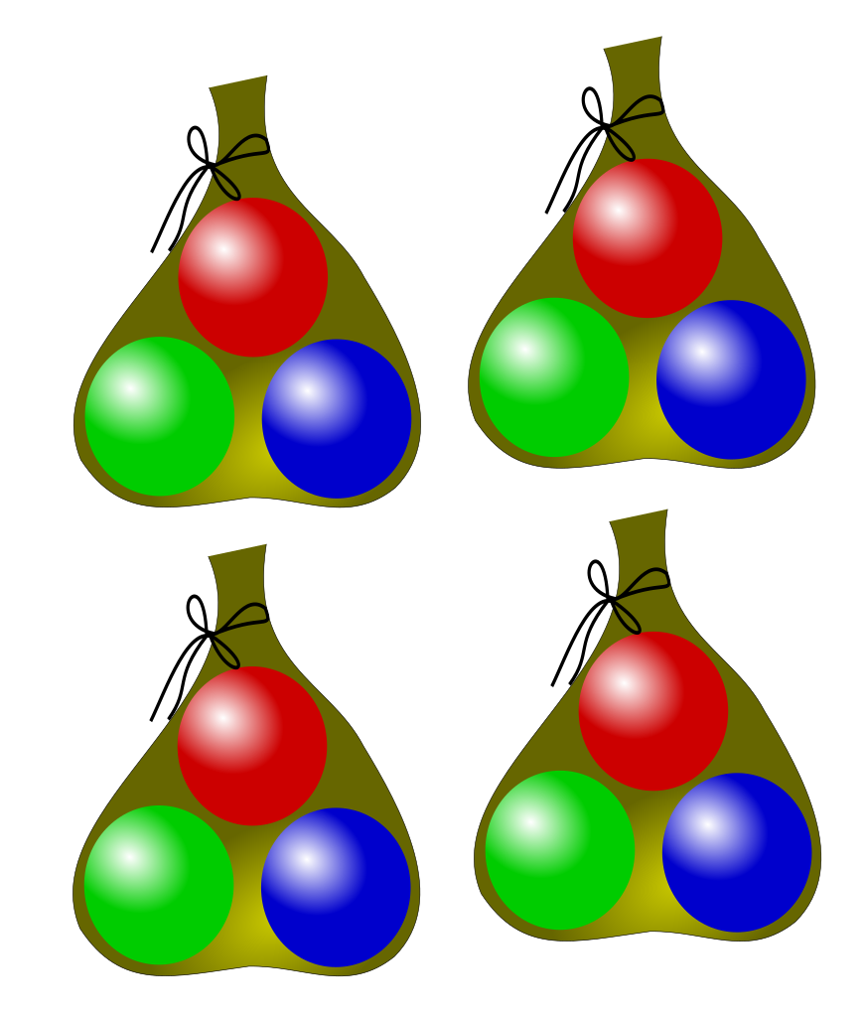
Draw a model to show this
4 groups of 3

Slide 99
How many cakes all together?
3 groups of 2

Slide 100
6 cakes all together
3 groups of 2

Slide 101
How many balloons all together?
5 groups of 1

Slide 102
5 balloons all together
5 groups of 1

Slide 103
How many apples all together?
2 groups of 7

Slide 104
14 apples all together
2 groups of 7

Slide 105
How many stars all together?
1 group of 9

Slide 106
9 stars all together
1 group of 9

