Slide 1
What is the value of this:

Slide 2
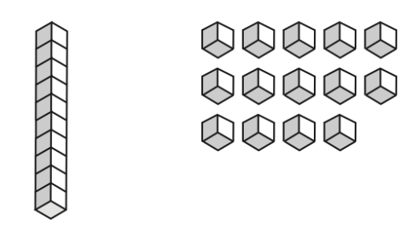
What is the value of this:

Slide 3
1 ten and 14 ones

Slide 4
This is ten
1 ten and 14 ones

Slide 5
This is ten
2 tens and 4 ones

Slide 6
This is ten
2 tens and 4 ones 24

Slide 7
What is the value of this:

Slide 8
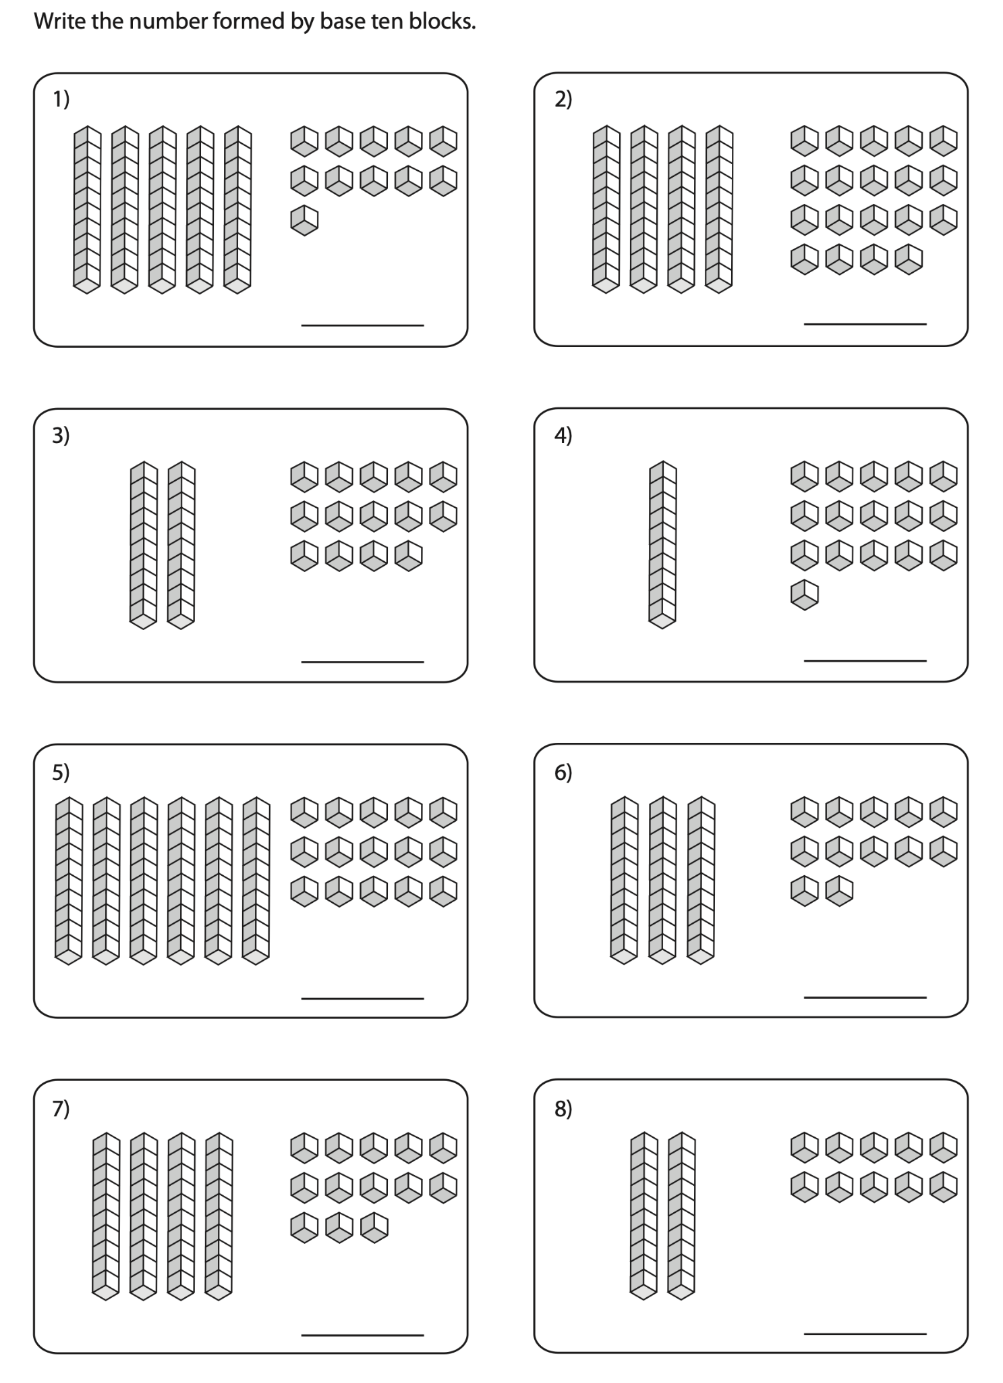
What is the value of this:

Slide 9
What is the value of this:
4 tens and 15 ones

Slide 10
What is the value of this:
4 tens and 15 ones

Slide 11
What is the value of this:
5 tens and 5 ones

Slide 12
What is the value of this:
5 tens and 5 ones 55

Slide 13
What is the value of this:

Slide 14
What is the value of this:
5 tens and 10 ones

Slide 15
What is the value of this:
5 tens and 10 ones

Slide 16
What is the value of this:
5 tens and 10 ones

Slide 17
What is the value of this:
5 tens and 10 ones

Slide 18
What is the value of this:
6 tens

Slide 19
What is the value of this:
6 tens 60

Slide 20
What is missing?

Slide 21
What is missing?
45 ones + __ tens = 75

Slide 22
What is missing?
45 ones + __ tens = 75

Slide 23
What is missing?
45 ones + __ tens = 75
45 + 30 = 75

Slide 24
What is missing?
45 ones + 3 tens = 75
45 + 30 = 75

Slide 25
What is missing?
45 ones + 3 tens = 75
45 + 30 = 75

