Slide 1
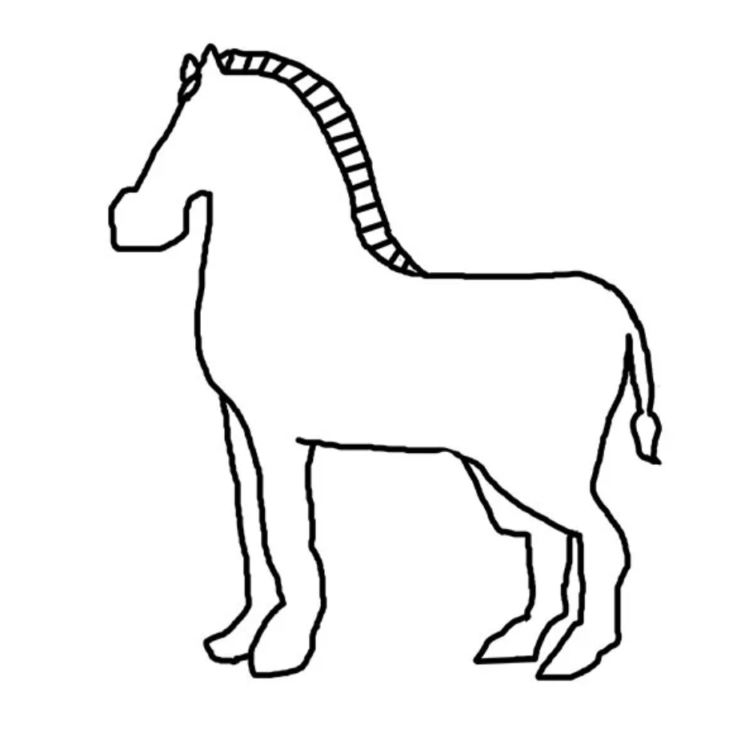
DID YOU KNOW?
Baby zebras are born with…

Slide 2
...spots!

Slide 3
They can have up to 5 spots

Slide 4
Let’s count the spots by describing patterns or groups

Slide 6
EXAMPLE:
2 and 2
there are 4

Slide 8
5

Slide 10
5

Slide 12
5

Slide 14
5

Slide 16
5

Slide 18
5

Slide 20
4

Slide 22
4

Slide 24
4

Slide 26
4

Slide 28
4

Slide 30
4

Slide 32
4

Slide 34
4

Slide 36
4

Slide 38
3

Slide 40
3

Slide 42
3

Slide 44
3

Slide 46
3

Slide 48
3

Slide 50
3

Slide 52
3

Slide 54
3

Slide 56
2

Slide 58
2

Slide 60
2

Slide 62
2

Slide 64
1

Slide 66
1

Slide 68
1

Slide 70
1

Slide 72
1

Slide 73
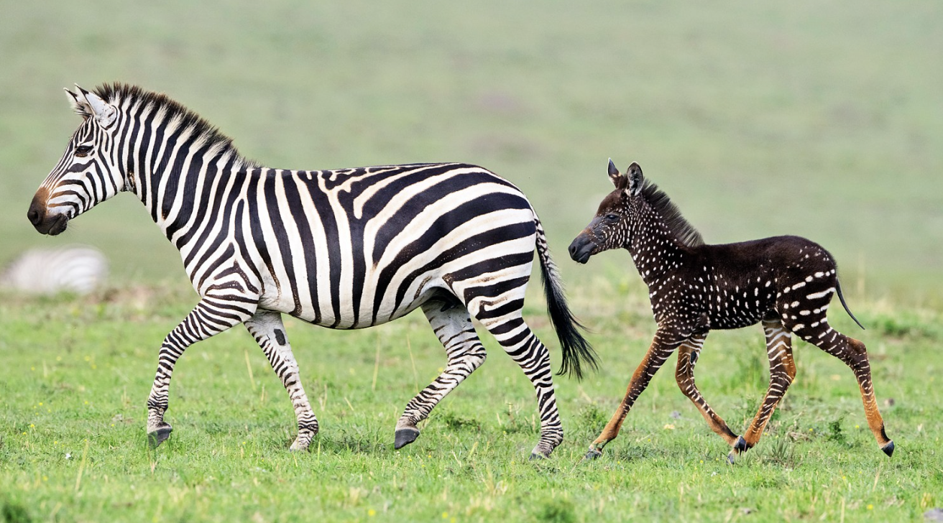
Now let’s practice

