Slide 1
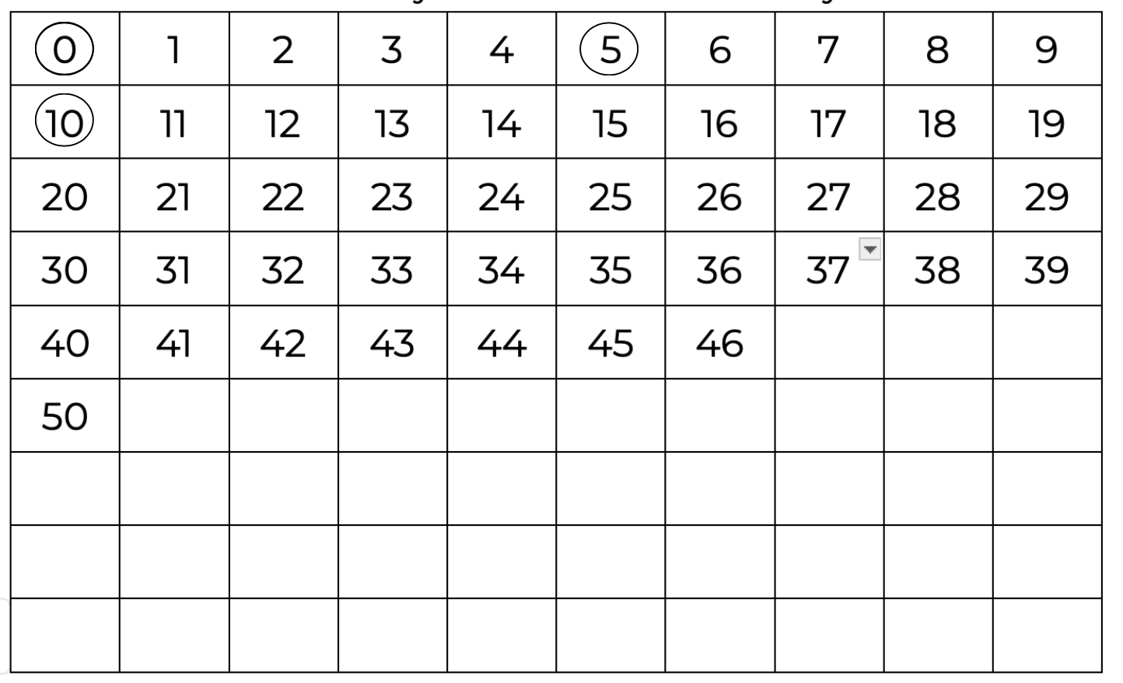
Let’s follow a rule.

Slide 2
Let’s follow a rule. Start at 0 and mark every fifth number.

Slide 3
Let’s follow a rule. Start at 0 and mark every fifth number.

Slide 4
Let’s follow a rule. Start at 0 and mark every fifth number.

Slide 5
Let’s follow a rule. Start at 0 and mark every fifth number.

Slide 6
Let’s follow a rule. Start at 0 and mark every fifth number.

Slide 7
Let’s follow a rule. Start at 0 and mark every fifth number.

Slide 8
Let’s follow a rule. Start at 0 and mark every fifth number.

Slide 9
Let’s follow a rule. Start at 0 and mark every fifth number.

Slide 10
Let’s follow a rule. Start at 0 and mark every fifth number.

Slide 11
Let’s follow a rule. Start at 0 and mark every fifth number.

Slide 12
Let’s follow a rule. Start at 0 and mark every fifth number.

Slide 13
Let’s follow a rule.

Slide 14
Let’s follow a rule. Start at 1 and mark every fifth number.

Slide 15
Let’s follow a rule. Start at 1 and mark every fifth number.

Slide 16
Let’s follow a rule. Start at 1 and mark every fifth number.

Slide 17
Let’s follow a rule. Start at 1 and mark every fifth number.

Slide 18
Let’s follow a rule. Start at 1 and mark every fifth number.

Slide 19
Let’s follow a rule. Start at 1 and mark every fifth number.

Slide 20
Let’s follow a rule. Start at 1 and mark every fifth number.

Slide 21
Let’s follow a rule. Start at 1 and mark every fifth number.

Slide 22
Let’s follow a rule. Start at 1 and mark every fifth number.

Slide 23
Let’s follow a rule. Start at 1 and mark every fifth number.

Slide 24
I can see a pattern. Can you?

Slide 25
How can we describe the pattern?

Slide 26
1 6 1 6 1 6 1 … how can we describe this?

Slide 27
There are two alternating numbers in the ones place

Slide 28
There tens place changes every second skip jump

Slide 29
Tricky to describe but it helps up to know what comes next.

Slide 30
Tricky to describe but it helps up to know what comes next.
51

Slide 31
Tricky to describe but it helps up to know what comes next.
51
56

Slide 32
Let’s have another look at the pattern

Slide 33
Let’s have another look at the pattern
0

Slide 34
Let’s have another look at the pattern
0, 5

Slide 35
Let’s have another look at the pattern
0, 5, 10

Slide 36
Let’s have another look at the pattern
0, 5, 10, 15

Slide 37
Let’s have another look at the pattern
0, 5, 10, 15, 20

Slide 38
Let’s have another look at the pattern
0, 5, 10, 15, 20, 25

Slide 39
Let’s have another look at the pattern
0, 5, 10, 15, 20, 25, 30

Slide 40
Let’s have another look at the pattern
0, 5, 10, 15, 20, 25, 30

Slide 41
Let’s have another look at the pattern
0, 5, 10, 15, 20, 25, 30

Slide 42
Let’s have another look at the pattern
0, 5, 10, 15, 20, 25, 30

Slide 43
Let’s follow a rule.

Slide 44
Let’s follow a rule. Start at 2 and mark every fifth number.

Slide 45
Let’s follow a rule. Start at 2 and mark every fifth number.

Slide 46
Let’s follow a rule. Start at 2 and mark every fifth number.

Slide 47
Let’s follow a rule. Start at 2 and mark every fifth number.

Slide 48
Let’s have another look at the pattern

Slide 49
Let’s have another look at the pattern
2, 7

Slide 50
Let’s have another look at the pattern
2, 7, 12, 17

Slide 51
Let’s have another look at the pattern
2, 7, 12, 17, 22, 27

Slide 52
Let’s have another look at the pattern
2, 7, 12, 17, 22, 27, 32, 37

Slide 53
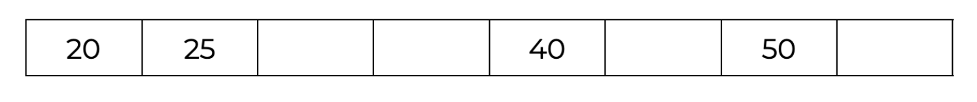
Skip count by 5

Slide 54
Skip count by 5
30

Slide 55
Skip count by 5
30
35

Slide 56
Skip count by 5
30
35
45

Slide 57
Skip count by 5
30
35
45
55

Slide 58
Skip count by 5
38

Slide 59
Skip count by 5
38
43

Slide 60
Skip count by 5
38
43
53

Slide 61
Skip count by 5
38
43
53
63

Slide 62
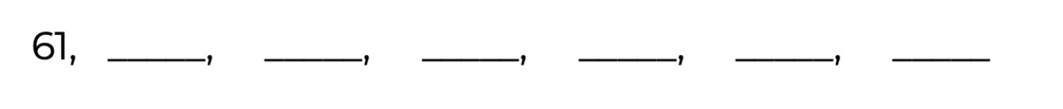
Skip count by 5

Slide 63
Skip count by 5
What will the pattern be?

Slide 64
Skip count by 5
What will the pattern be?
1 6 1 6 1 6 1

Slide 65
Skip count by 5
66
What will the pattern be?
1 6 1 6 1 6 1

Slide 66
Skip count by 5
66
71
What will the pattern be?
1 6 1 6 1 6 1

Slide 67
Skip count by 5
66
71
76
What will the pattern be?
1 6 1 6 1 6 1

Slide 68
Skip count by 5
66
71
76
81
What will the pattern be?
1 6 1 6 1 6 1

Slide 69
Skip count by 5
66
71
76
81
86
What will the pattern be?
1 6 1 6 1 6 1

Slide 70
Skip count by 5
66
71
76
81
86
91
What will the pattern be?
1 6 1 6 1 6 1

Slide 71
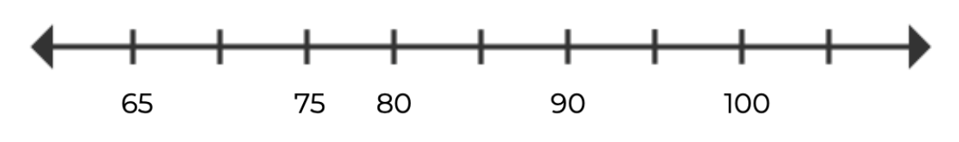
The number line is showing INTERVALS OF FIVE

Slide 72
The number line is showing INTERVALS OF FIVE
What are the missing numbers?

Slide 73
The number line is showing INTERVALS OF FIVE
What are the missing numbers?

Slide 74
The number line is showing INTERVALS OF FIVE
What are the missing numbers?
5

Slide 75
The number line is showing INTERVALS OF FIVE
What are the missing numbers?
5
70

Slide 76
The number line is showing INTERVALS OF FIVE
What are the missing numbers?
70

Slide 77
The number line is showing INTERVALS OF FIVE
What are the missing numbers?
70
85

Slide 78
The number line is showing INTERVALS OF FIVE
What are the missing numbers?
70
85
95

Slide 79
The number line is showing INTERVALS OF FIVE
What are the missing numbers?
70
85
95
105

Slide 80
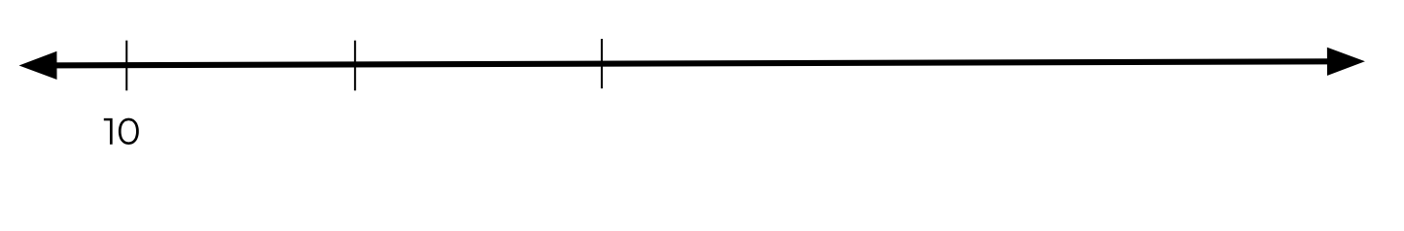
Draw a number line starting at 43 with intervals of 5

Slide 81
Draw a number line starting at 43 with intervals of 5
43

Slide 82
Draw a number line starting at 43 with intervals of 5
5
43

Slide 83
Draw a number line starting at 43 with intervals of 5
5
43
48

Slide 84
Draw a number line starting at 43 with intervals of 5
12
43
48

Slide 85
Draw a number line starting at 43 with intervals of 5
5
12
43
48

Slide 86
Draw a number line starting at 43 with intervals of 5
5
12
43
48
53

Slide 87
Draw a number line starting at 43 with intervals of 5
12
43
48
53

Slide 88

Draw a number line starting at 43 with intervals of 5
12
43
48
53

Slide 89
Draw a number line starting at 43 with intervals of 5
12
43
48
53
58

Slide 90
Draw a number line starting at 43 with intervals of 5
12
43
48
53
58
61

