Slide 1
Language
part
whole

Slide 2
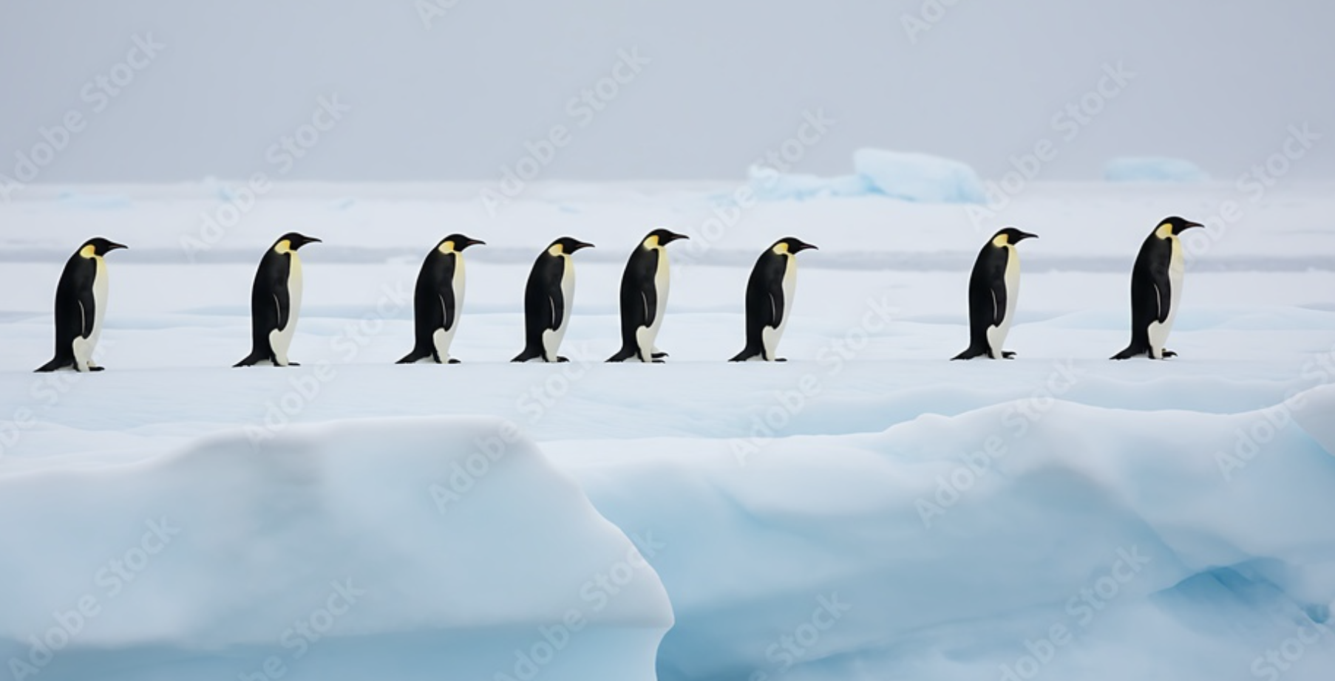
8 penguins

Slide 3
Some penguins jump in the water.
8 penguins

Slide 4
Some penguins jump in the water.
8 penguins

Slide 5
Some penguins jump in the water. Some penguins stay.
8 penguins

Slide 6
Some penguins jump in the water. Some penguins stay.
8 penguins

Slide 7
8 penguins

Slide 8
Some penguins jump in the water.
8 penguins

Slide 9
Some penguins jump in the water.
8 penguins

Slide 10
Some penguins jump in the water. Some penguins stay.
8 penguins

Slide 11
Some penguins jump in the water. Some penguins stay.
8 penguins

Slide 12
8 penguins

Slide 13
Some penguins jump in the water.
8 penguins

Slide 14
Some penguins jump in the water.
8 penguins

Slide 15
Some penguins jump in the water. Some penguins stay.
8 penguins

Slide 16
Some penguins jump in the water. Some penguins stay.
8 penguins

Slide 17
Some penguins jump in the water.
8 penguins

Slide 18
Some penguins jump in the water.
8 penguins

Slide 19
Some penguins jump in the water. Some penguins stay.
8 penguins

Slide 20
_____ penguins jump in the water. ____ penguins stay.
Make 2 parts
8 penguins

Slide 21
3 penguins jump in the water. 5 penguins stay.
8 penguins

Slide 22
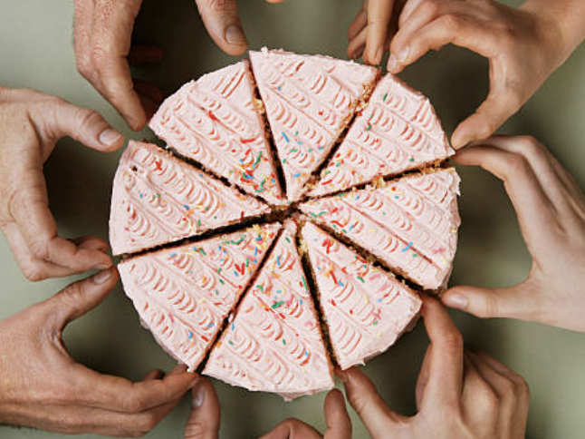
8 slices

Slide 23
_____ slices are eaten. ____ slices are left.
8 slices

Slide 24
_____ slices are eaten. ____ slices are left.
Make 2 parts
8 slices

Slide 25
1 slice is eaten. 7 slices are left.
8 slices

Slide 26
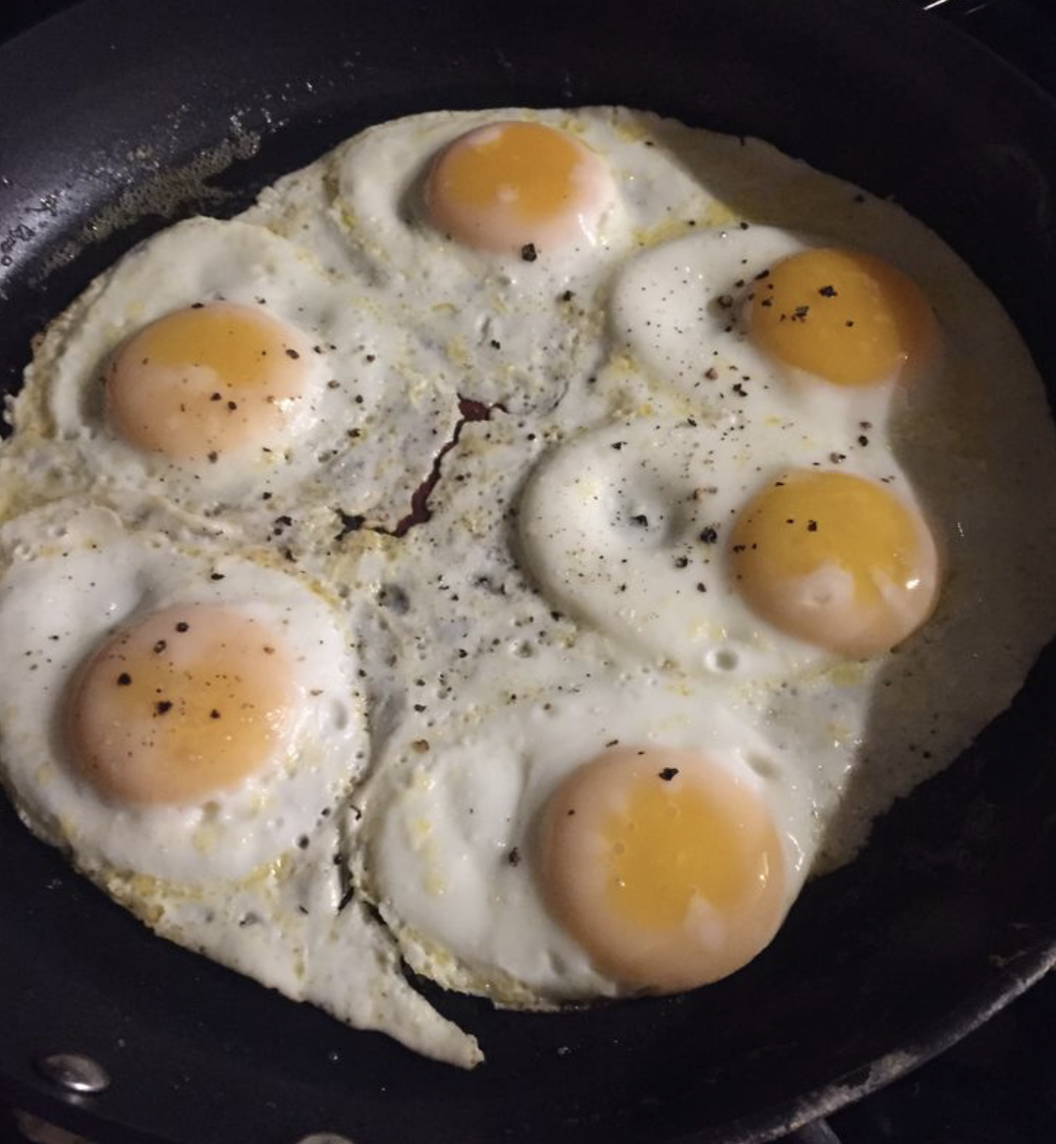
6 eggs

Slide 27
_____ eggs have pepper.
____ eggs don’t have pepper.
Make 2 parts
6 eggs

Slide 28
2 eggs have pepper.
4 eggs don’t have pepper.
6 eggs

Slide 29
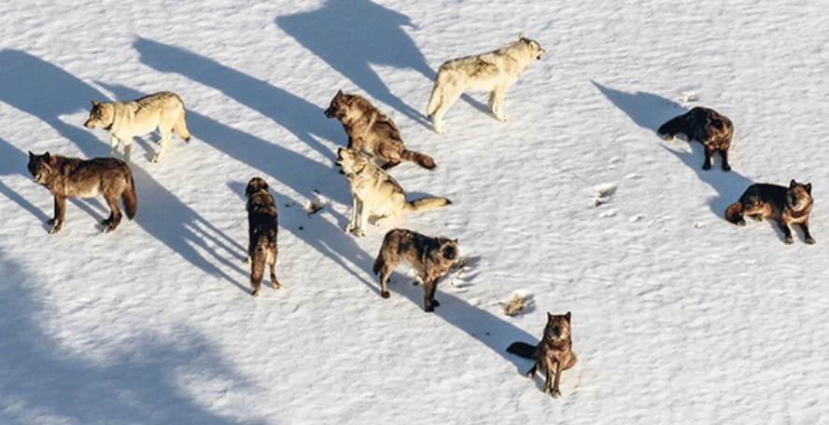
10 dogs

Slide 30
____ dogs are hungry. ____ dogs are not hungry.
10 dogs

Slide 31
____ dogs are hungry. ____ dogs are not hungry.
Make 2 parts
10 dogs

Slide 32
5 dogs are hungry. 5 dogs are not hungry.
10 dogs

Slide 33
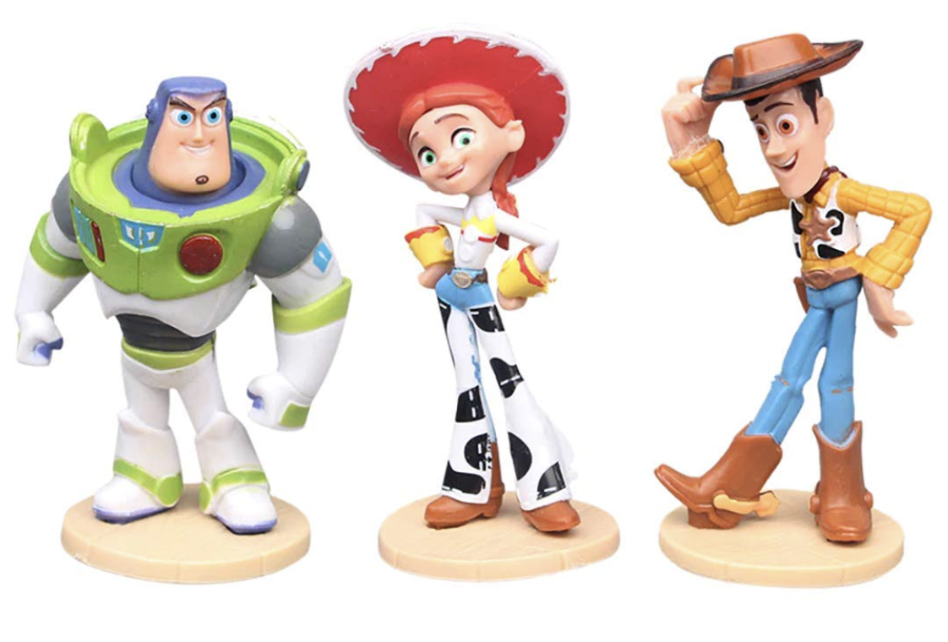
3 toys

Slide 34
____ toys have been lost.
____ toys are still in the toy box.
3 toys

Slide 35
____ toys have been lost.
____ toys are still in the toy box.
Make 2 parts
3 toys

Slide 36
1 toy have been lost.
2 toys are still in the toy box.
3 toys

Slide 37
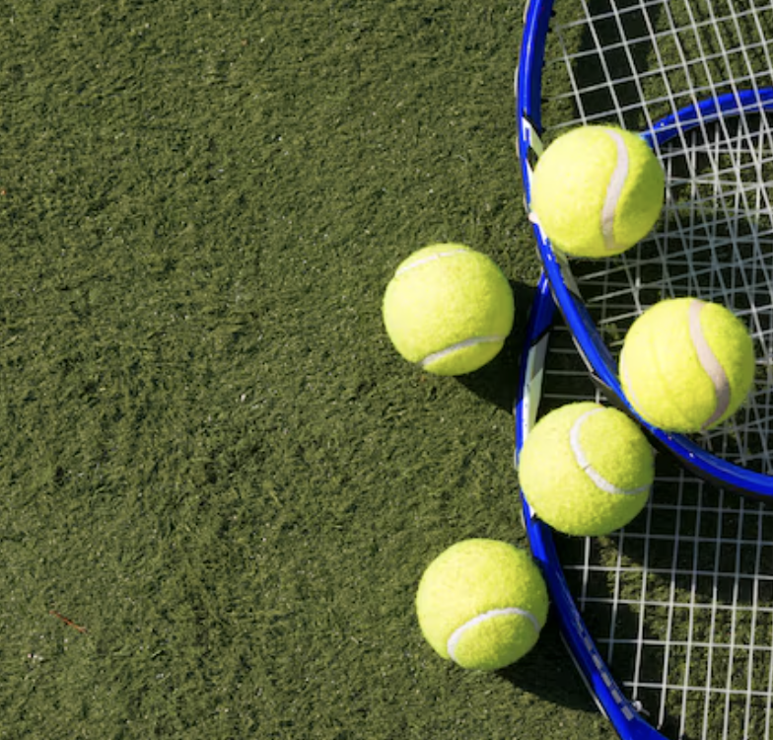
5 balls

Slide 38
A player picks up ____ balls.
____ balls stay on the ground.
5 balls

Slide 39
A player picks up ____ balls.
____ balls stay on the ground.
Make 2 parts
5 balls

Slide 40
A player picks up 4 balls.
1 ball stay on the ground.
5 balls

