Slide 1
Let’s count back from 30

Slide 2
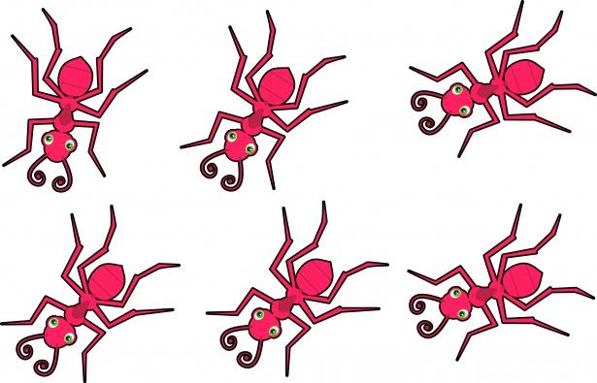
30

Slide 3
29

Slide 4
28

Slide 5
27

Slide 6
26

Slide 7
25

Slide 8
24

Slide 9
23

Slide 10
22

Slide 11
21

Slide 12
20

Slide 13
19

Slide 14
18

Slide 15
17

Slide 16
16

Slide 17
15

Slide 18
14

Slide 19
13

Slide 20
12

Slide 21
11

Slide 22
10

Slide 23
9

Slide 24
8

Slide 25
7

Slide 26
6

Slide 27
5

Slide 28
4

Slide 29
3

Slide 30
2

Slide 31
1

Slide 32
0

Slide 33
Let’s count back from 30

Slide 34
30

Slide 35
30 29

Slide 36
30 29 28

Slide 37
30 29 28 27

Slide 38
30 29 28 27 26

Slide 39
30 29 28 27 26 25

Slide 40
30 29 28 27 26 25 24

Slide 41
30 29 28 27 26 25 24 23

Slide 42
30 29 28 27 26 25 24 23 22

Slide 43
30 29 28 27 26 25 24 23 22 21

Slide 44
30 29 28 27 26 25 24 23 22 21
20

Slide 45
30 29 28 27 26 25 24 23 22 21
20 19

Slide 46
30 29 28 27 26 25 24 23 22 21
20 19 18

Slide 47
30 29 28 27 26 25 24 23 22 21
20 19 18 17

Slide 48
30 29 28 27 26 25 24 23 22 21
20 19 18 17 16

Slide 49
30 29 28 27 26 25 24 23 22 21
20 19 18 17 16 15

Slide 50
30 29 28 27 26 25 24 23 22 21
20 19 18 17 16 15 14

Slide 51
30 29 28 27 26 25 24 23 22 21
20 19 18 17 16 15 14 13

Slide 52
30 29 28 27 26 25 24 23 22 21
20 19 18 17 16 15 14 13 12

Slide 53
30 29 28 27 26 25 24 23 22 21
20 19 18 17 16 15 14 13 12 11

Slide 54
30 29 28 27 26 25 24 23 22 21
20 19 18 17 16 15 14 13 12 11
10

Slide 55
30 29 28 27 26 25 24 23 22 21
20 19 18 17 16 15 14 13 12 11
10 9

Slide 56
30 29 28 27 26 25 24 23 22 21
20 19 18 17 16 15 14 13 12 11
10 9 8

Slide 57
30 29 28 27 26 25 24 23 22 21
20 19 18 17 16 15 14 13 12 11
10 9 8 7

Slide 58
30 29 28 27 26 25 24 23 22 21
20 19 18 17 16 15 14 13 12 11
10 9 8 7 6

Slide 59
30 29 28 27 26 25 24 23 22 21
20 19 18 17 16 15 14 13 12 11
10 9 8 7 6 5

Slide 60
30 29 28 27 26 25 24 23 22 21
20 19 18 17 16 15 14 13 12 11
10 9 8 7 6 5 4

Slide 61
30 29 28 27 26 25 24 23 22 21
20 19 18 17 16 15 14 13 12 11
10 9 8 7 6 5 4 3

Slide 62
30 29 28 27 26 25 24 23 22 21
20 19 18 17 16 15 14 13 12 11
10 9 8 7 6 5 4 3 2

Slide 63
30 29 28 27 26 25 24 23 22 21
20 19 18 17 16 15 14 13 12 11
10 9 8 7 6 5 4 3 2 1

Slide 64
30 29 28 27 26 25 24 23 22 21
20 19 18 17 16 15 14 13 12 11
10 9 8 7 6 5 4 3 2 1 0

Slide 65
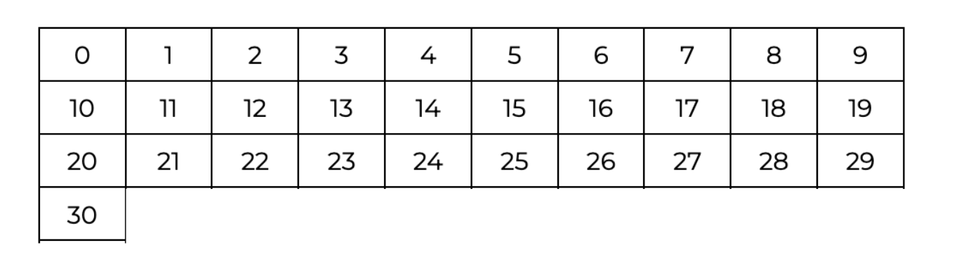
Let’s use the 0 to 30 grid

Slide 66
What number is before 23?

Slide 67
What number is before 23?

Slide 68
Is 22 bigger or smaller?

Slide 69
What number is one less than 28?

Slide 70
What number is one less than 28?

Slide 71
Which number is bigger? 28 or 27?

Slide 72
Count back one from 30

Slide 73
Count back one from 30

Slide 74
Count back one from 30

Slide 75
Count back one from 30 29

Slide 76
What number is in between 26 and 28 ?

Slide 77
What number is in between 26 and 28 ?

Slide 78
What number is in between 26 and 28 ?

Slide 79
26 __ 28

Slide 80
26 27 28

Slide 81
What number is in between 22 and 20 ?

Slide 82
What number is in between 22 and 20 ?

Slide 83
22 __ 20

Slide 84
Ah it is counting back! 22 __ 20

Slide 85
Ah it is counting back! 22 21 20

Slide 86
What number is in between 30 and 28 ?

Slide 87
What number is in between 30 and 28 ?

Slide 88
30 __ 28

Slide 89
30 __ 28

Slide 90
30 29 28

