Slide 1
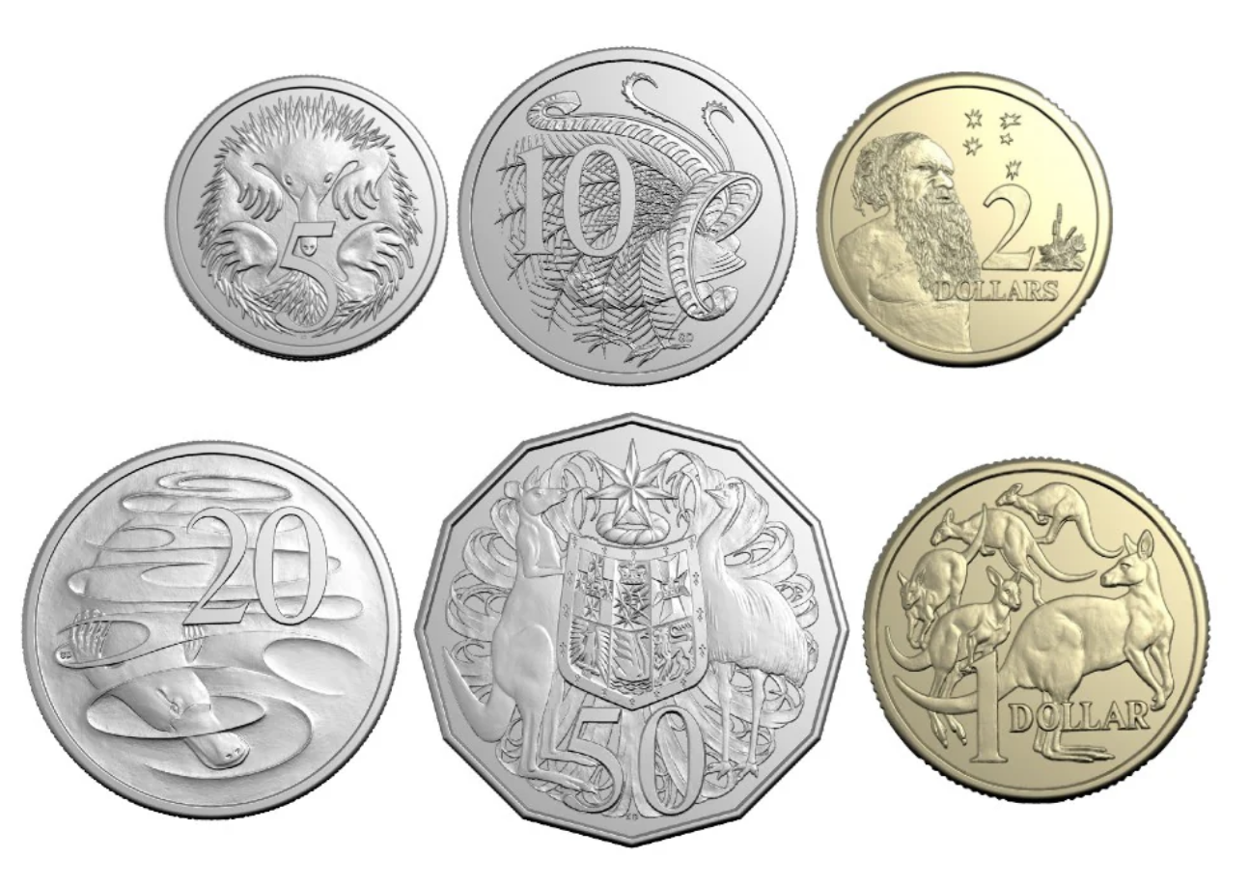
If I have 2 of these, how much do I have?

Slide 2
If I have 2 of these, how much do I have?
5 cents
and
5 cents

Slide 3
If I have 2 of these, how much do I have?
5 cents
and
5 cents
is 10 cents

Slide 4
If I have 3 of these, how much do I have?

Slide 5
If I have 3 of these, how much do I have?
5 cents
and
5 cents
and 5 cents

Slide 6
If I have 2 of these, how much do I have?
5 cents
and
5 cents
and 5 cents
is 15 cents

Slide 7
What coin is this?
10 cents

Slide 8
What coin is this?
10 cents
10c

Slide 9
If I have 2 of these, how much do I have?

Slide 10
If I have 2 of these, how much do I have?
10 cents
and
10 cents

Slide 11
If I have 2 of these, how much do I have?
10 cents
and
10 cents
is 20 cents

Slide 12
If I have 5 of these, how much do I have?

Slide 13
If I have 2 of these, how much do I have?
10 cents,
10 cents,
10 cents,
10 cents and 10 cents

Slide 14
If I have 2 of these, how much do I have?
10 cents,
10 cents,
10 cents,
10 cents and 10 cents
is 50 cents

Slide 15
What coin is this?

Slide 16
What coin is this?
20 cents

Slide 17
What coin is this?
20 cents
20c

Slide 18
How much do I have?

Slide 19
How much do I have?
20 cents,
10 cents,
and 5 cents

Slide 20
How much do I have?
20 cents,
10 cents,
and 5 cents
is 35 cents

Slide 21
How much do I have?

Slide 22
How much do I have?
20 cents,
5 cents,
and 5 cents

Slide 23
How much do I have?
20 cents,
5 cents,
and 5 cents
is 30 cents

Slide 24
REMEMBER: What coins can I swap this for?
10 cents

Slide 25
REMEMBER: What coins can I swap this for?
10 cents

Slide 26
REMEMBER: What coins can I swap this for?
10 cents
10 cents

Slide 27
REMEMBER: What coins can I swap this for?
20 cents

Slide 28
REMEMBER: What coins can I swap this for?
20 cents

Slide 29
REMEMBER: What coins can I swap this for?
20 cents
20 cents

Slide 30
REMEMBER: What coins can I swap this for?
20 cents

Slide 31
REMEMBER: What coins can I swap this for?
20 cents

Slide 32
REMEMBER: What coins can I swap this for?
20 cents

Slide 33
REMEMBER: What coins can I swap this for?
20 cents
20 cents

Slide 34
REMEMBER: What coins can I swap this for?
20 cents

Slide 35
REMEMBER: What coins can I swap this for?
20 cents

Slide 36
REMEMBER: What coins can I swap this for?
20 cents

Slide 37
REMEMBER: What coins can I swap this for?
20 cents
20 cents

Slide 38
REMEMBER: What coins can I swap this for?
50 cents

Slide 39
REMEMBER: There are many combinations!
50 cents

